Slide 1
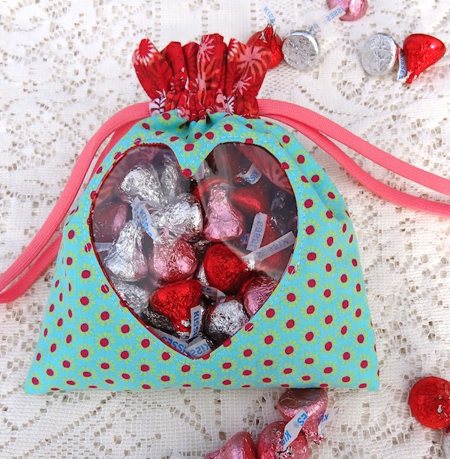
Peekaboo Pouch
From Twinkle and Twine Designs
http://www.twinkleandtwine.com/2013/02/tutorial-peek-boo-heart-pouch.html

Slide 2
Supplies
Exterior bag fabric - 7" x 16" rectangle
Interior/accent fabric - 7" x 21" rectangle
1 yd. of cord
Clear vinyl - 5" square
Heart template
Disappearing ink fabric marker or any marking pencil
Scissors
Thread
Note in the photos in this tutorial they have used:
Light Aqua fabric as the Exterior bag fabric
Red Print fabric as the Interior bag fabric

Slide 3
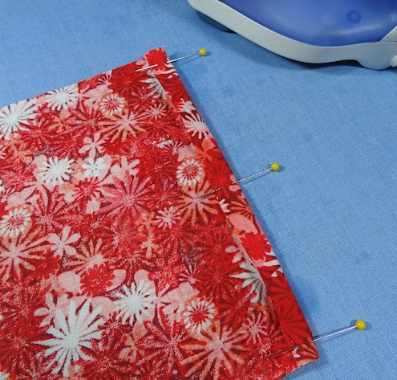
Step 1: Iron the short ends of the large rectangle under 1/4". It helps to pin them in place first.

Slide 4
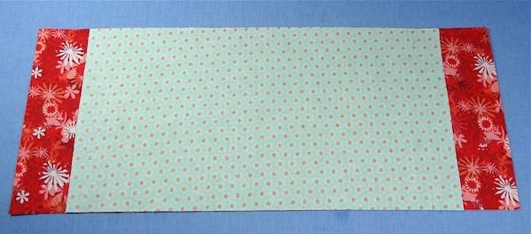
Step 2: Center the smaller rectangle on top of the larger rectangle, right sides together. You should have exactly 2" of the large rectangle sticking out on either side of the short rectangle. Precision is important.
(Mine were not exactly 2”, I just made sure they were the same. This forms the contrast band at the top)

Slide 5
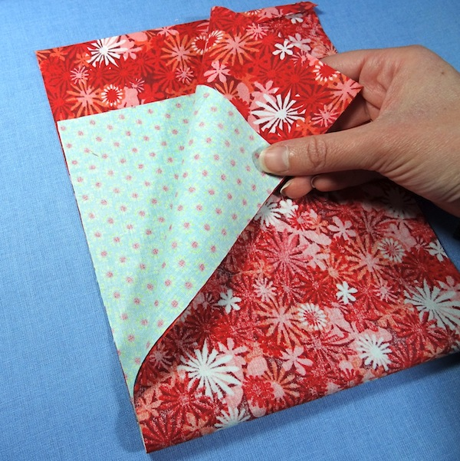
Step 3: Fold your rectangle sandwich in half so that the short ends of both rectangles match up. Lightly press the fold to create a crease at the center of both rectangles.

Slide 6
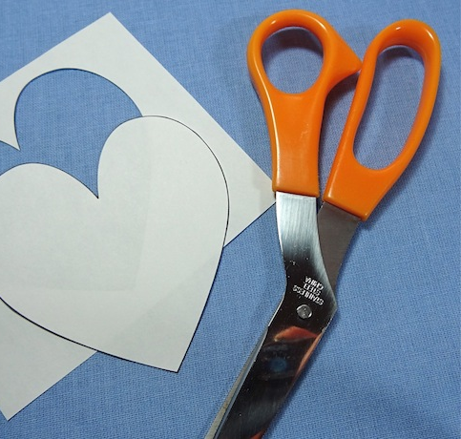
Step 4: Cut out your heart template if you haven't already done so.

Slide 7
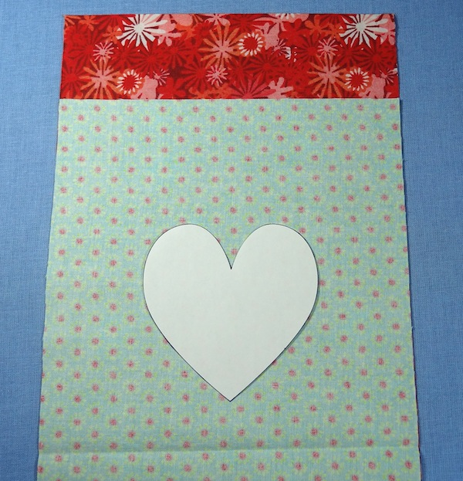
Step 5: Open up the folded rectangles and center the heart template 1 1/4" above the center crease of one half.

Slide 8
Step 6: Use your disappearing ink marker/pencil to trace around the heart.

Slide 9
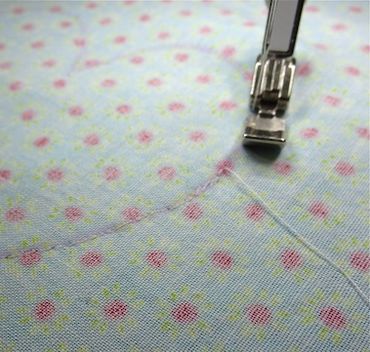
Step 7: Keeping both rectangles together, sew on the line of the heart shape you just drew.

Slide 10
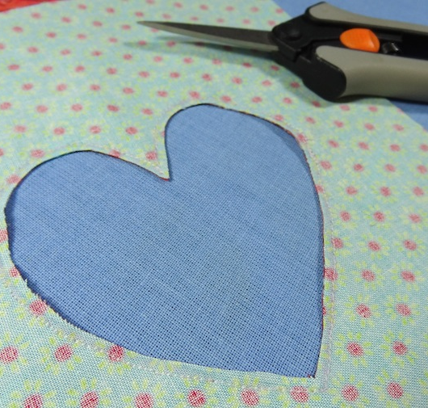
Step 8: Using sharp scissors, carefully cut out the center of the heart shape through both layers of rectangles, 1/8" inside your sewn line. Be very careful not to cut through your stitches.
(I clipped the curves)

Slide 11
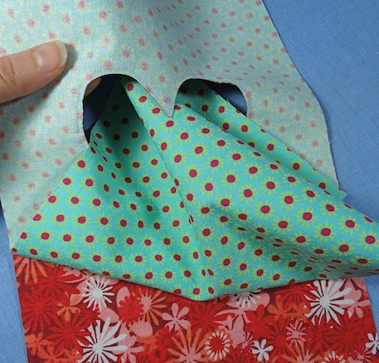
Step 9: Turn the rectangles right side out, by flipping the exterior fabric rectangle through the center of the heart hole you just cut. You will need to use something with a dull point (ie. pencil) to push the top point of the heart right side out.

Slide 12
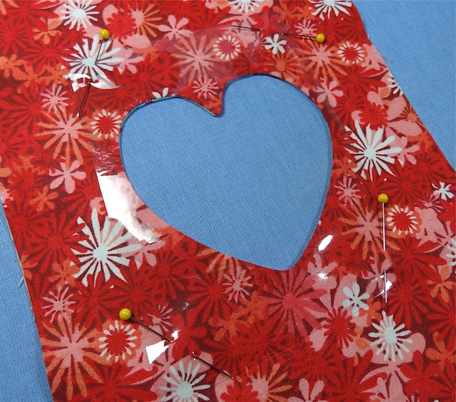
Step 10: Press your heart hole so that the seam on the edge of the heart is smooth and flat all the way around.
Step 11: Pin your vinyl square on top of the heart hole on the interior fabric side of your rectangles. Be careful to only pin through the four corners of the vinyl square. Do not pin through any of the vinyl in the center of the heart, otherwise there will be pin holes in your finished "window".

Slide 13
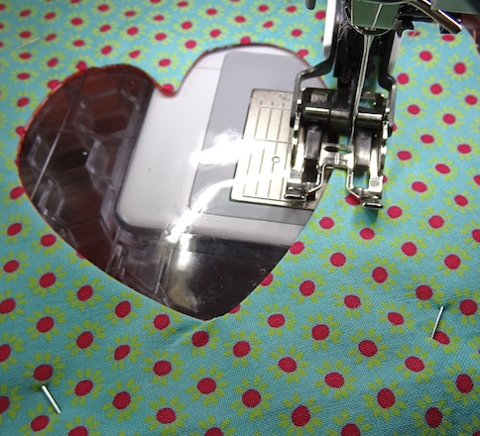
Step 12: Flip the heart window over to the exterior fabric so that the vinyl is on the bottom, and carefully sew around the heart window 1/8" from the edge. You may need to adjust your sewing machine tension for this part.
(I used a walking foot)

Slide 14
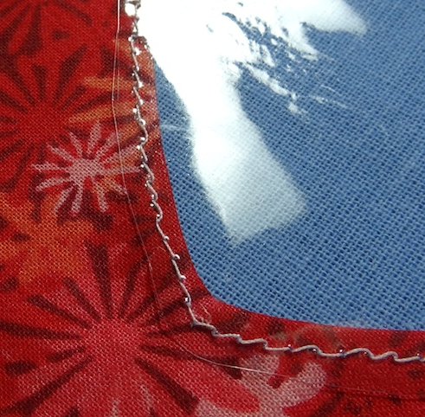
Step 13: Trim the vinyl 1/8" outside of the stitch line.

Slide 15
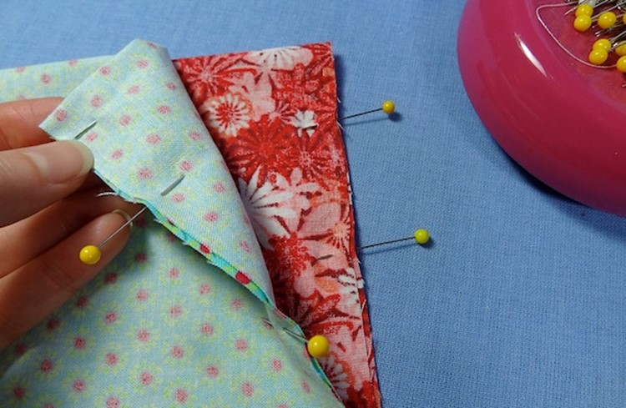
Step 14: Fold each of the two fabric rectangles in half, with the right sides of each together. You will be creating a folded rectangle sandwich with the two sides joined by the heart window in the middle. Pin the long edges of each of the folded rectangles together. You are about to create the exterior bag and the interior lining bag.

Slide 16
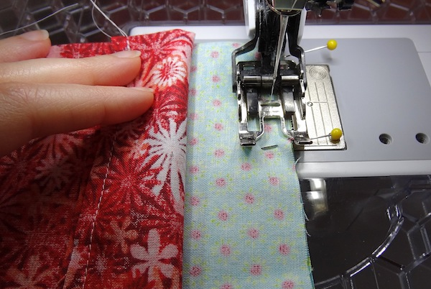
Step 15: Sew the pinned edges of the folded rectangles together. Remove the pins.

Slide 17
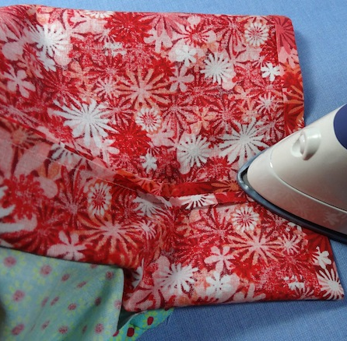
Step 16: Press the side seams open, near the top of both sides of the sewn rectangles.
(I used a sleeve ironing board and ironed all 4 seams fully open)

Slide 18
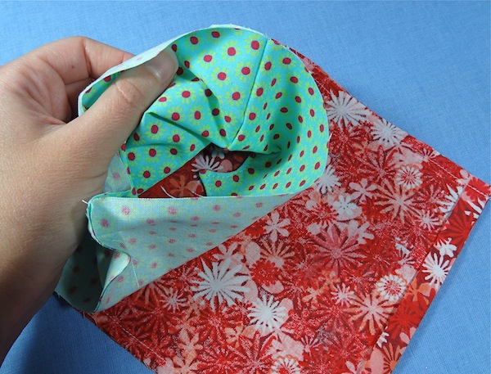
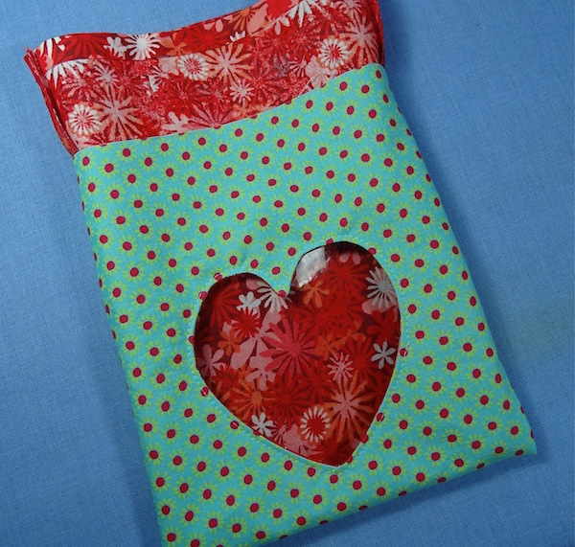
Step 17: Turn the exterior fabric bag right side out so that the interior lining bag is inside of it. Your bag should now look like this:

Slide 19
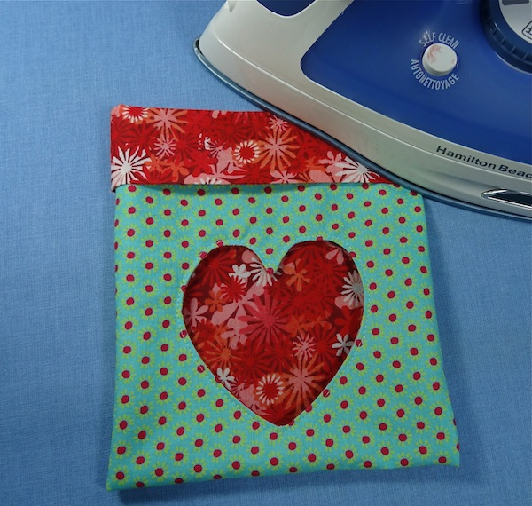
Step 18: Fold the top 2" cuff over and iron the crease so that it is smooth and straight all the way around (Make sure not to iron over the vinyl!).

Slide 20
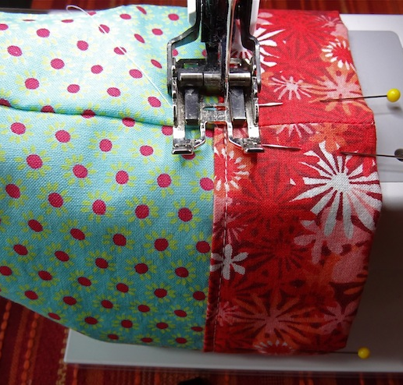
Step 19: Pin the cuff down, making sure to match up the side seams and stitch it in place around the bottom edge. Be sure to back tack when sewing over each of the side seams to reinforce the stitching in that area.

Slide 21
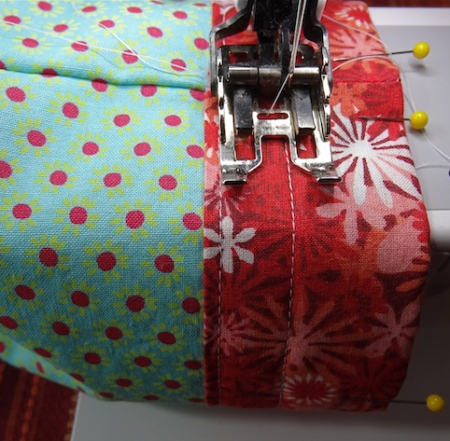
Step 20: Make a second row of stitching around the cuff, approximately 1/2" to 3/4" above the first. Be sure to back tack when sewing over each of the side seams to reinforce the stitching in that area.

Slide 22
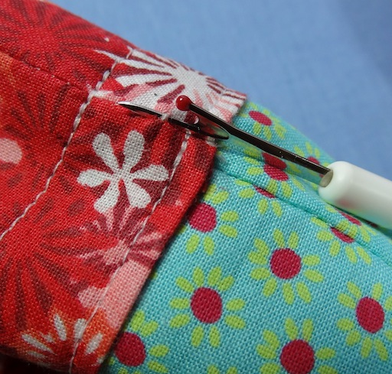
Step 21: Use your seam ripper to open the seam between the two lines of stitching on each side seam of the bag. You only need to remove the stitches from the top layer of the folded cuff fabric.

Slide 23
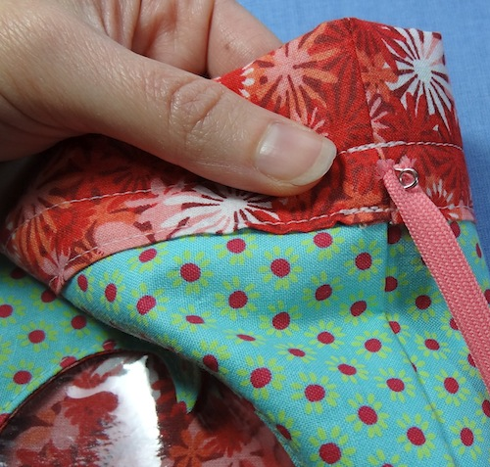
Step 22: Cut your 1 yd. piece of cording in half and secure a safety pin on the end of one piece.
Step 23: Feed the safety pin through one of the side seam openings you just made and work it all the way around the casing until it comes out through the same hole it went into. Remove the safety pin and secure it by tying the two ends of the cord together in a knot as pictured below. Repeat with the other piece of cord on the other side of the bag.

Slide 24
Fill it up with pretty candies!

