Slide 1
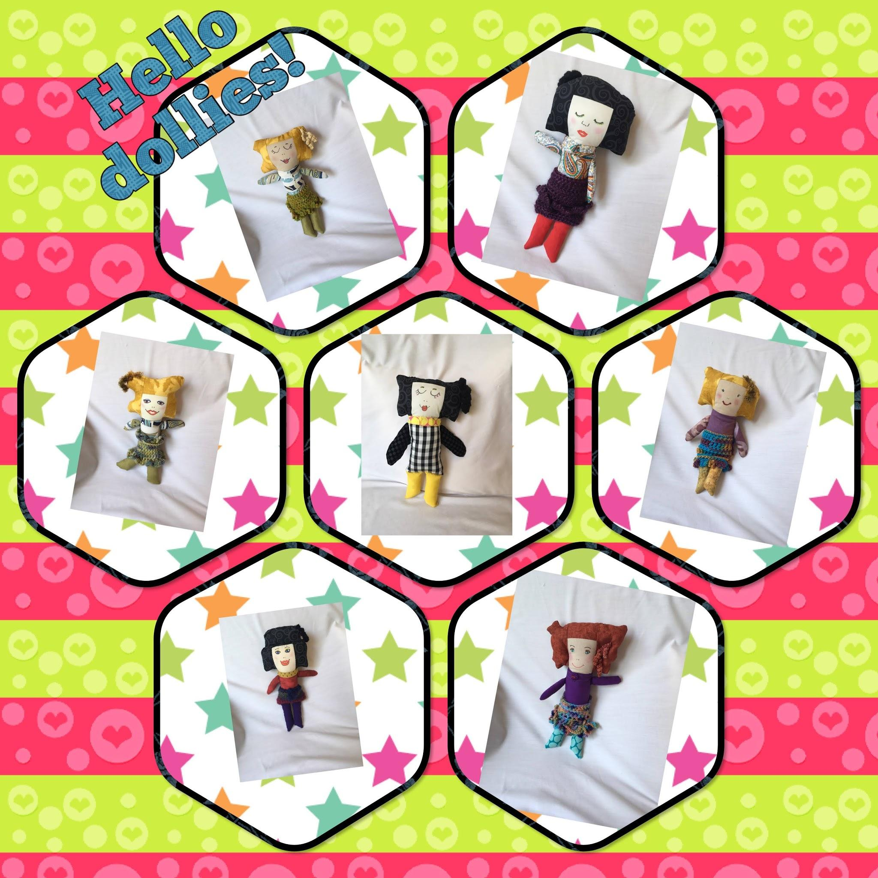

Slide 2
Rag Dolls Artsy Style
Presented by Jan Yeh, Sarasota Gulf Coast Chapter of ASG member
Waldemere Wednesday 8-18-21
Rag dolls measure 12-13” tall.
Arms and legs are sewn in.
Facial expressions are painted with fabric pens.
Head and hair are integrated as one fabric unit.
Machine & hand stitched.
Optional embellishments and accessories.
Designed for children or the young at heart.
Wearable art.
Comfort Companion- hand-free travel.

Slide 3
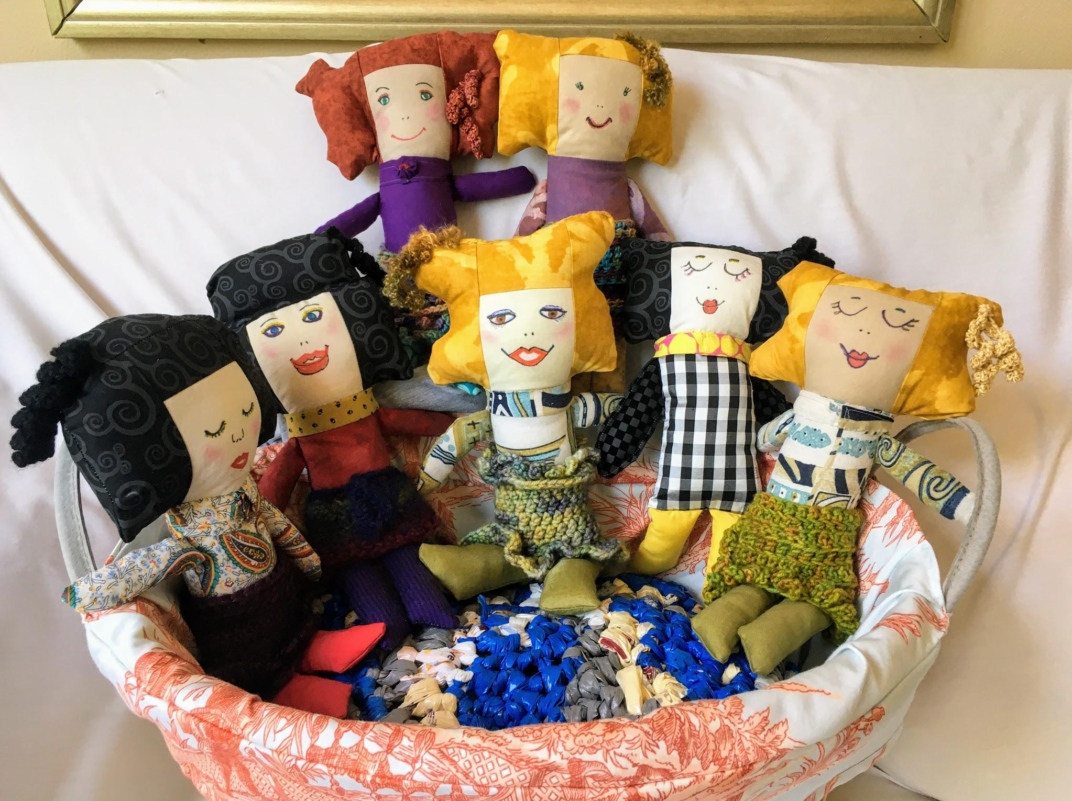
The Gang is all here!

Slide 4
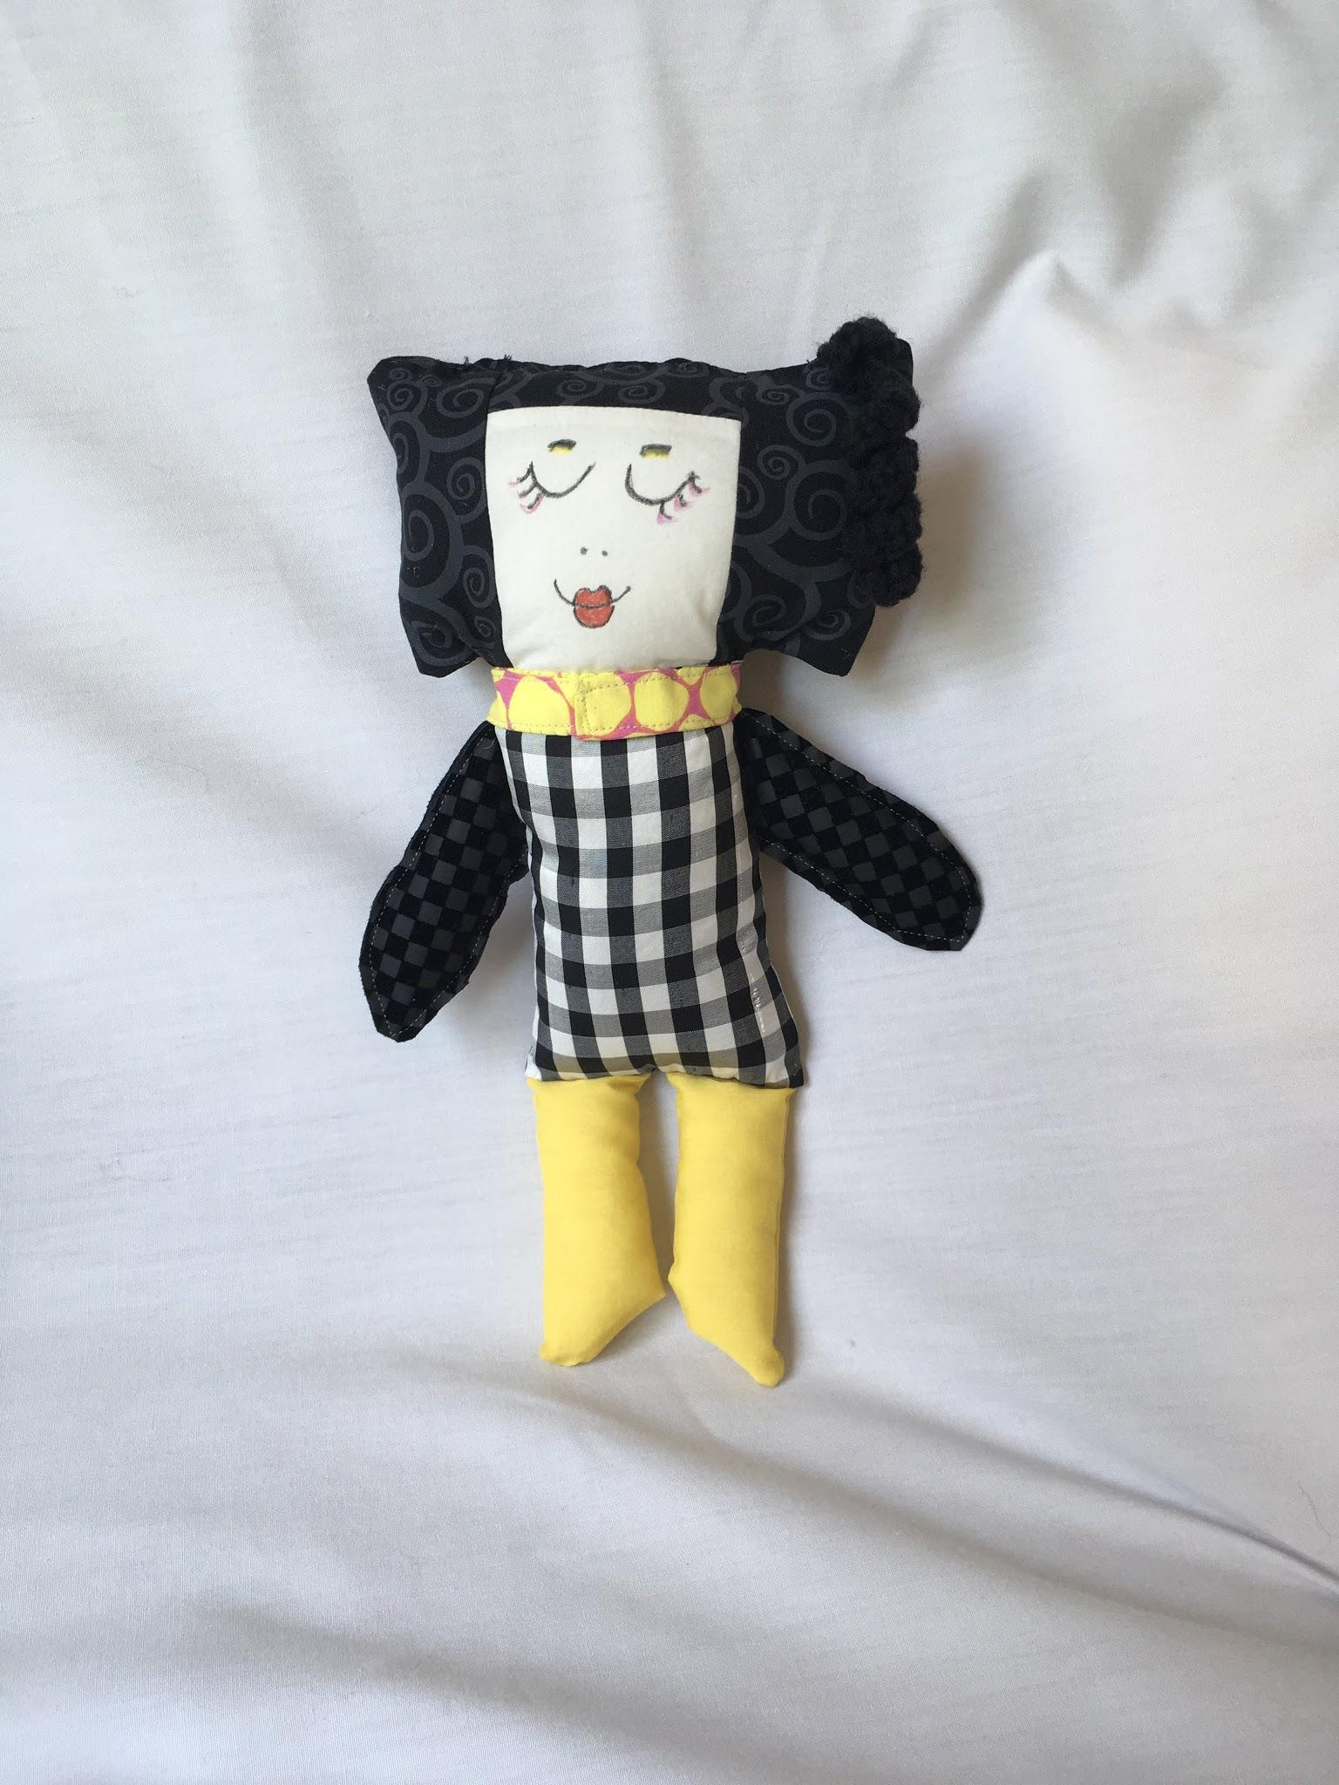
Modern Marcy

Slide 5
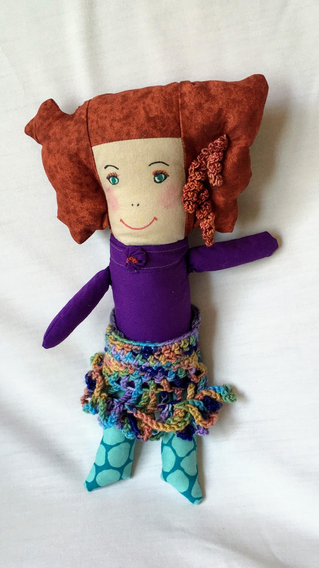
Rah,Rah Ruby

Slide 6
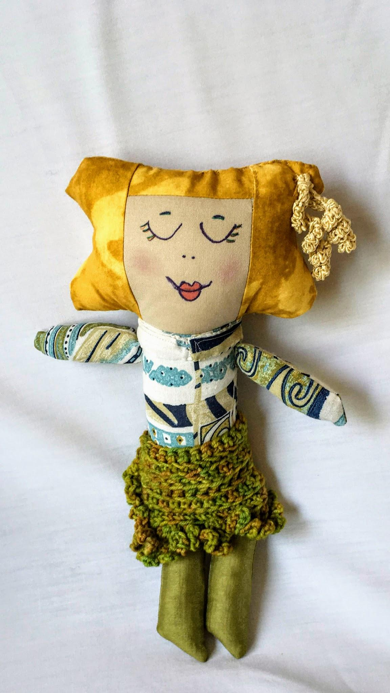
Restful Rhonda

Slide 7
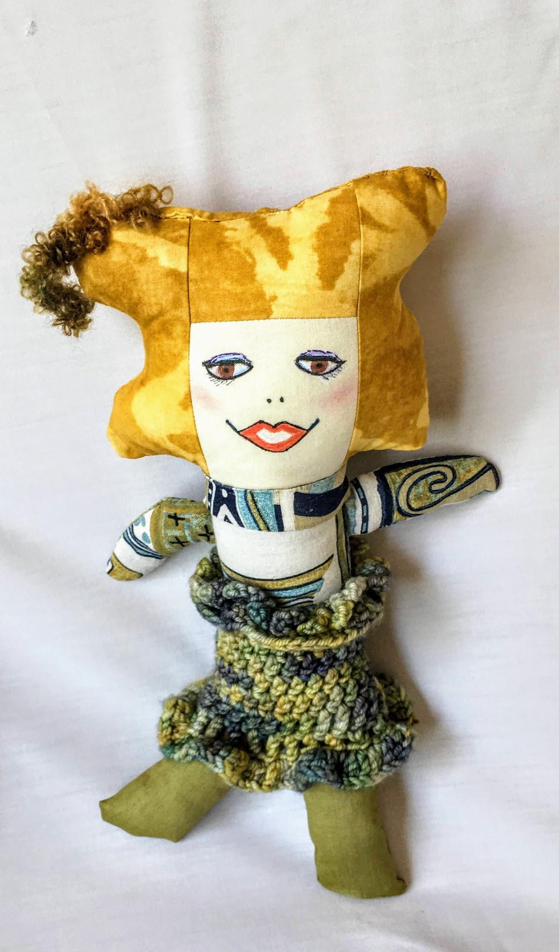
Ready Rita

Slide 8
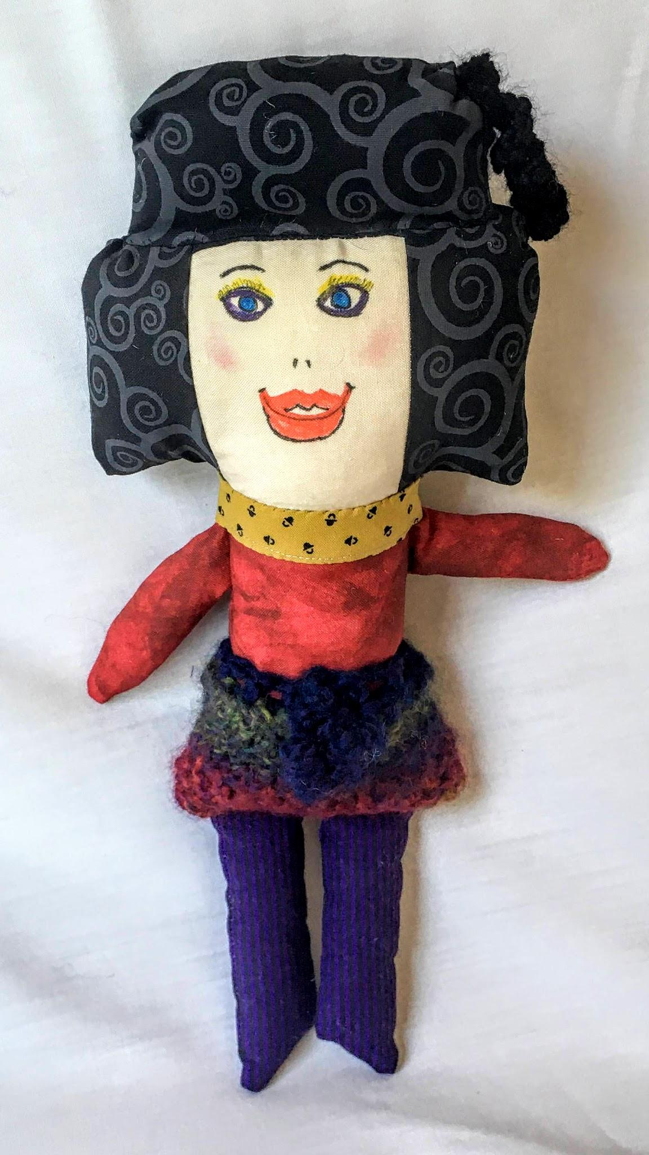
Bouffant Belle

Slide 9
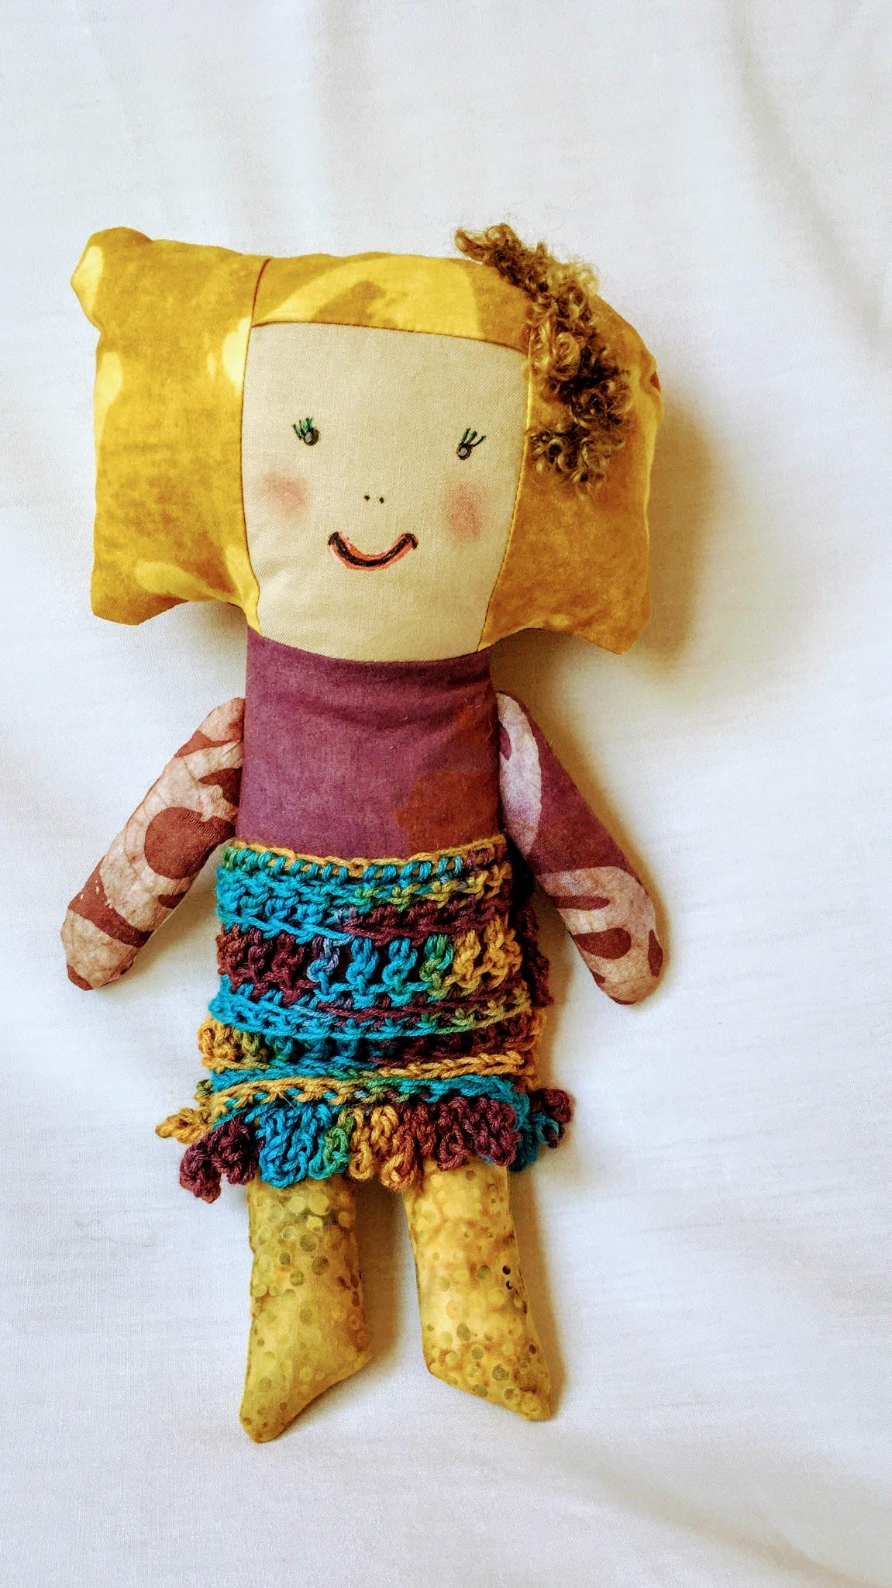
Ever So Soft Evie

Slide 10
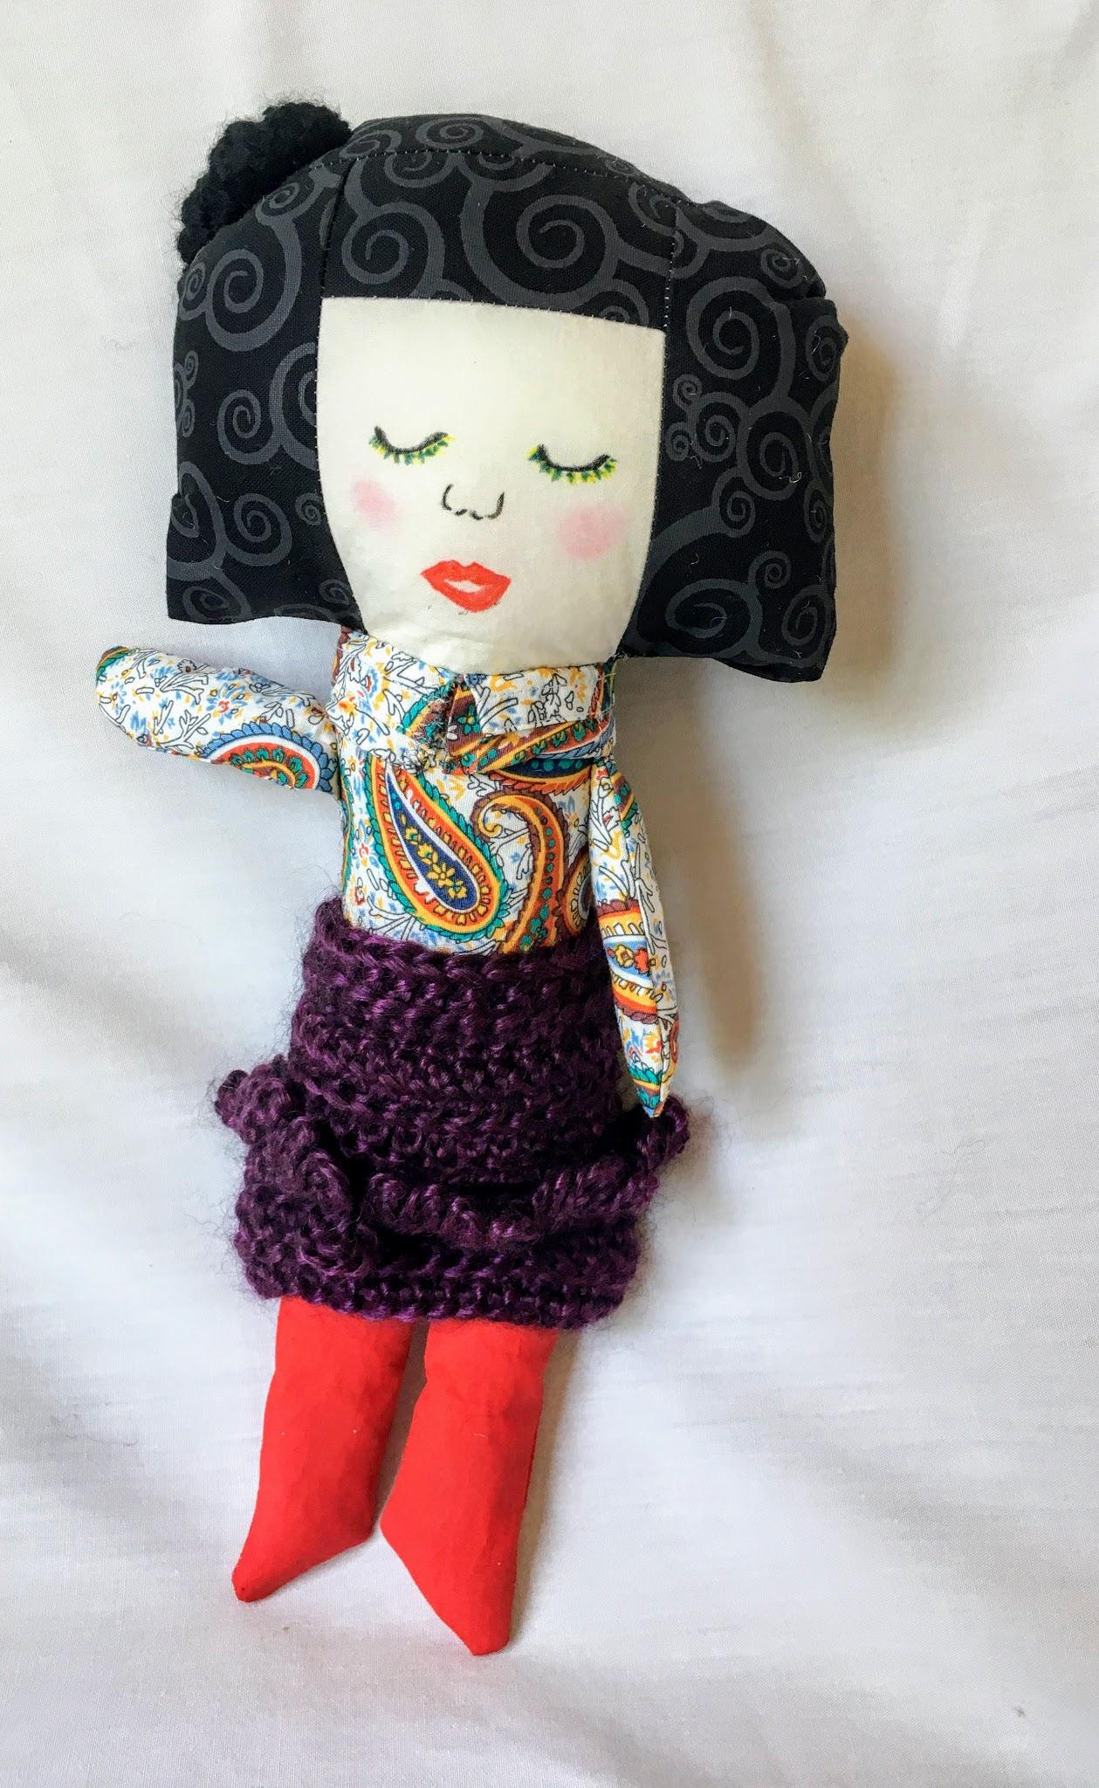
Peaceful Patty

Slide 11
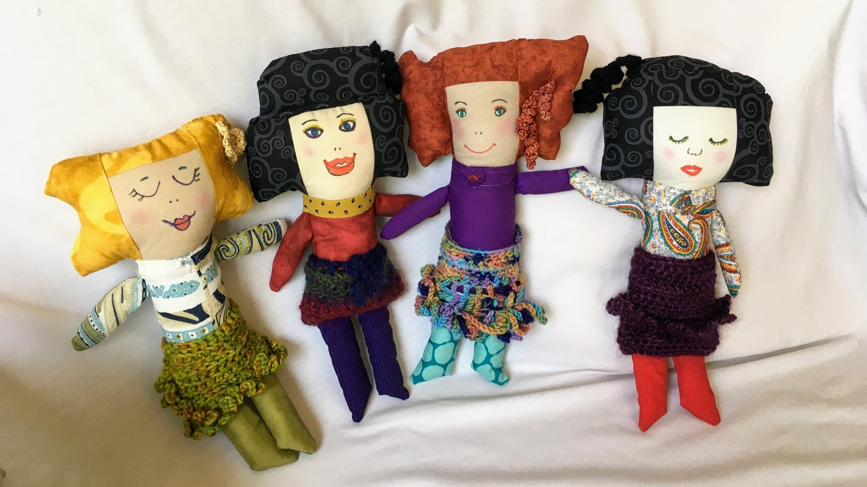

Slide 12
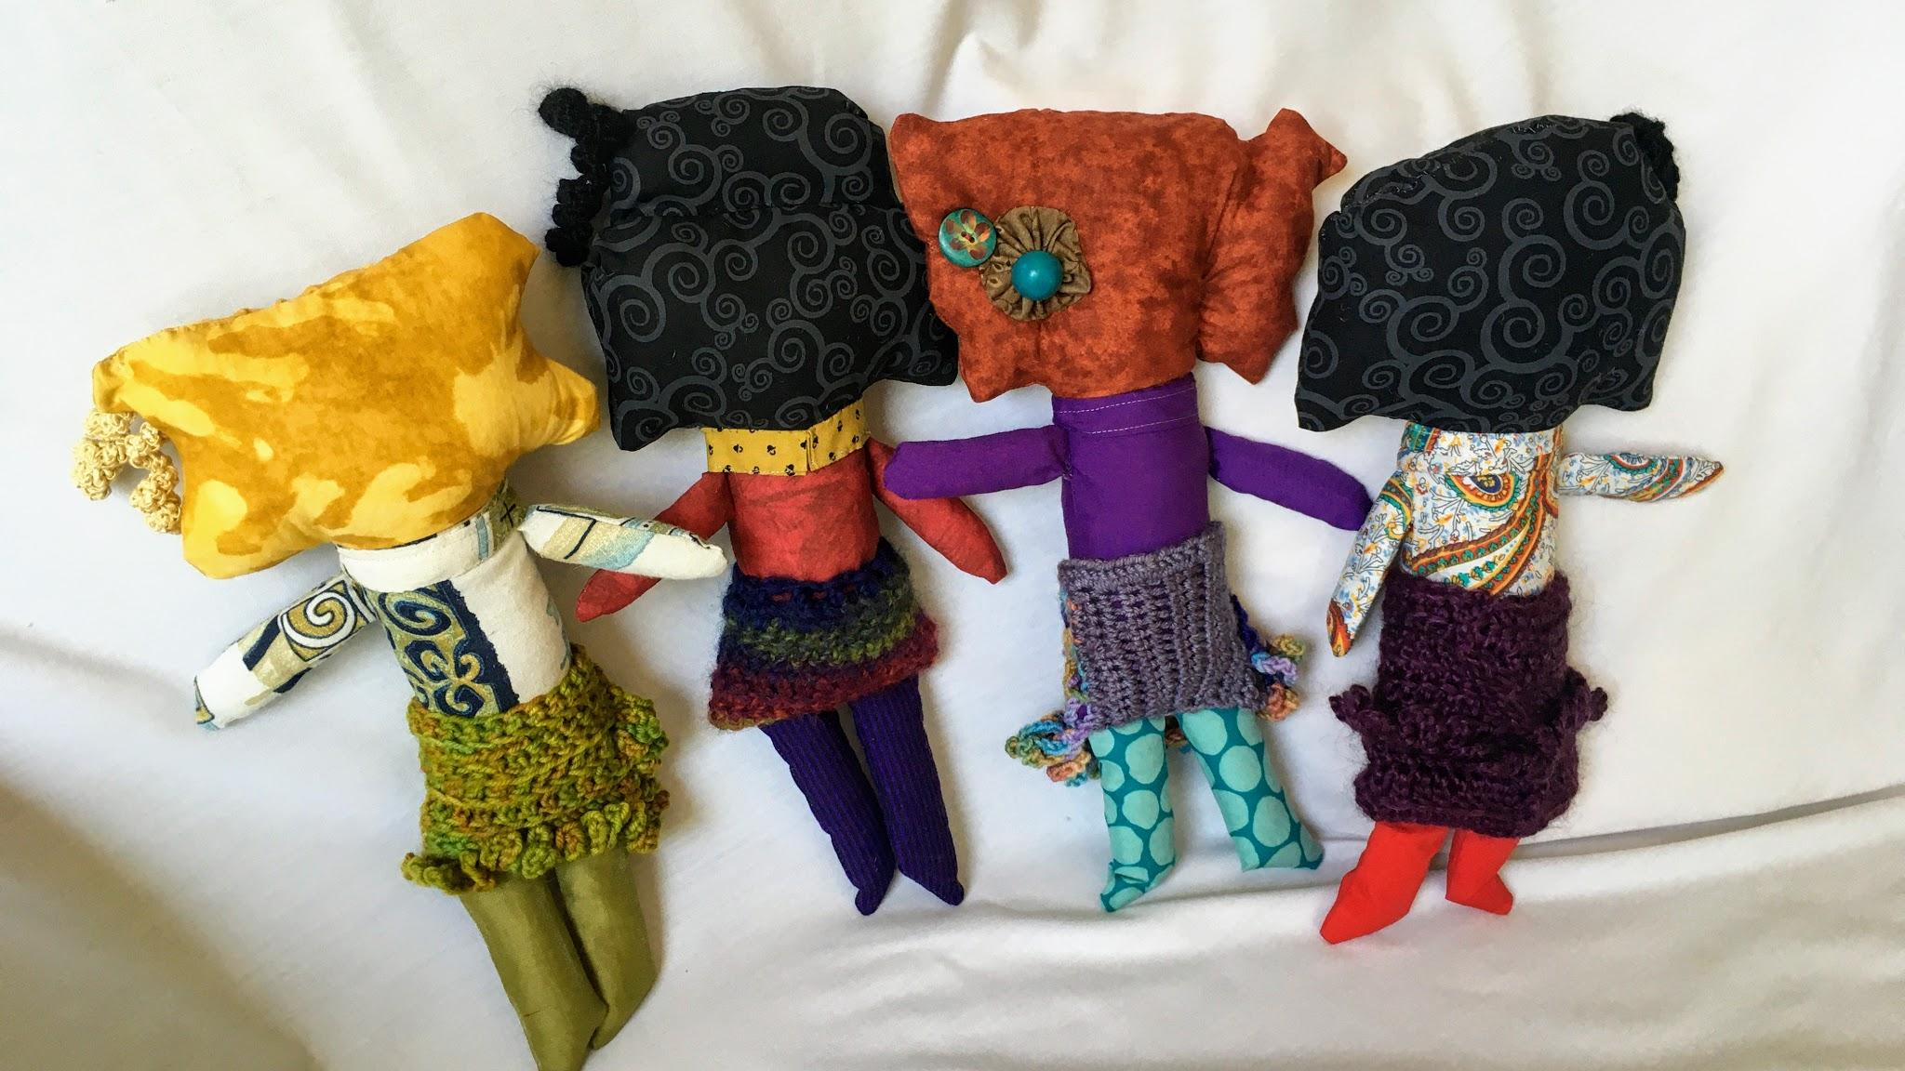

Slide 13
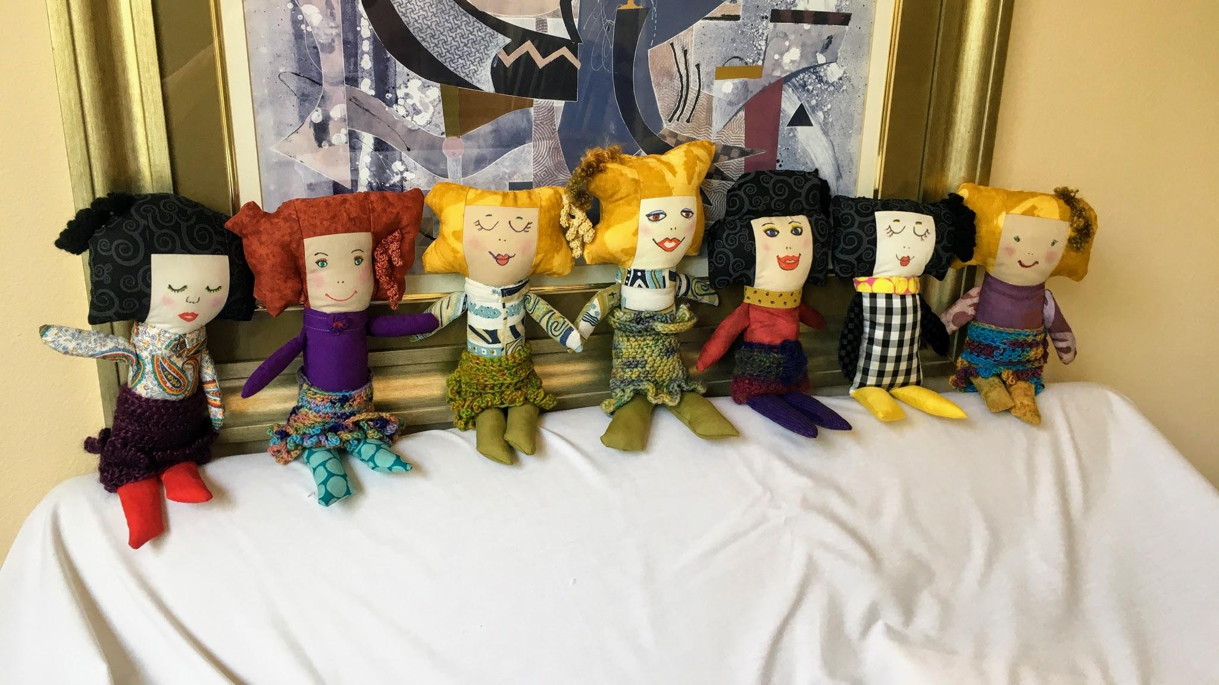

Slide 14
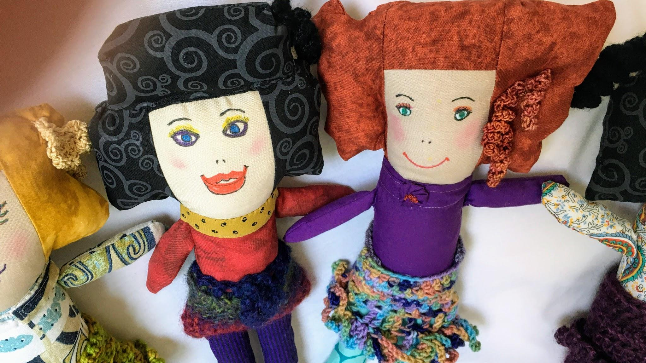

Slide 15
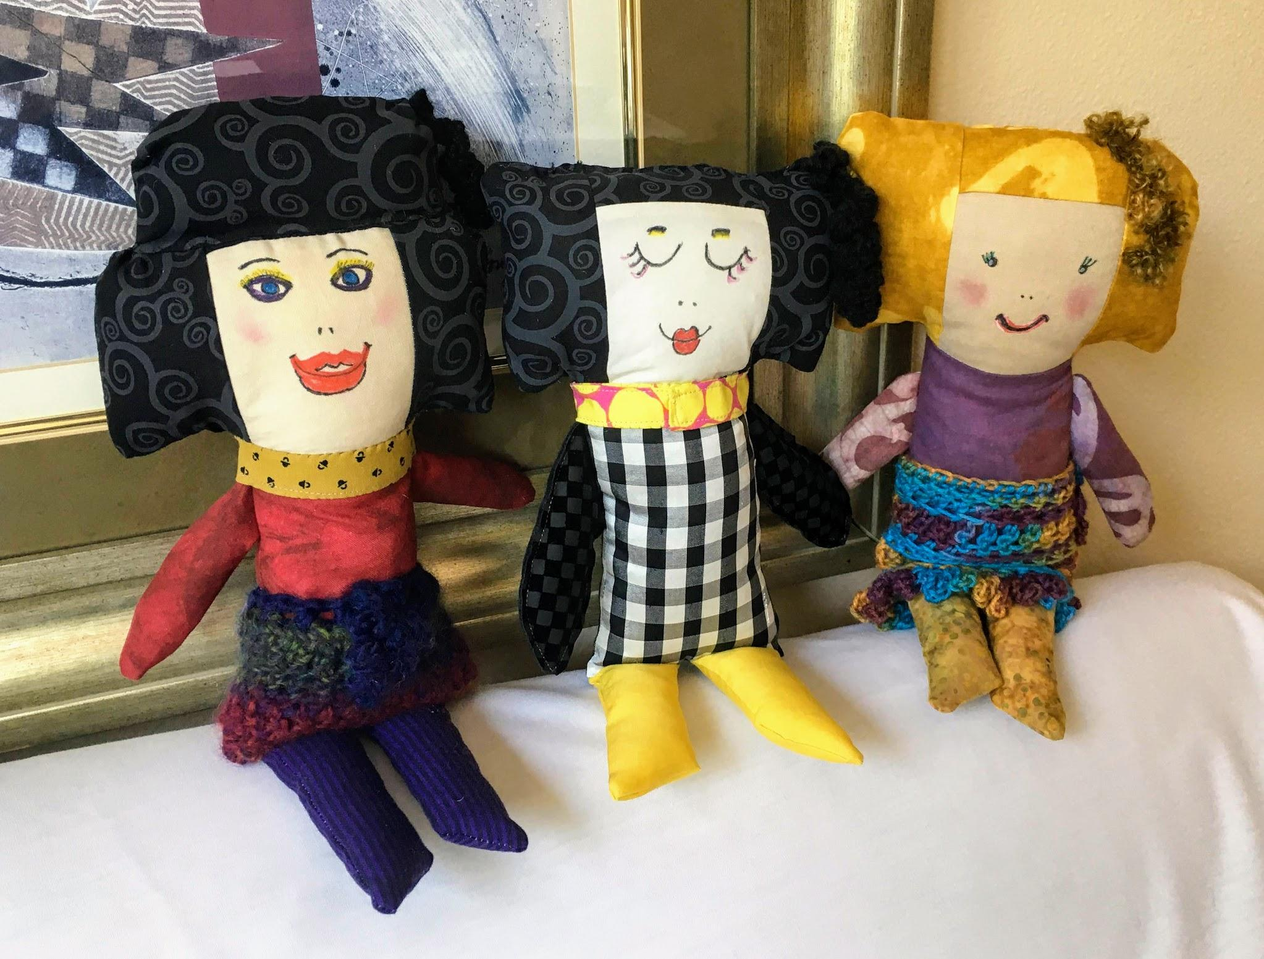

Slide 16
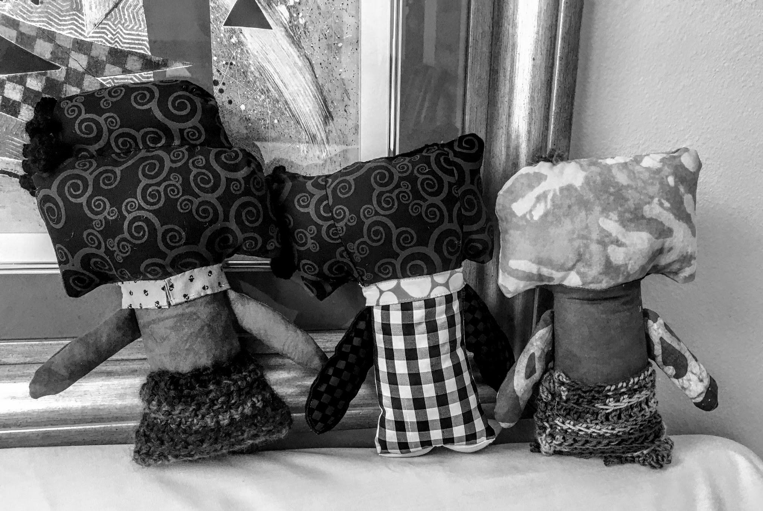

Slide 17
Rag Dolls Artsy Style Presentation
INSPIRATION
CONSTRUCTION
CREATING A FACE
EMBELLISHMENT-ACCESSORIES
TRAVEL COMPANION

Slide 18
Inspiration
Inspiration starts me on my way to make something I’ve never tried before or that I think I’ll be no good at, or that I don’t think I have time for.
Inspiration comes and goes during a project.
It is not linear in form like technique.
Sometimes I have to tell Inspiration to go “sit in a corner.” to get my Work done.
I like to record my Inspiration in a journal. That helps me commit to It instead of Inspiration drifting off like a puppy.

Slide 19
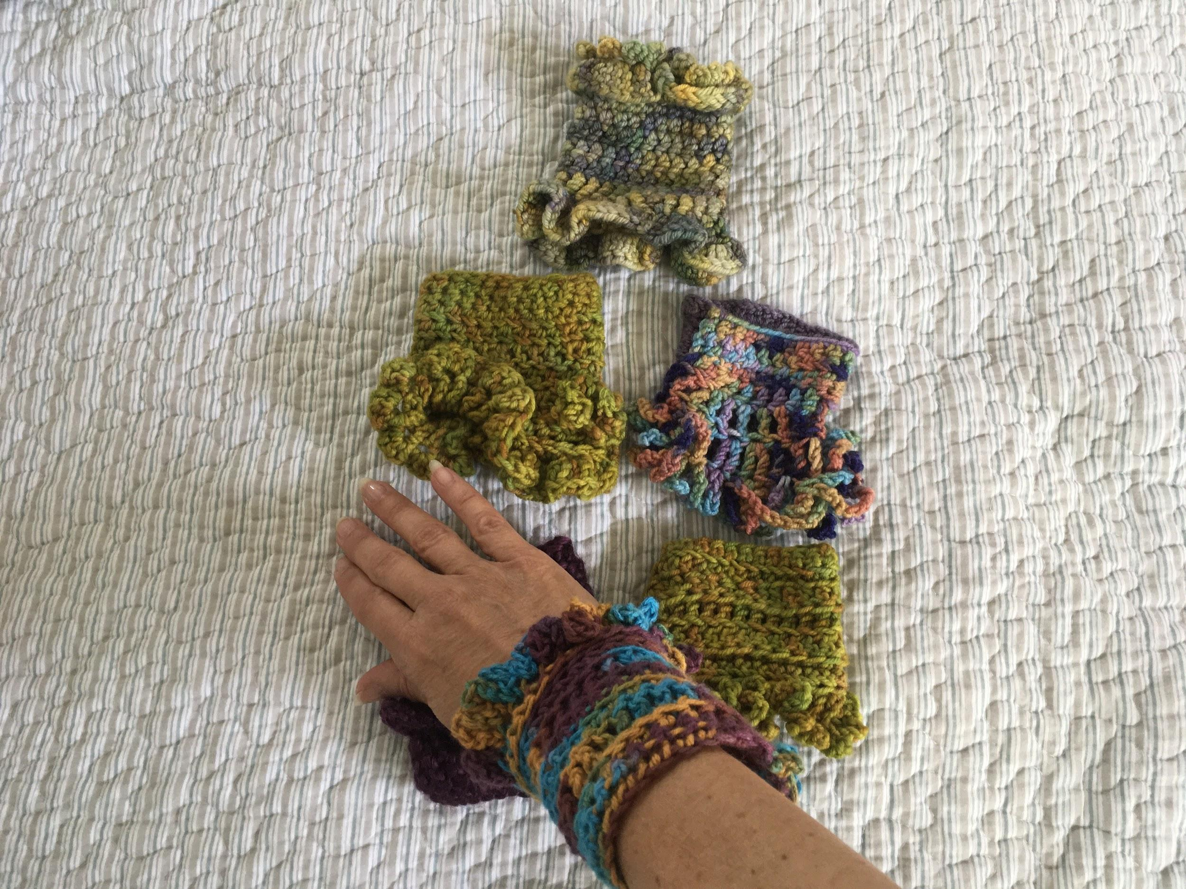
Inspiration began with my
collection of crochet cuffs.
“These would make great dolly skirts someday…..”
Notes:
I

Slide 20
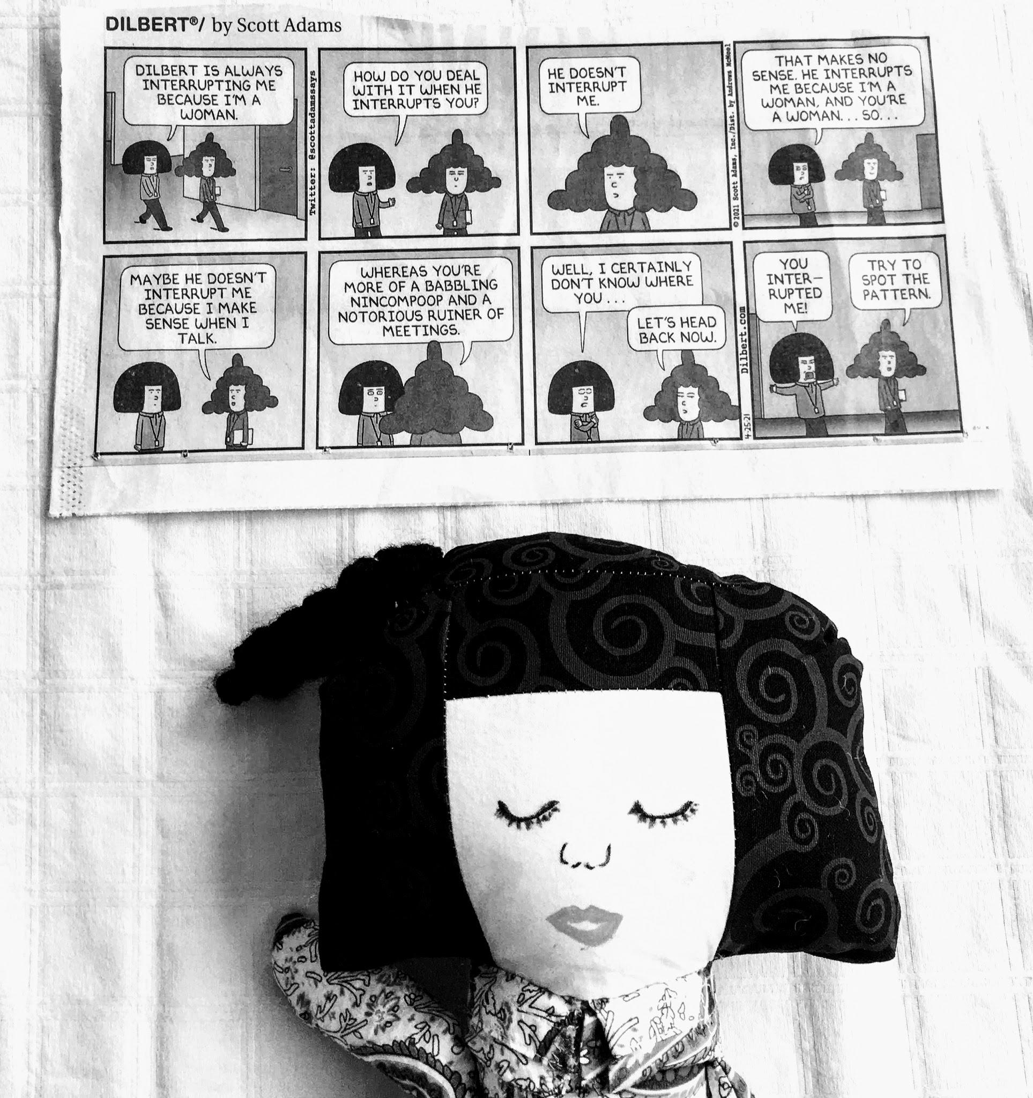
More inspiration came from the
Dilbert comic strip--
Tina-the technical writer
I want to make big hair like this!

Slide 21
CONSTRUCTION
Pattern Making
Fabric selection-skin tones
Piecing the fabric-the steps, techniques & tips
Stuffing
Notes:
Pattern-my own, developed so the crochet cuffs could be skirts
Fabric selection-depends on the purpose of the making-for gift, age of recipient, for sale, for self, for experimentation, to use up stash
Piecing construction
Stuffing-like the firmness of a pillow-soft, medium, solid

Slide 22
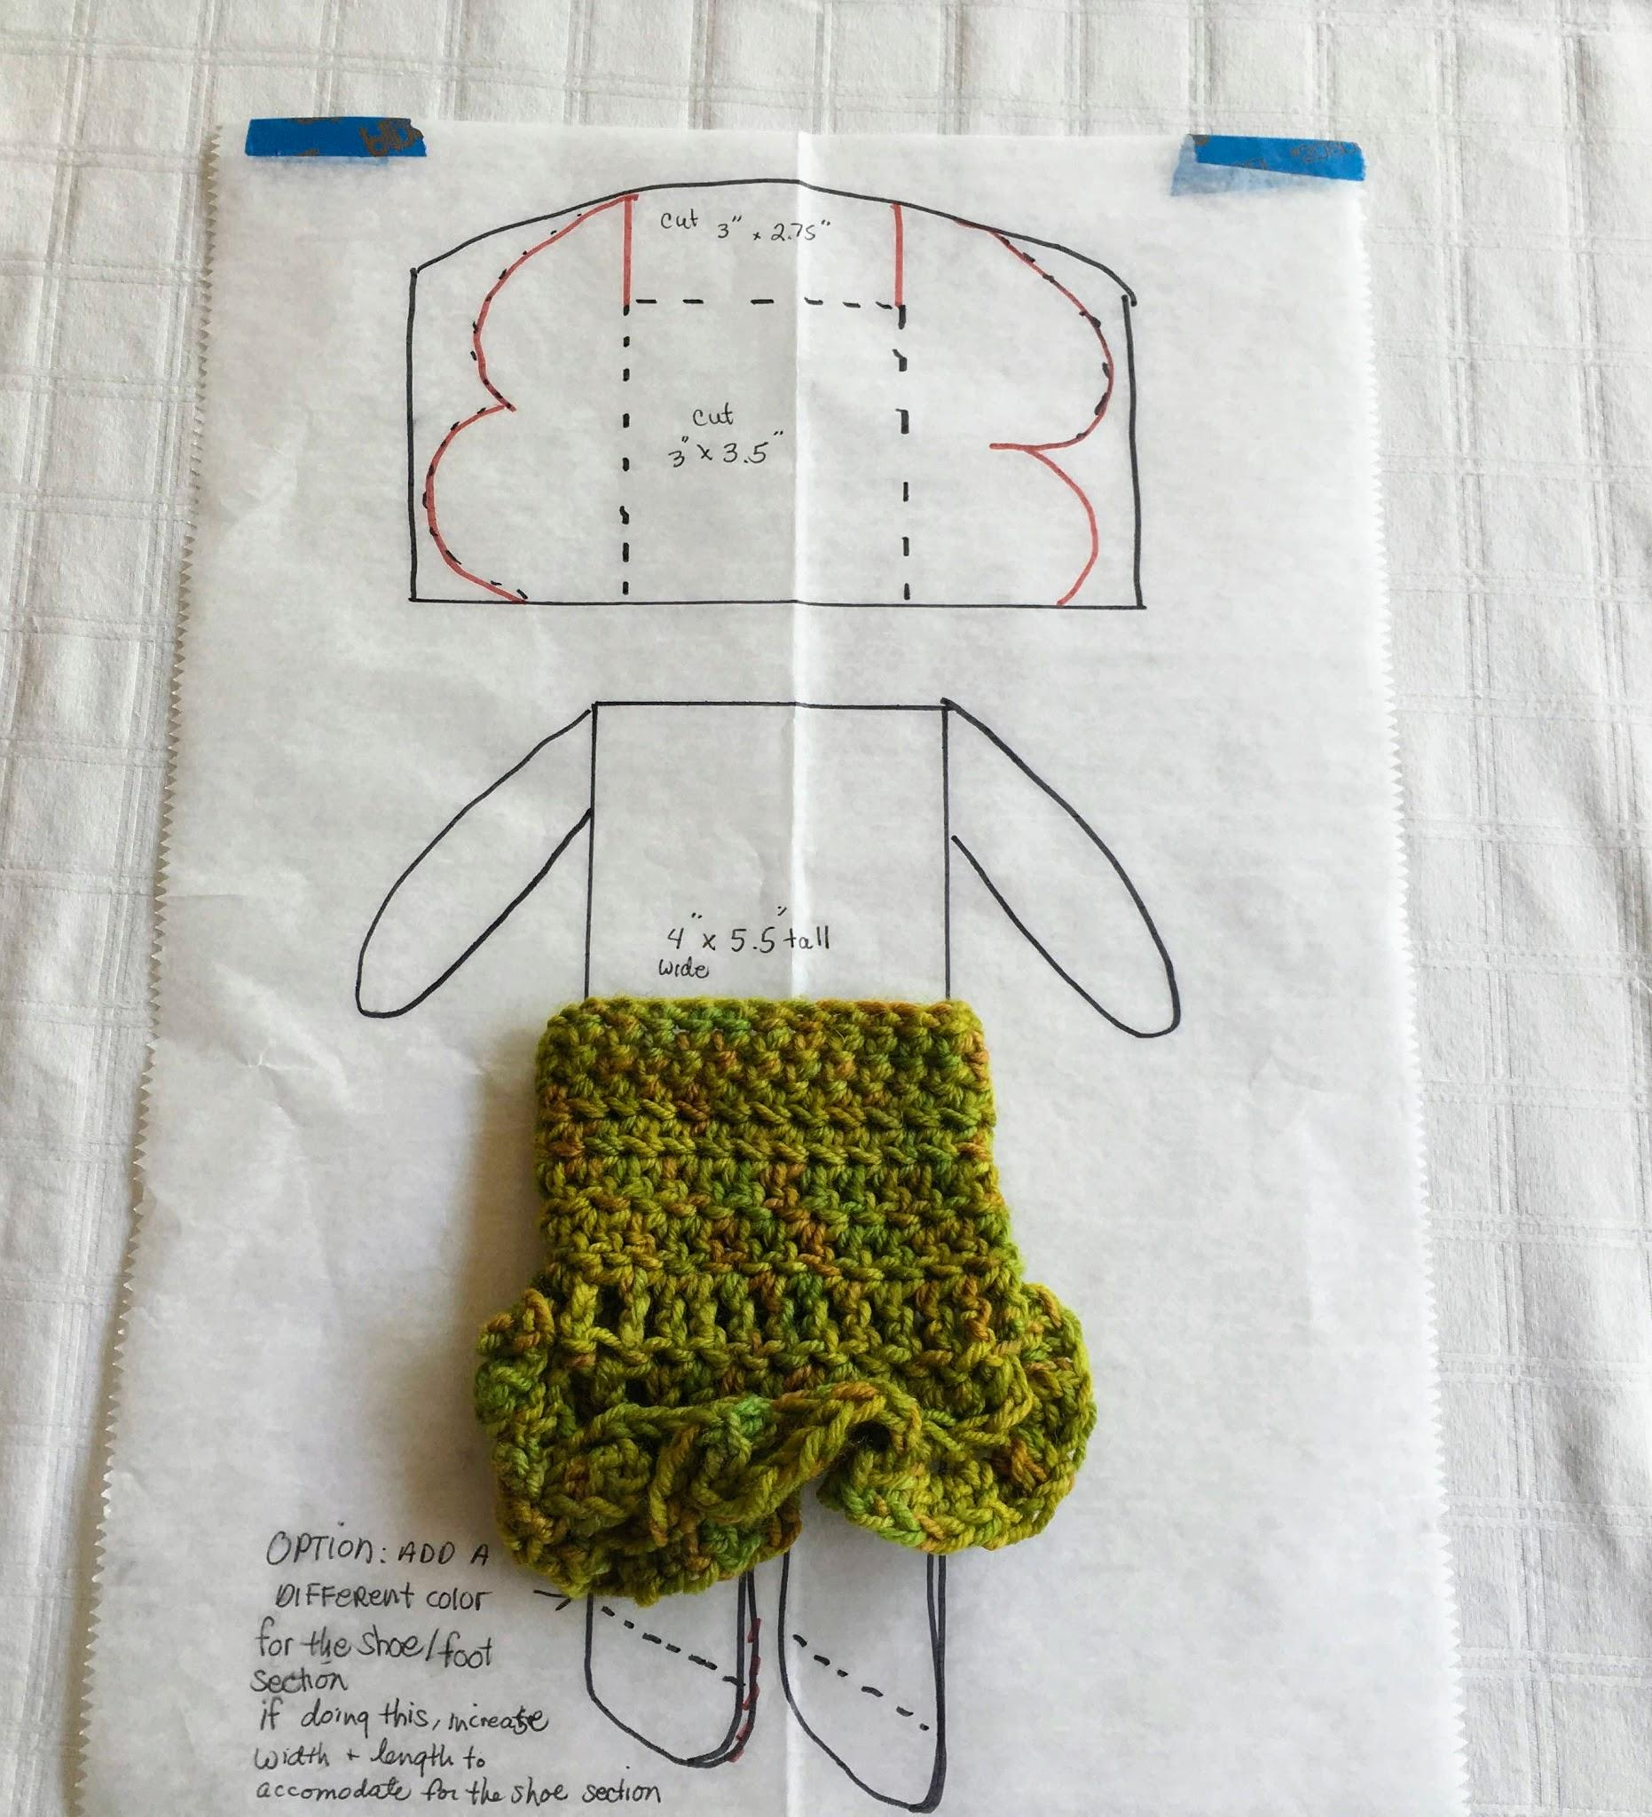
Doll Measurements:
12-13” tall
7.50” body circumference
Fabric Requirements for 1 doll:
One 3” x 3.5” rectangle for face color
One 2” x 3” rectangle for top of hair
Two 2.5” x 4.5” rectangles for sides of hair
Two 4” x 5.5 “ rectangles for front & back body
One 7.5” x 6” rectangle for back of hair
5” x 8” piece of fabric folded to cut out the arms and legs

Slide 23
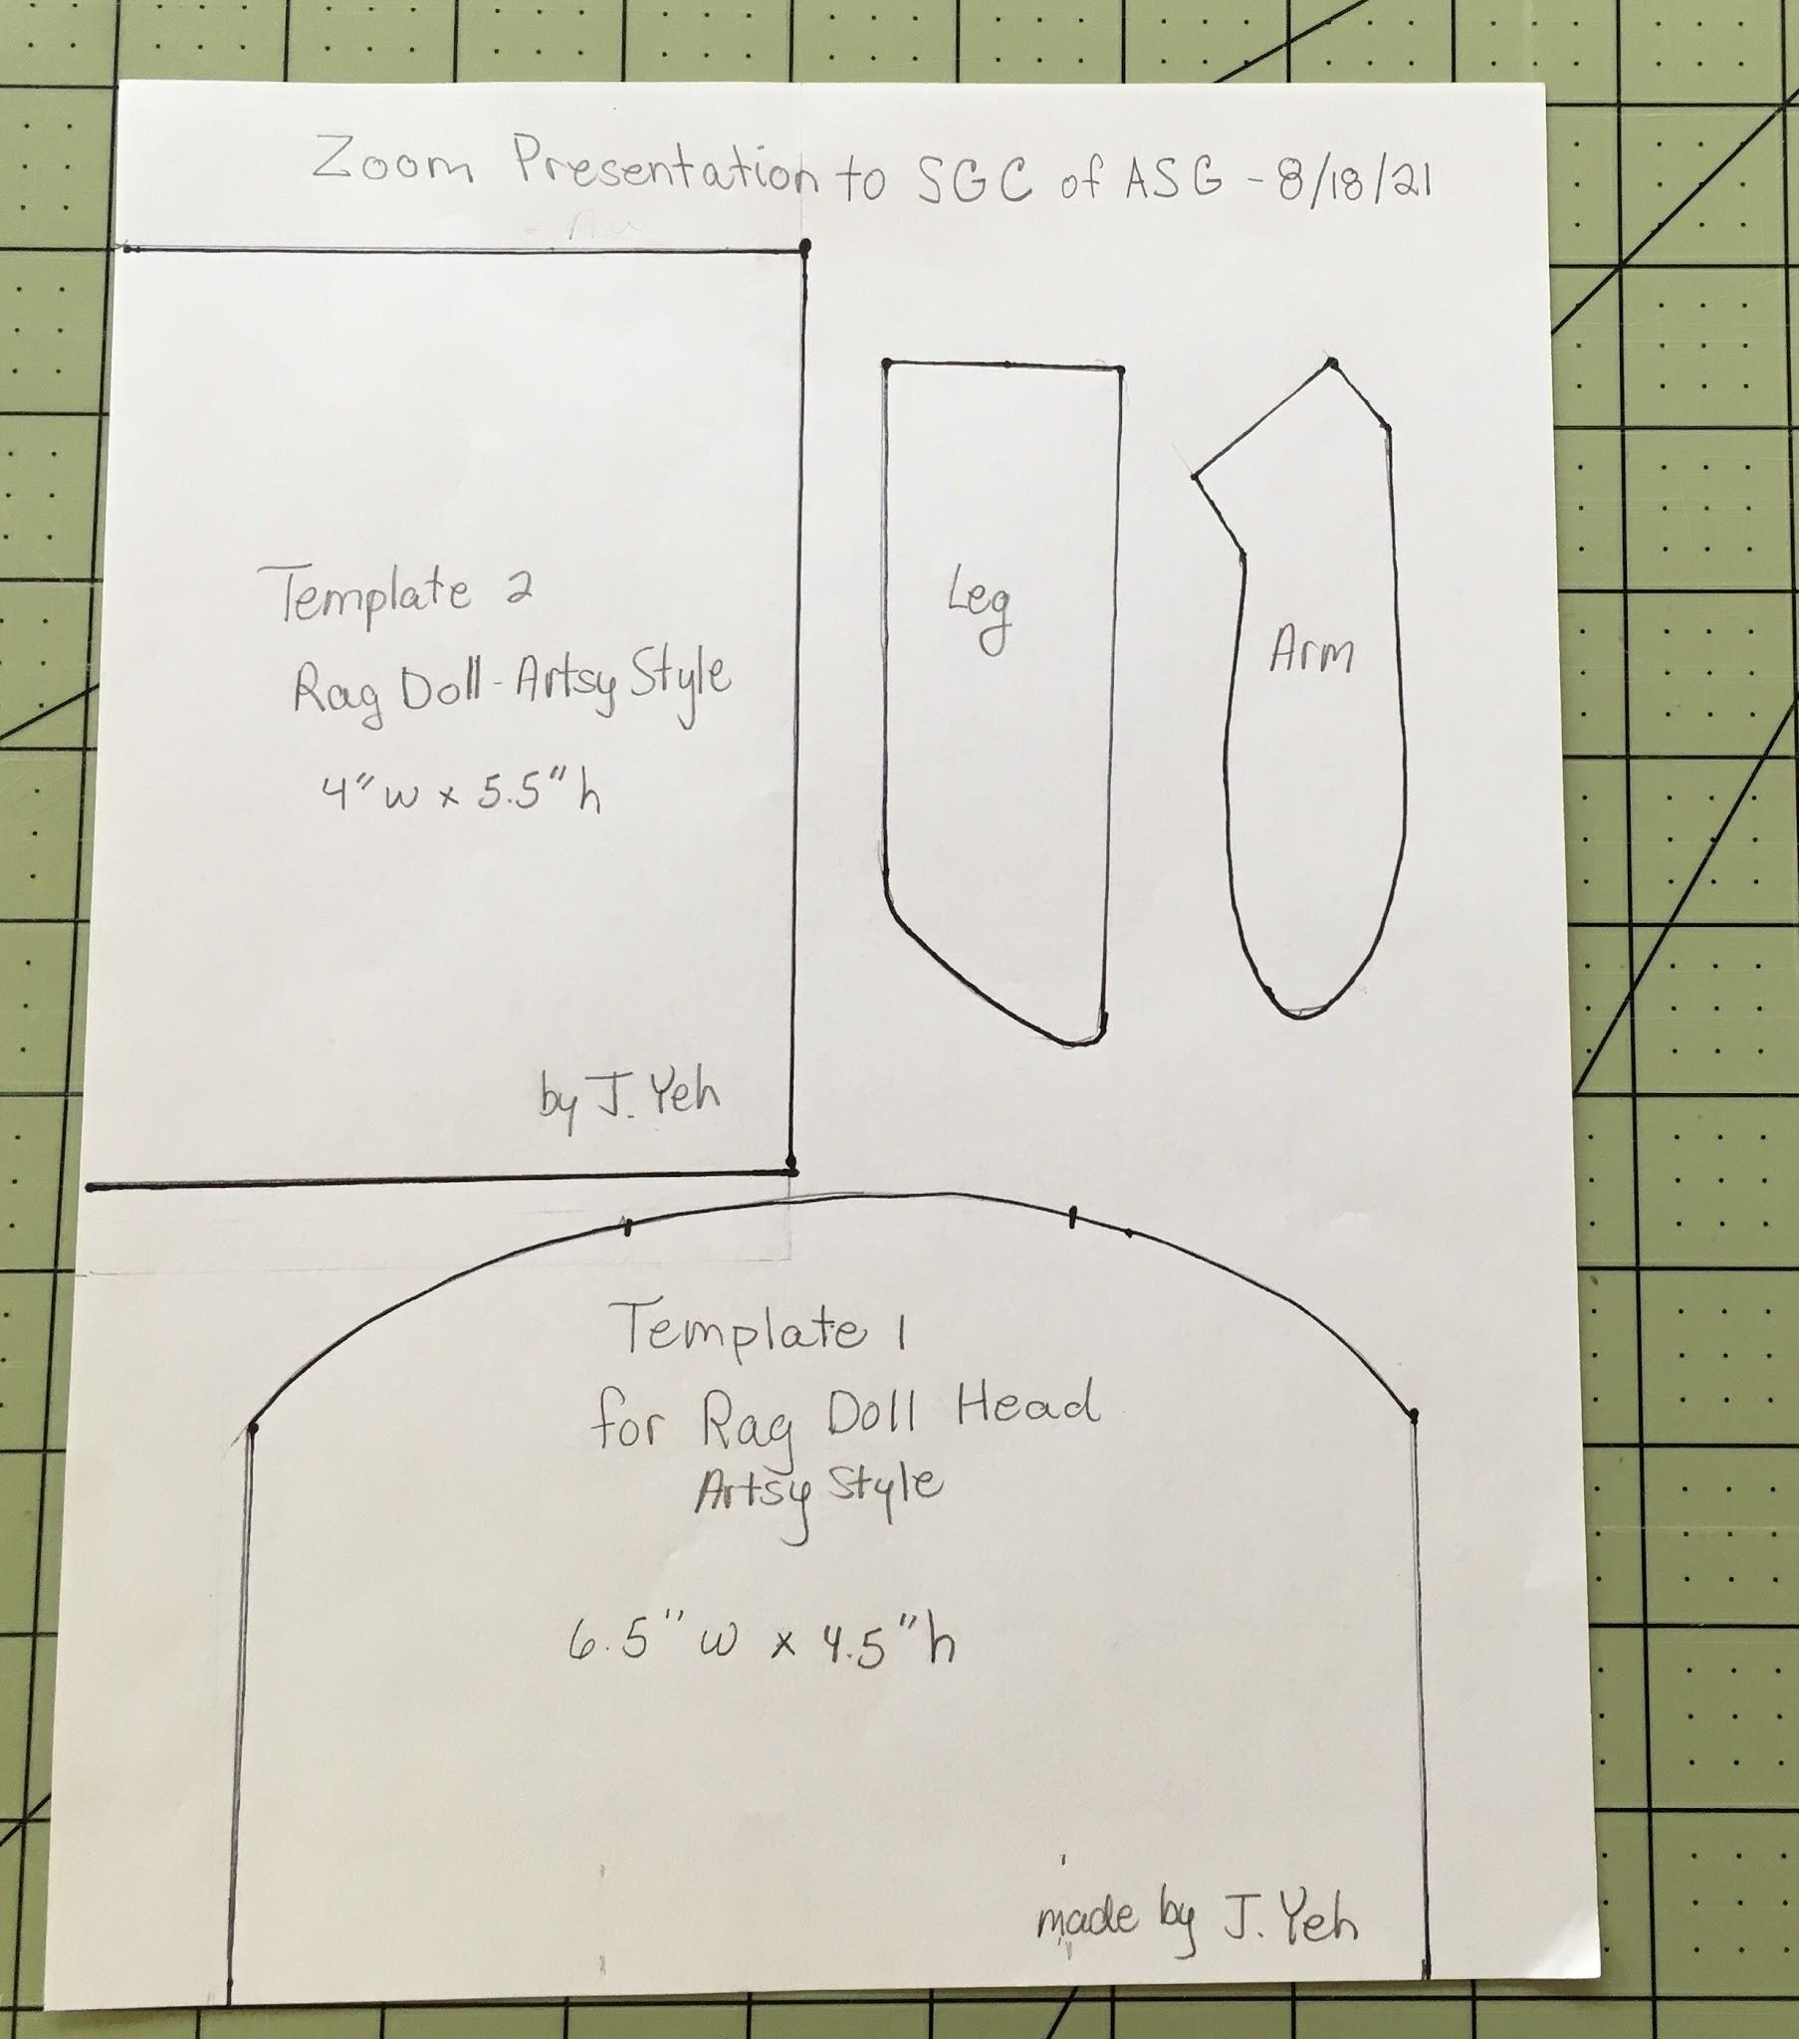
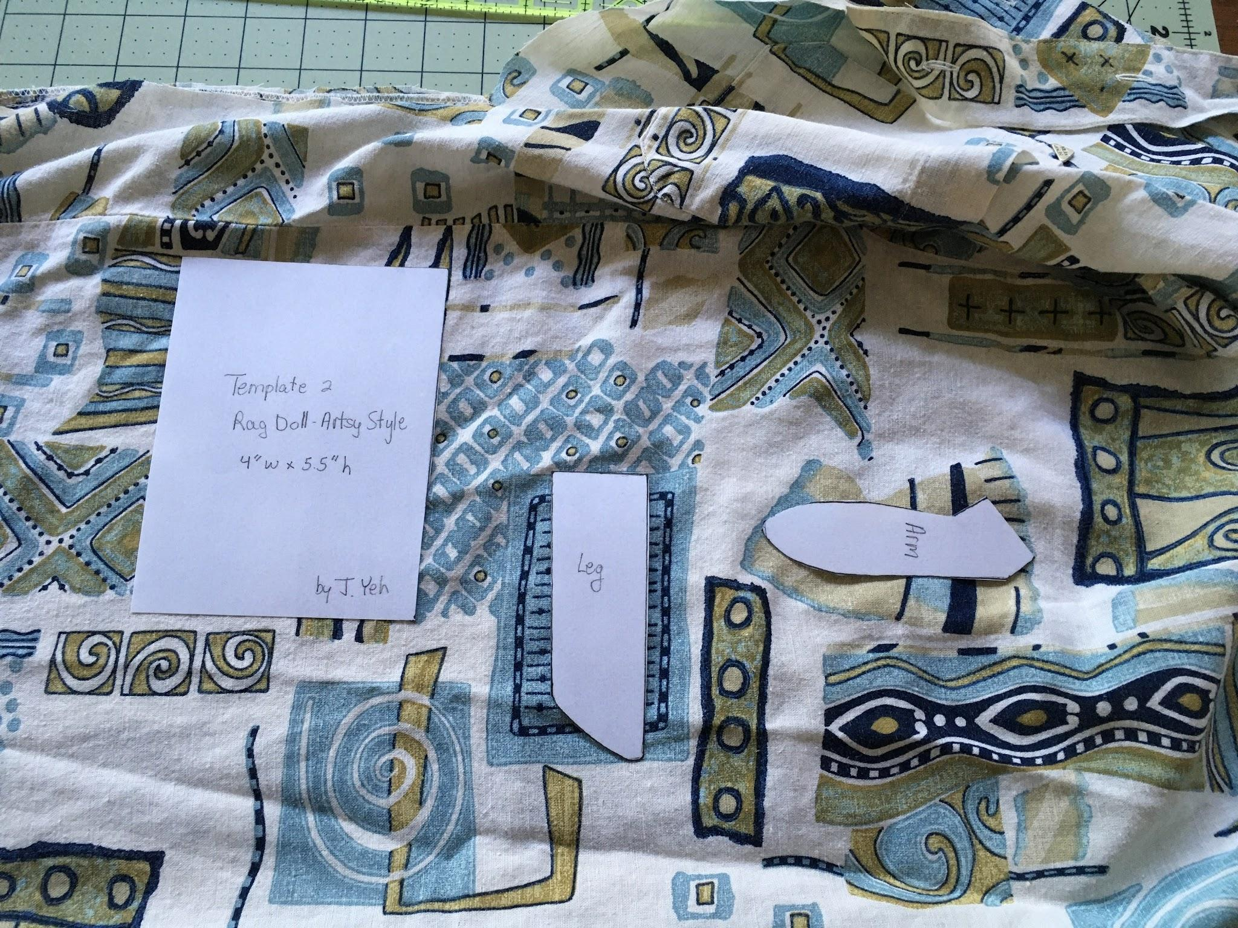
Templates
Use to fussy cut the section of fabric you want, say on a print shirt.
Cut just outside the black lines for the arms & legs. You will sew on the black lines.

Slide 24
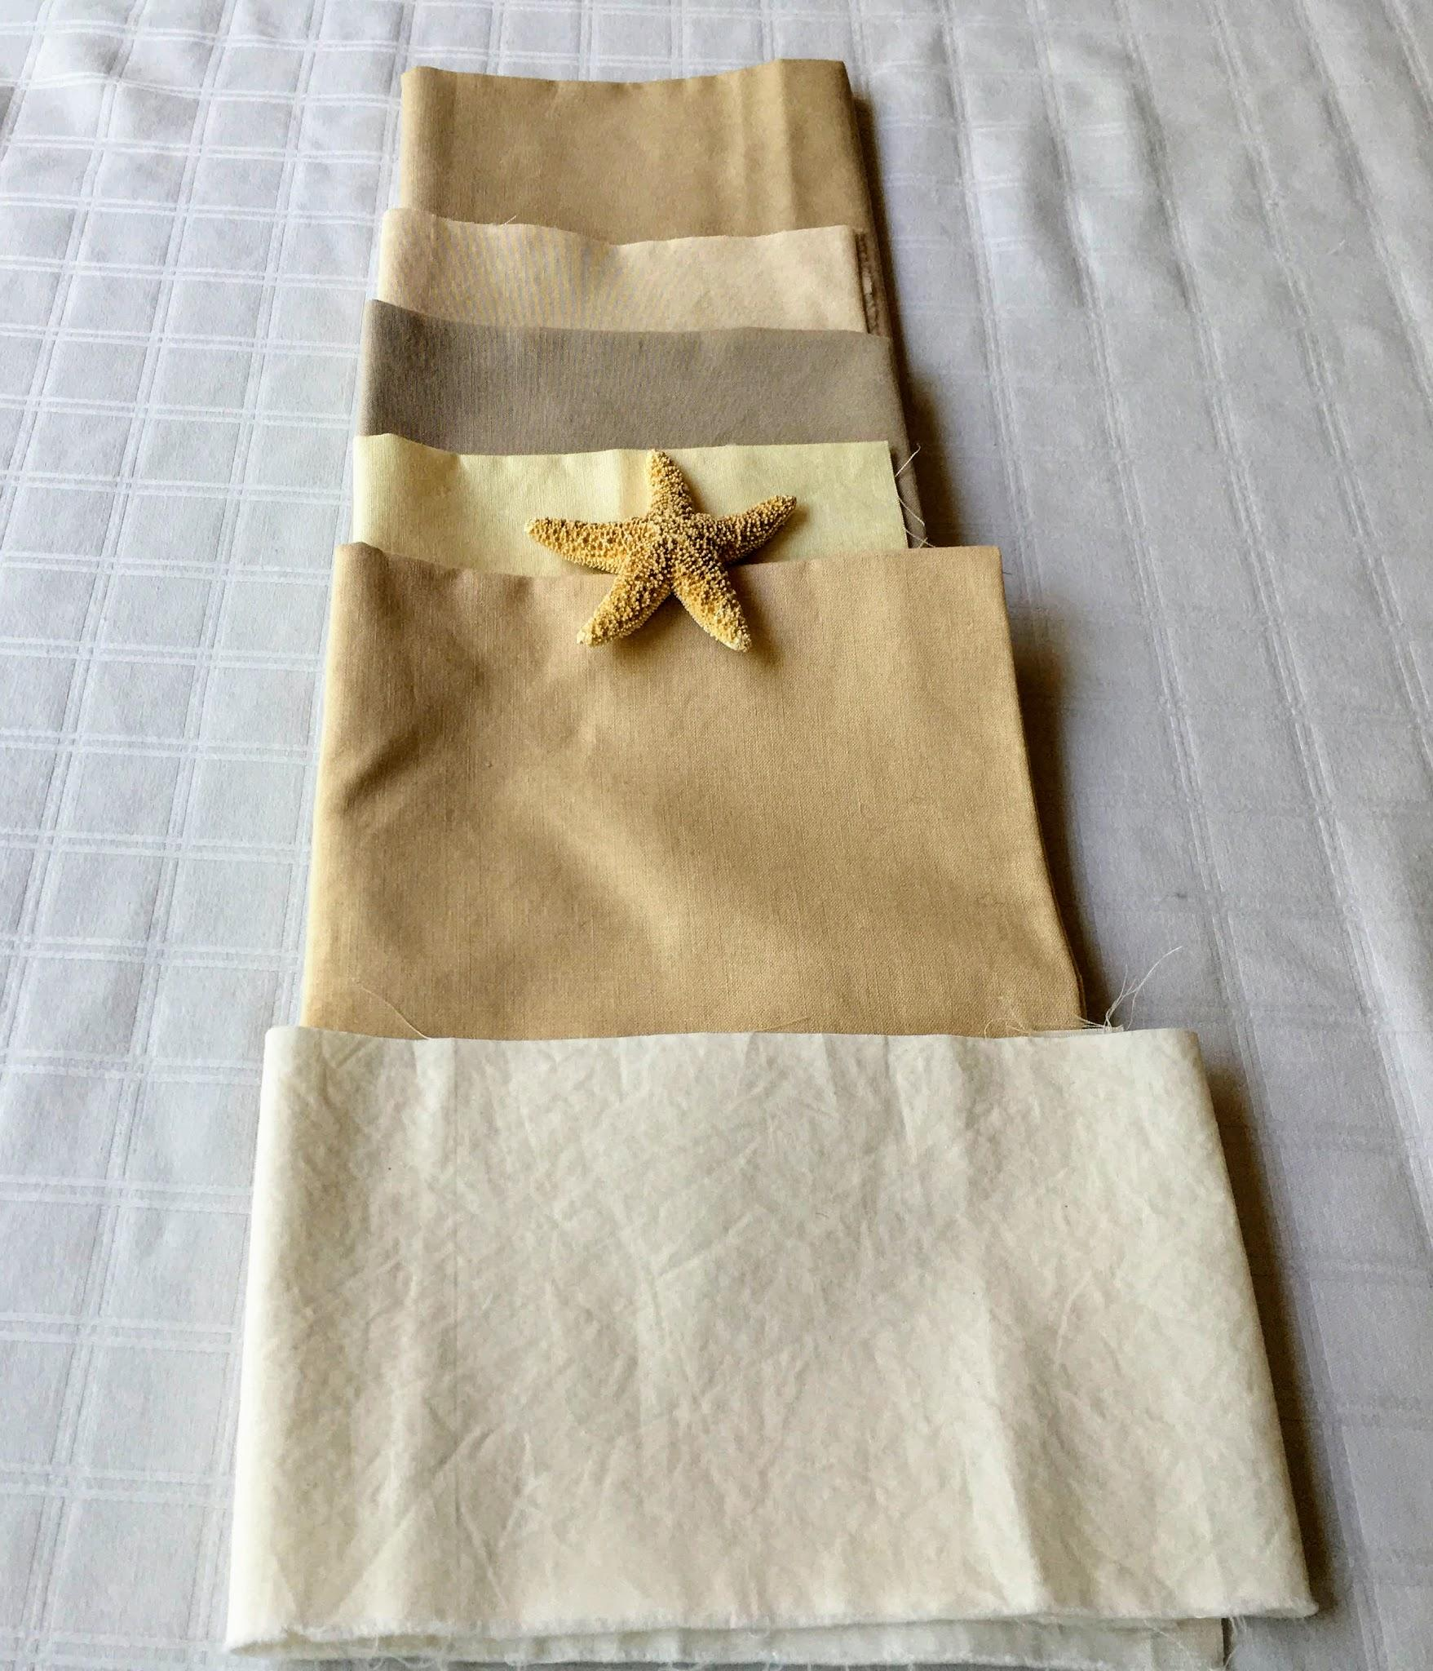
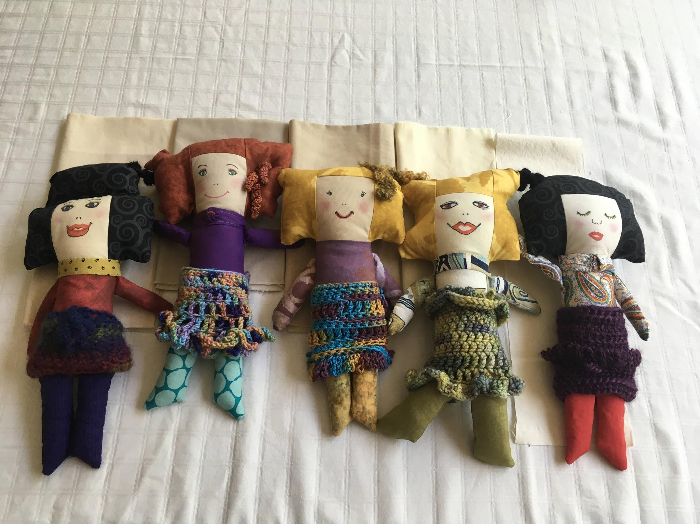
Kona cotton shades for face.
Hand stitch neck bands for dollies to hide any imperfections in stitching. Wrinkling at neck happens if under stuffed.

Slide 25
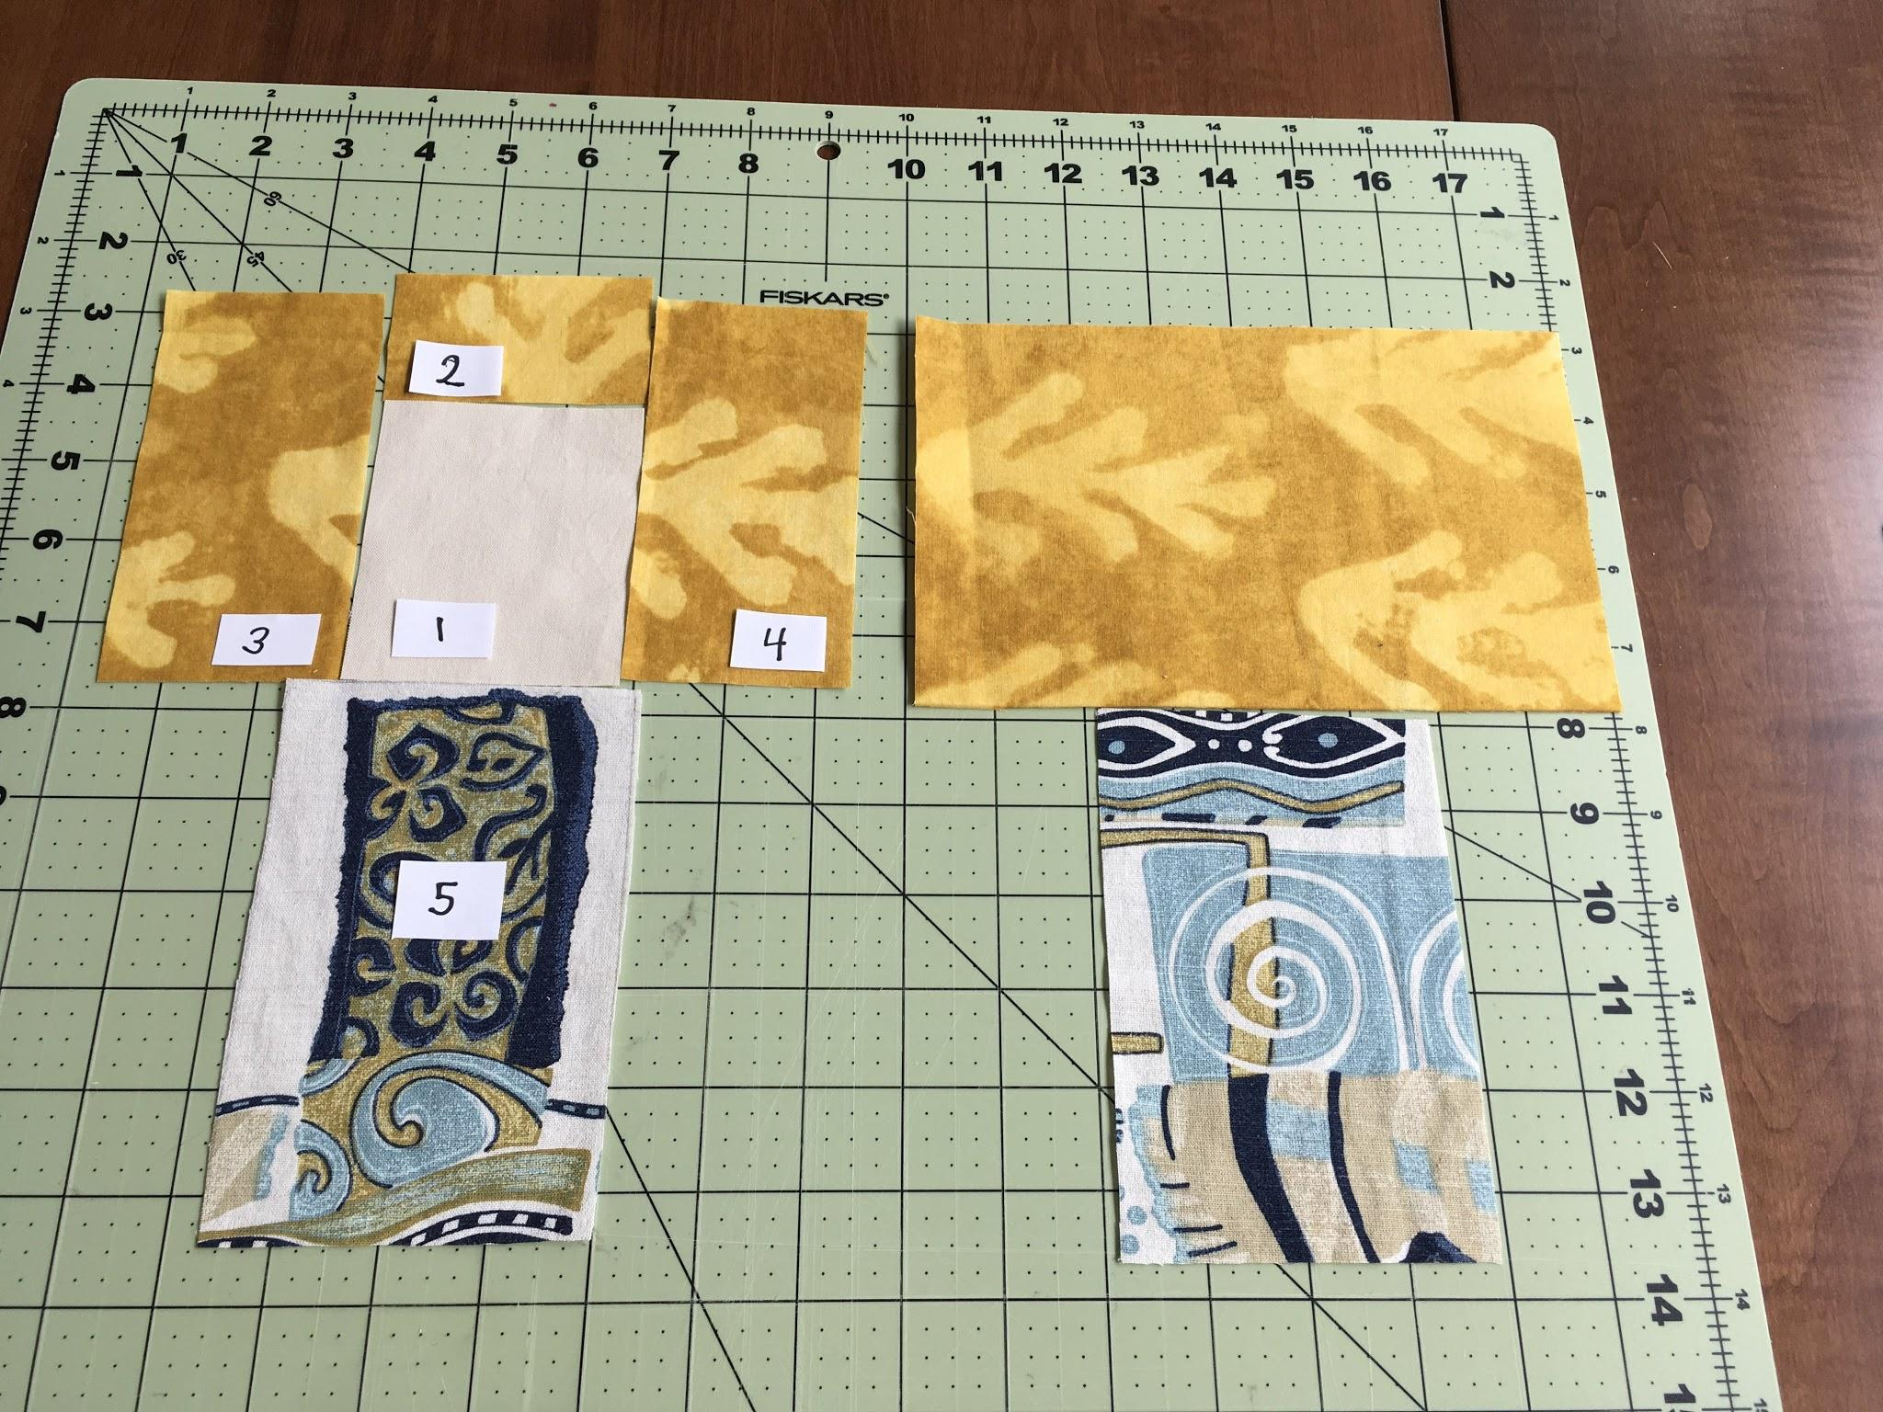
USE 1/4” seams, back stitch, right sides together, iron or finger press seams to dark side after joining each new piece.
Front
Back
FRONT BODY
Start with the face piece #1 oriented 3” horizontally and 3.5” vertically.
Attach top hair piece #2.
Attach sides 3 & 4.
* 👉Line up the side hair pieces #3 & #4 level to the bottom of the face #1. Leaving the top hair piece #2 ½” taller than the sides allows you to stuff and shape the final opening closed by hand stitching.
BACK BODY
Attach back of head to back body making sure to center pieces.

Slide 26
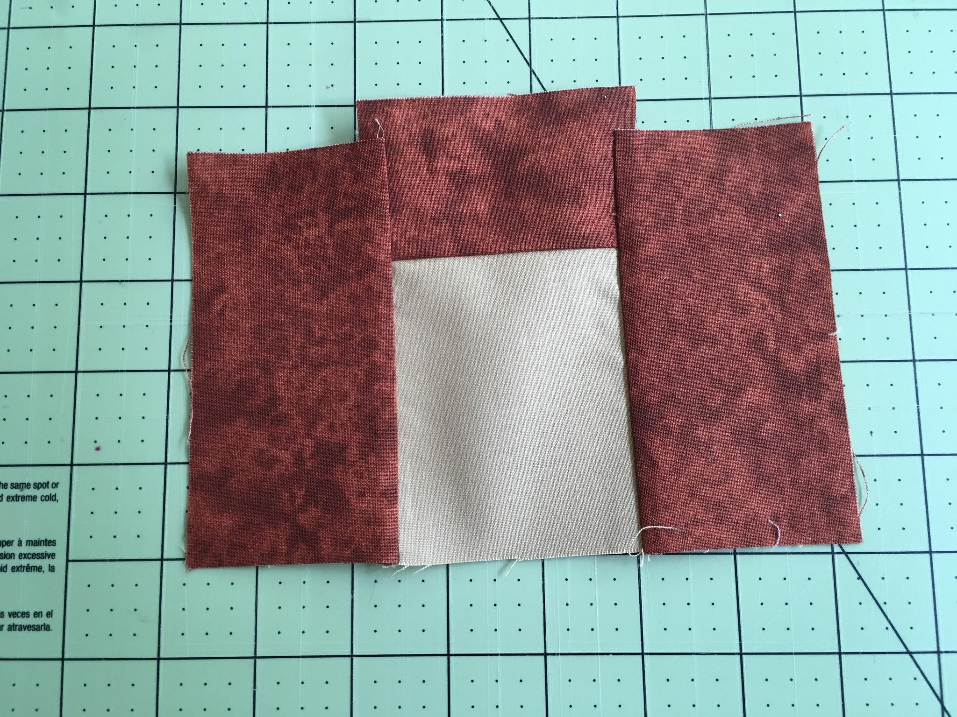
Important Tip notice the top piece is taller than the sides intentionally
Integrated face and hair by piecing fabric step-by-step
Close Up showing top hair piece is ½” taller than sides.
This makes it easier to stuff and shape the top of the head by hand sewing.

Slide 27
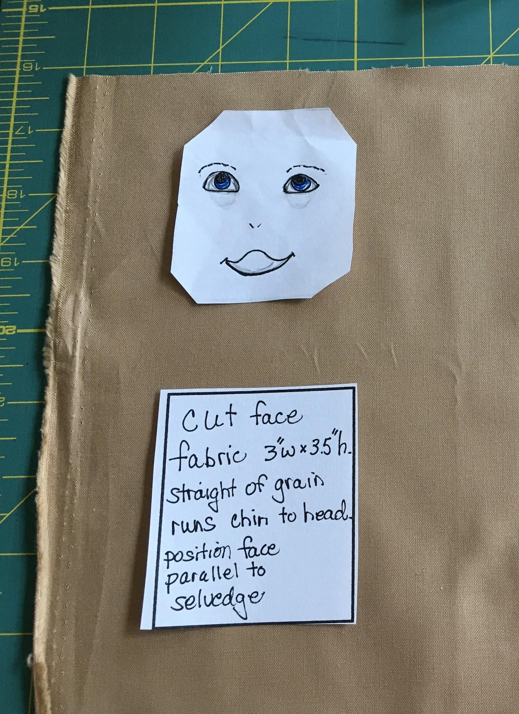
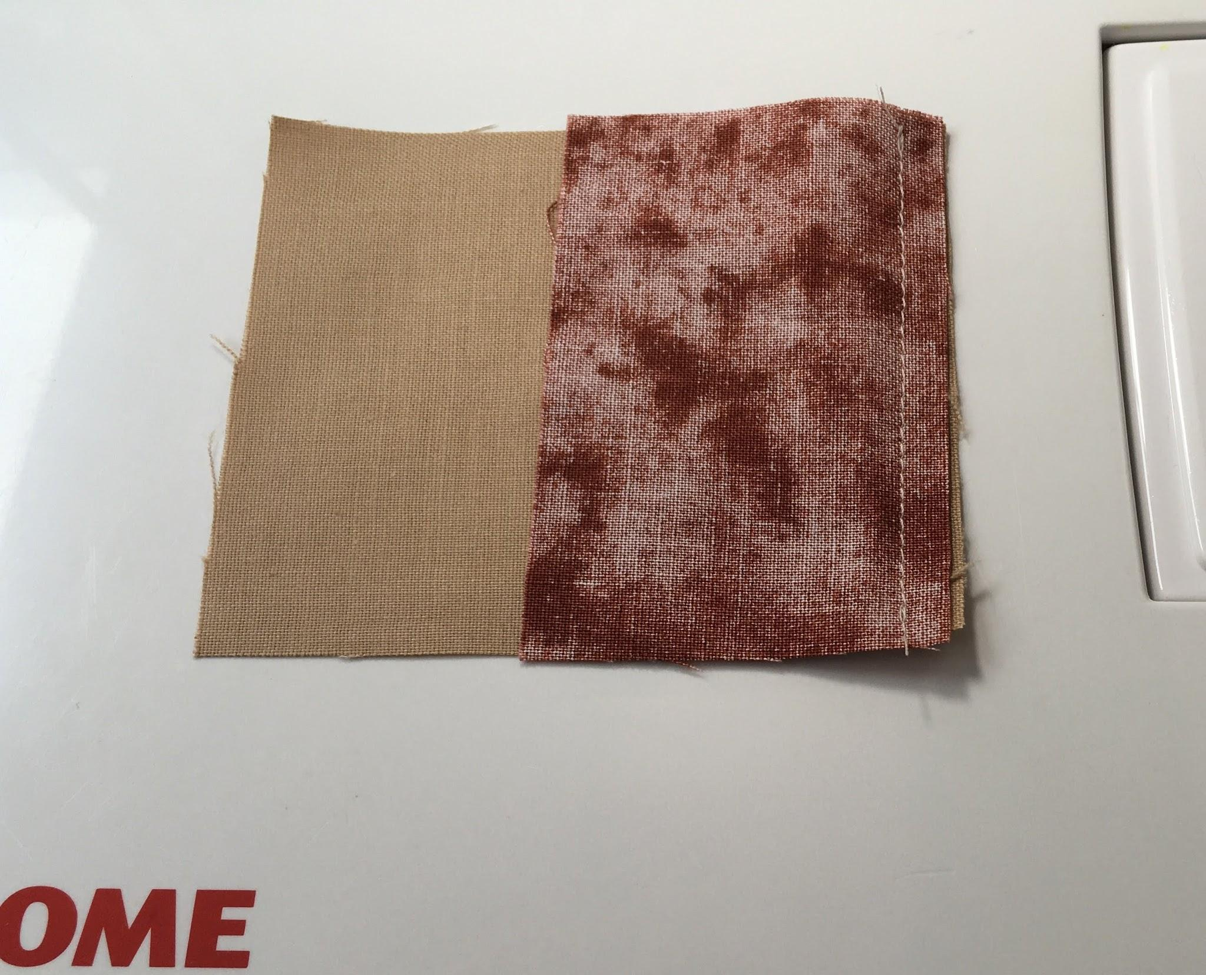
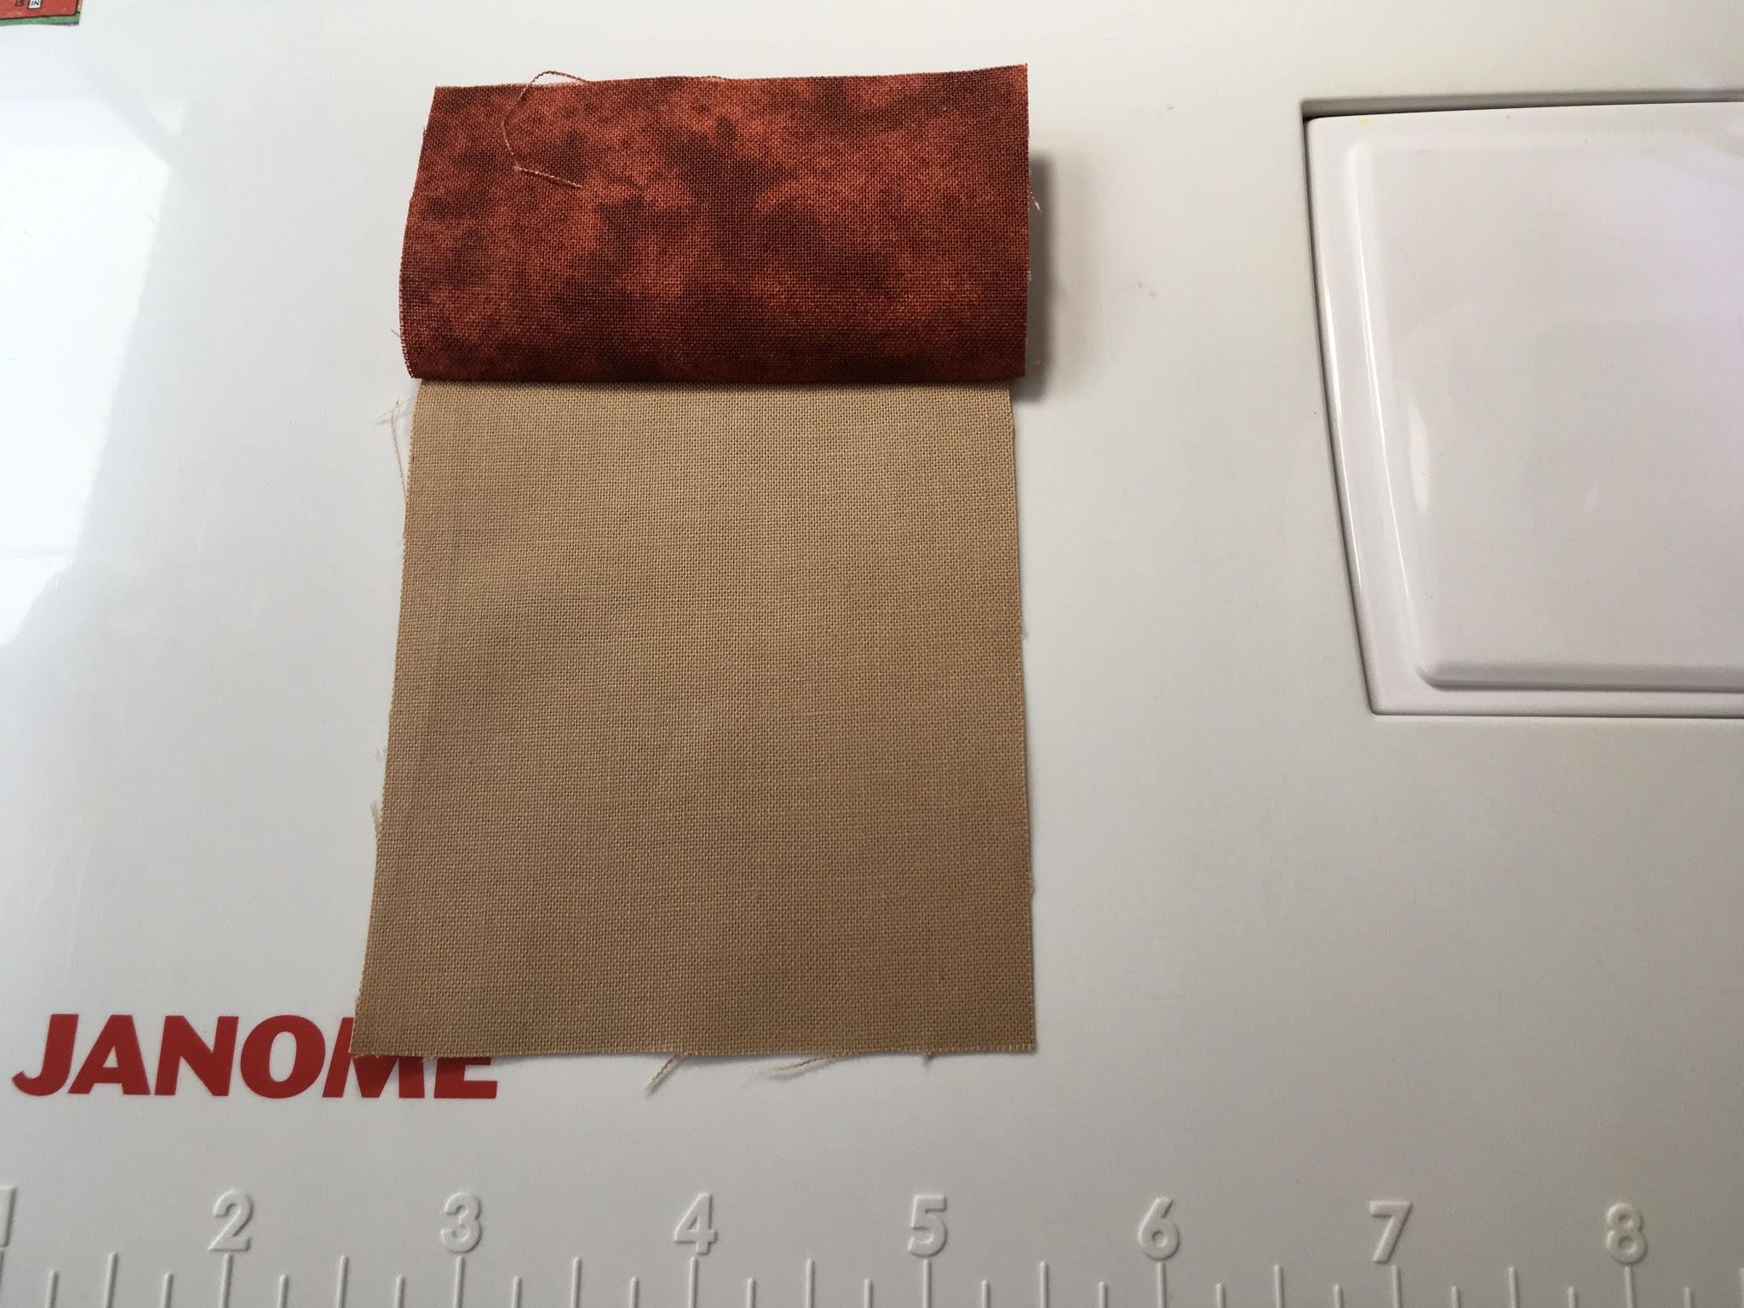
Important Tip
For the face fabric only have cross grain go side to side, straight of grain run vertically. Then the face shape turns out nice and plump.

Slide 28
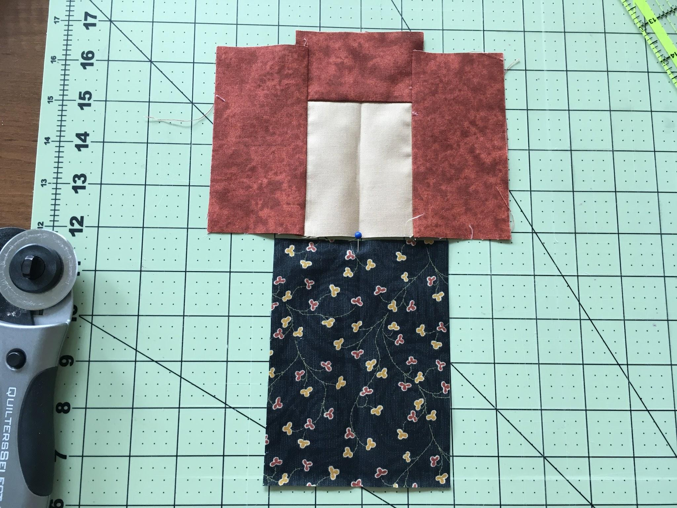
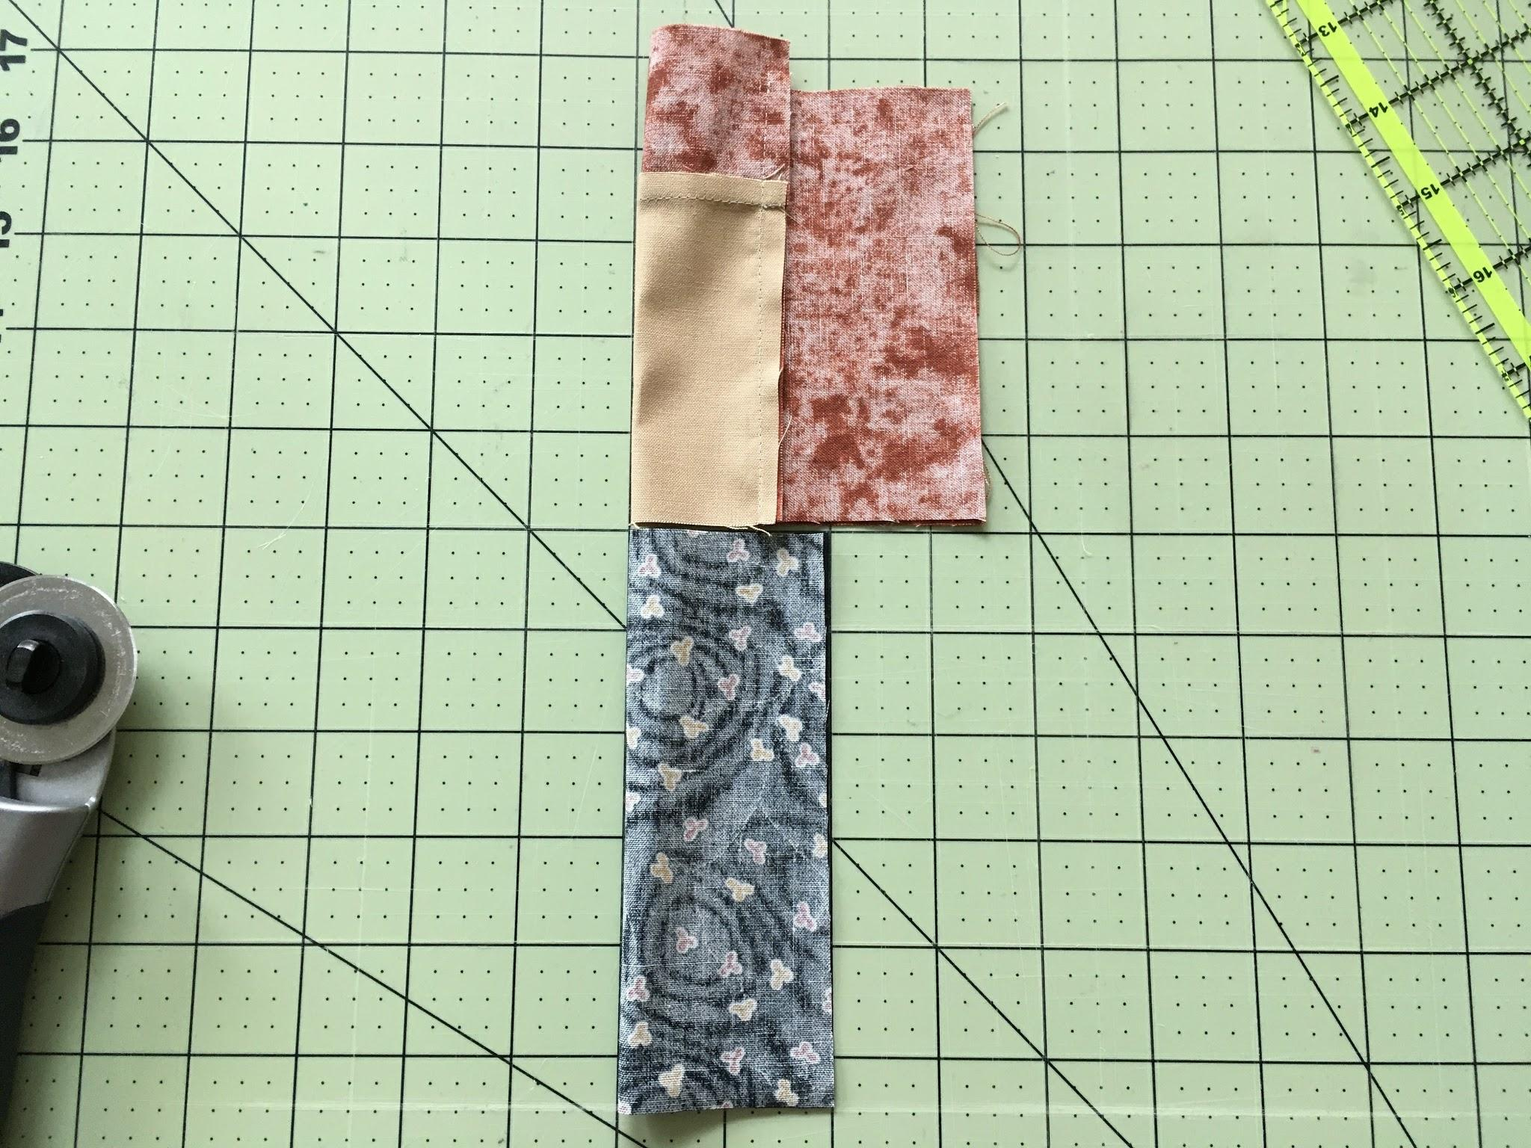
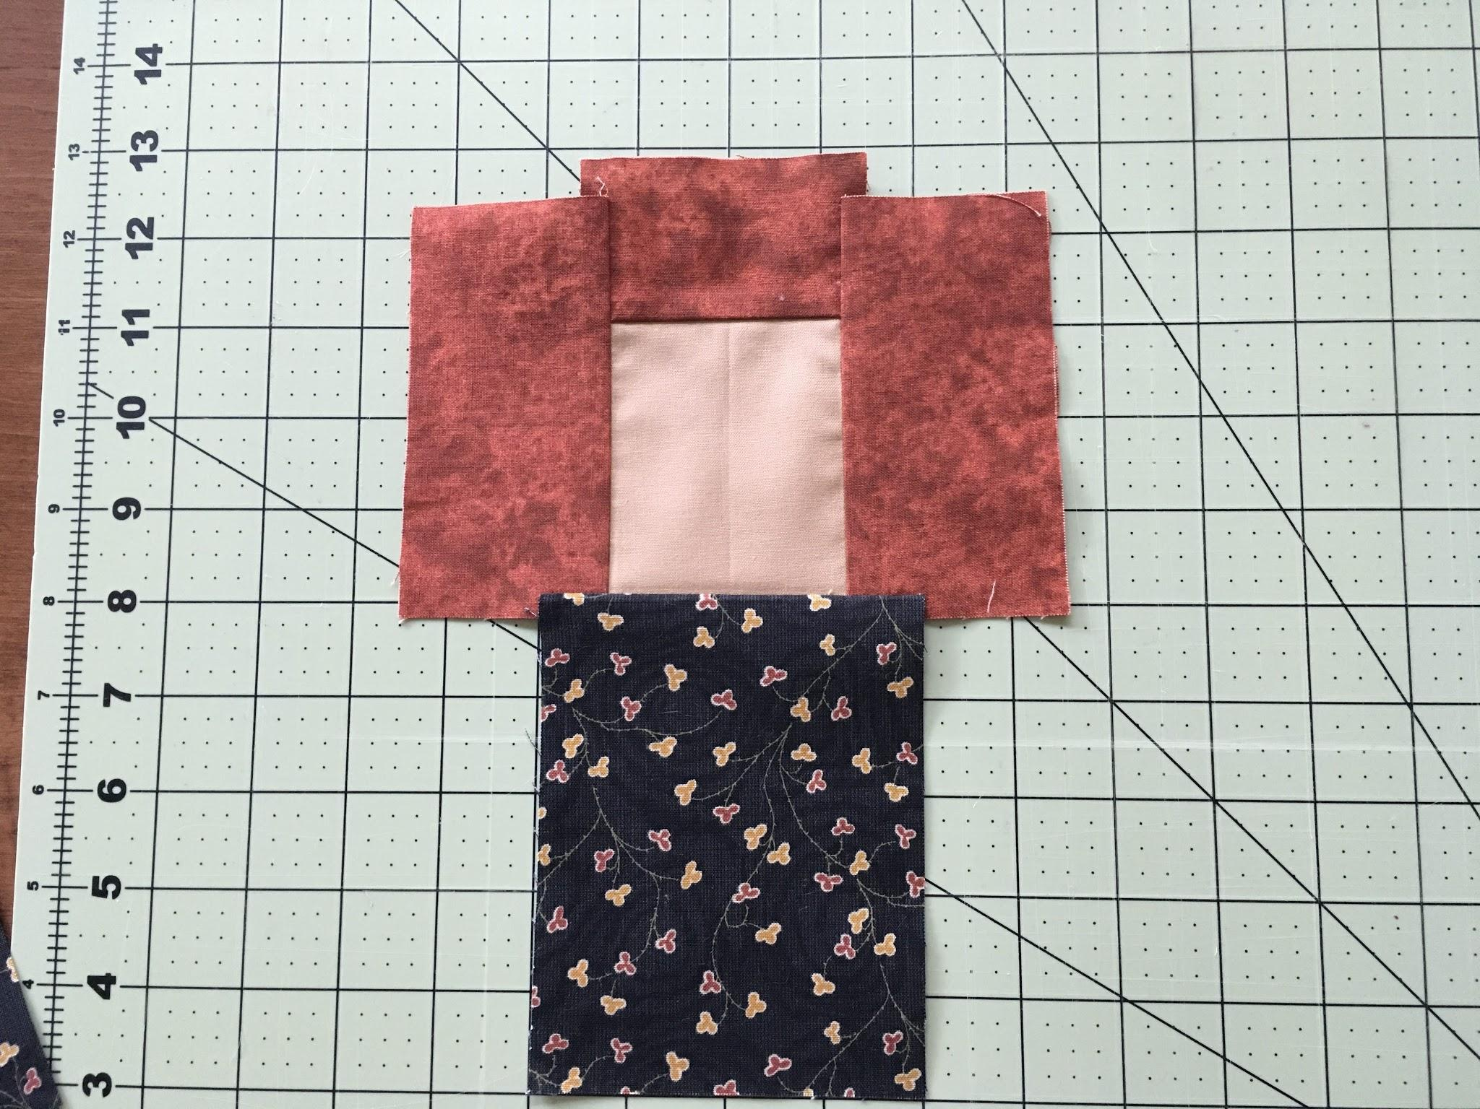
Find the middle of the head and body pieces.
Crease both pieces. Line up creases and sew right sides together.

Slide 29
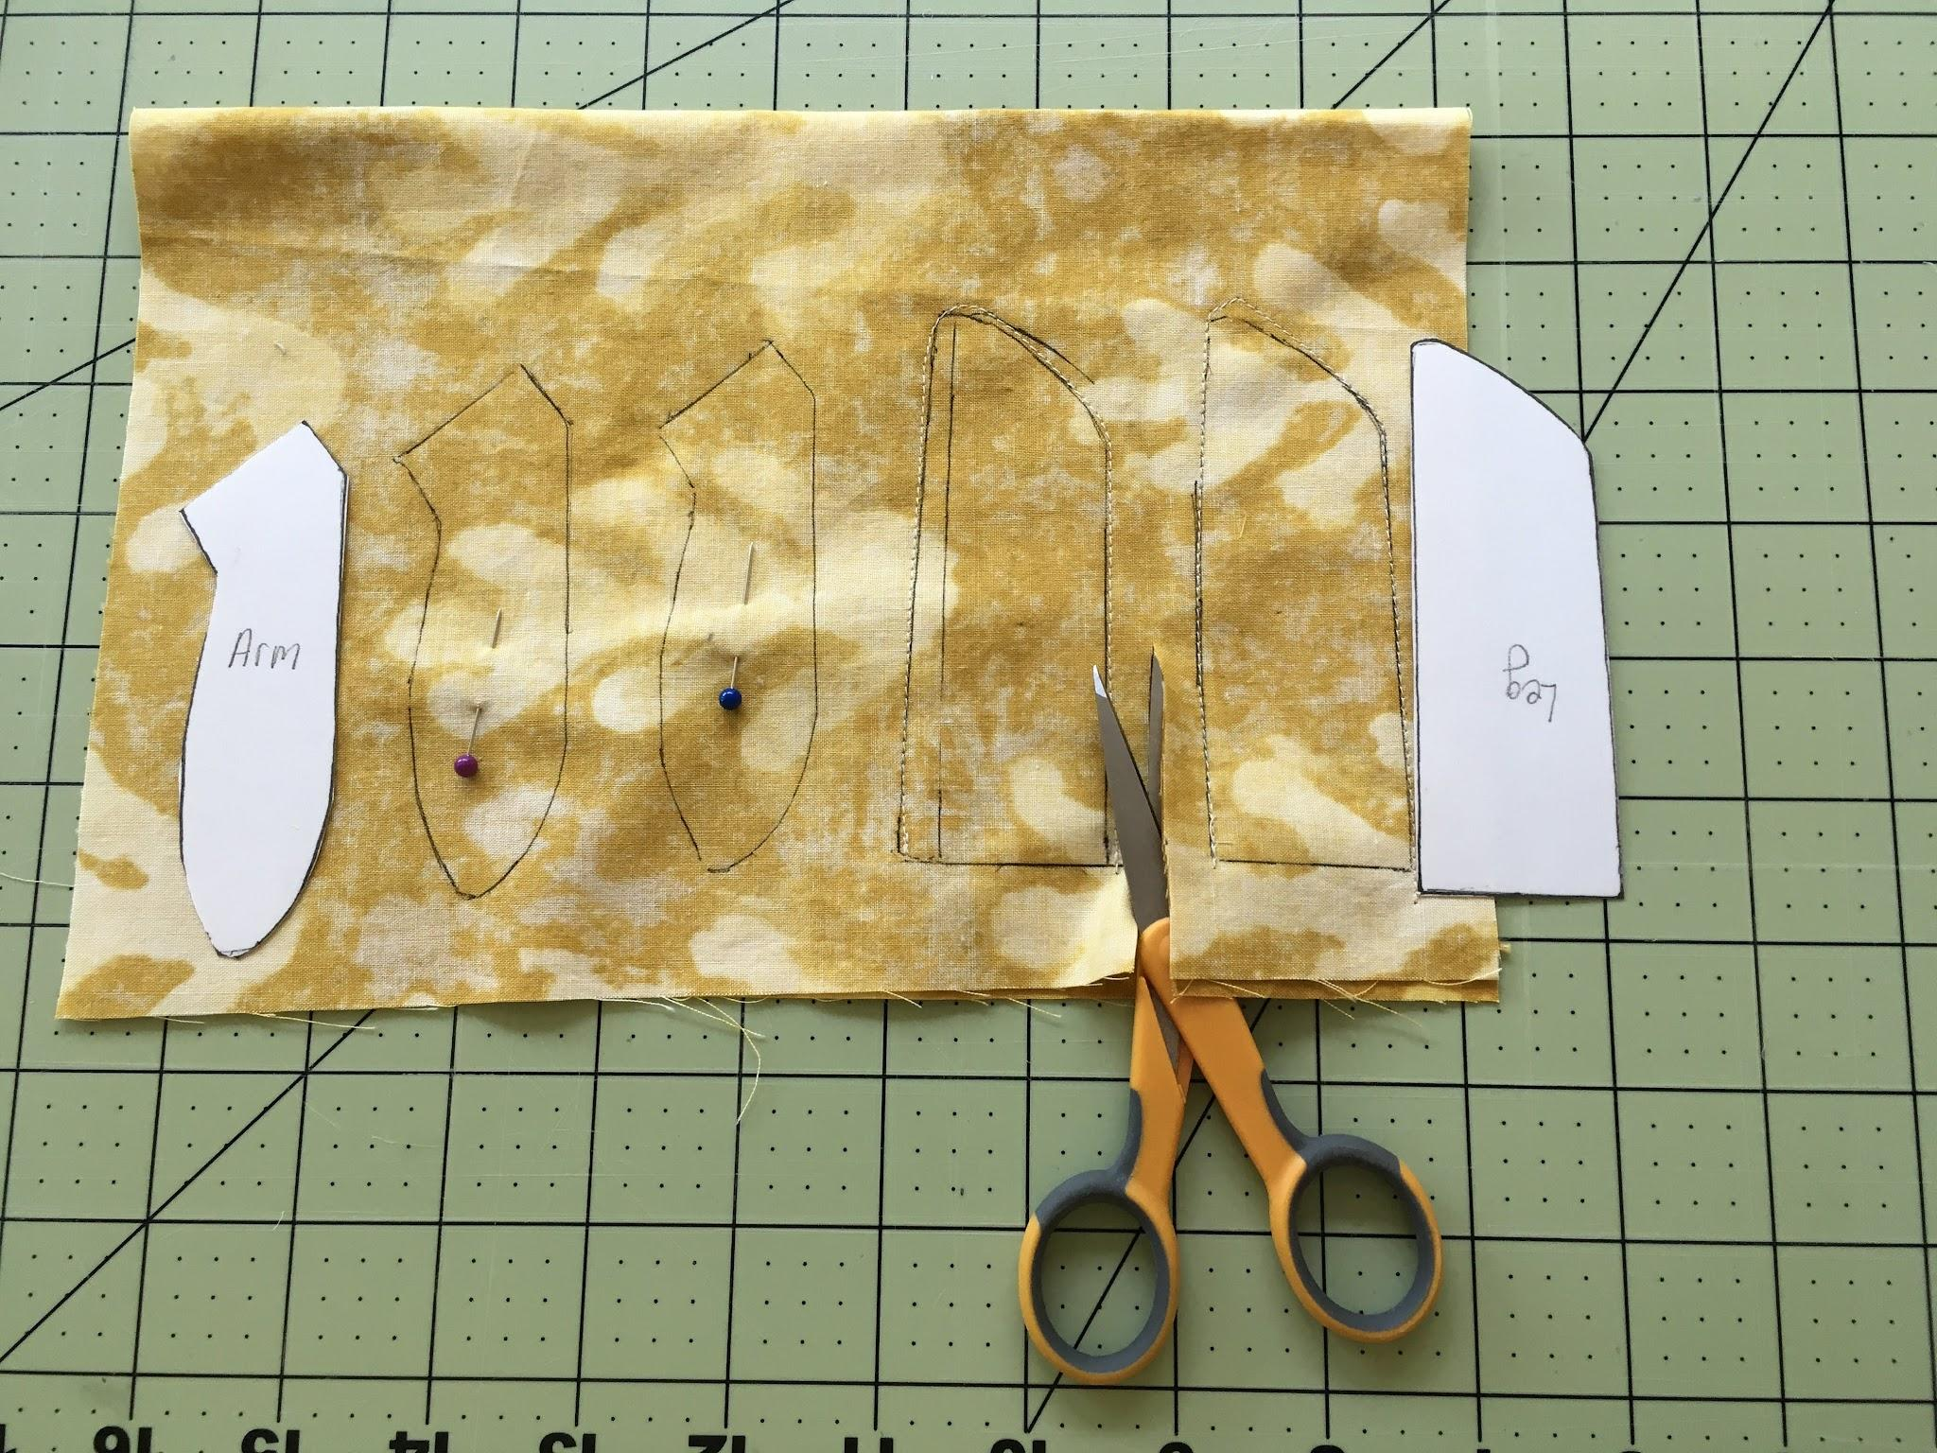
Fold fabric in half right sides together. Trace around each template with a pencil or pen. Stitch on the lines.
Correct Technique
I left enough space between the template pieces to be able to cut the fabric leaving the necessary ¼” seams.

Slide 30
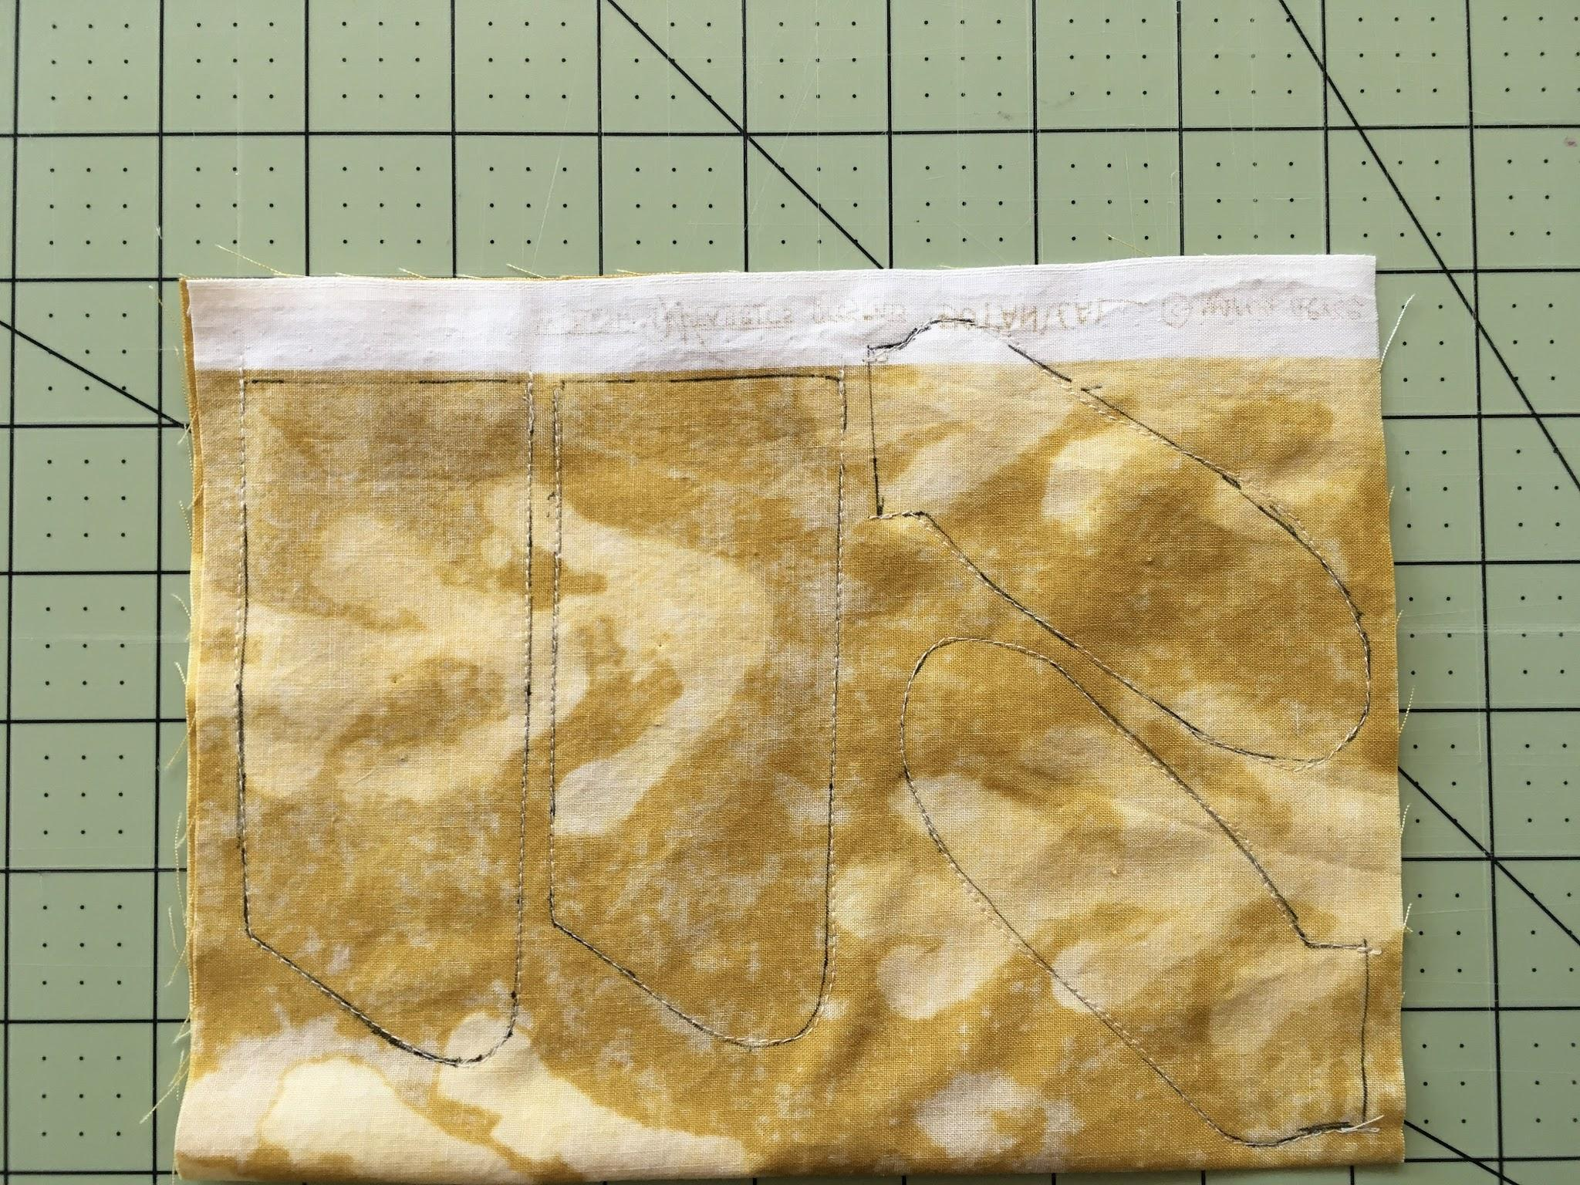
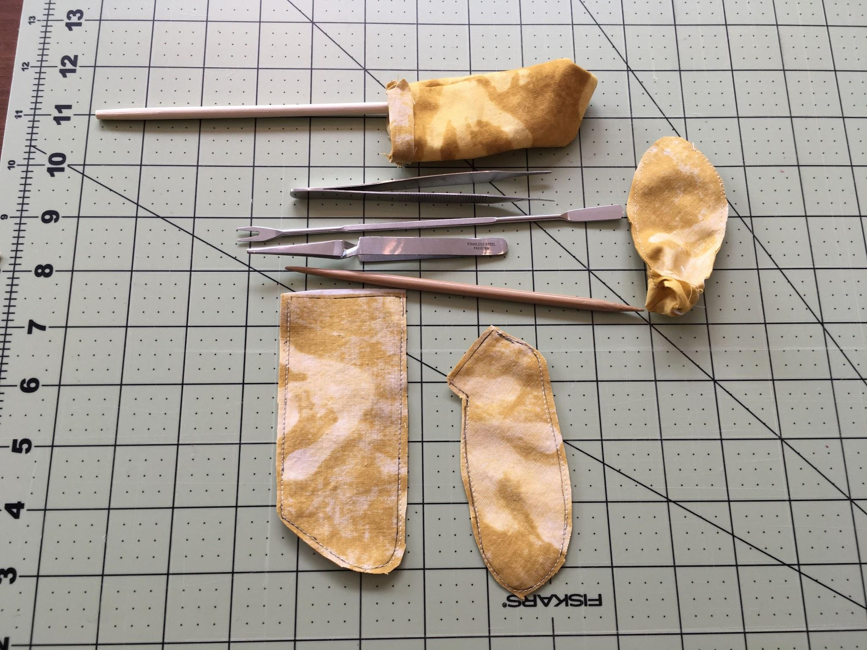
*I placed the pieces TOO close together. After I stitched and cut them apart, I had less than a ¼”“ seam allowance. My seams popped open when I turned them right side out and when I stuffed them. 😞
Big Construction Mistake

Slide 31
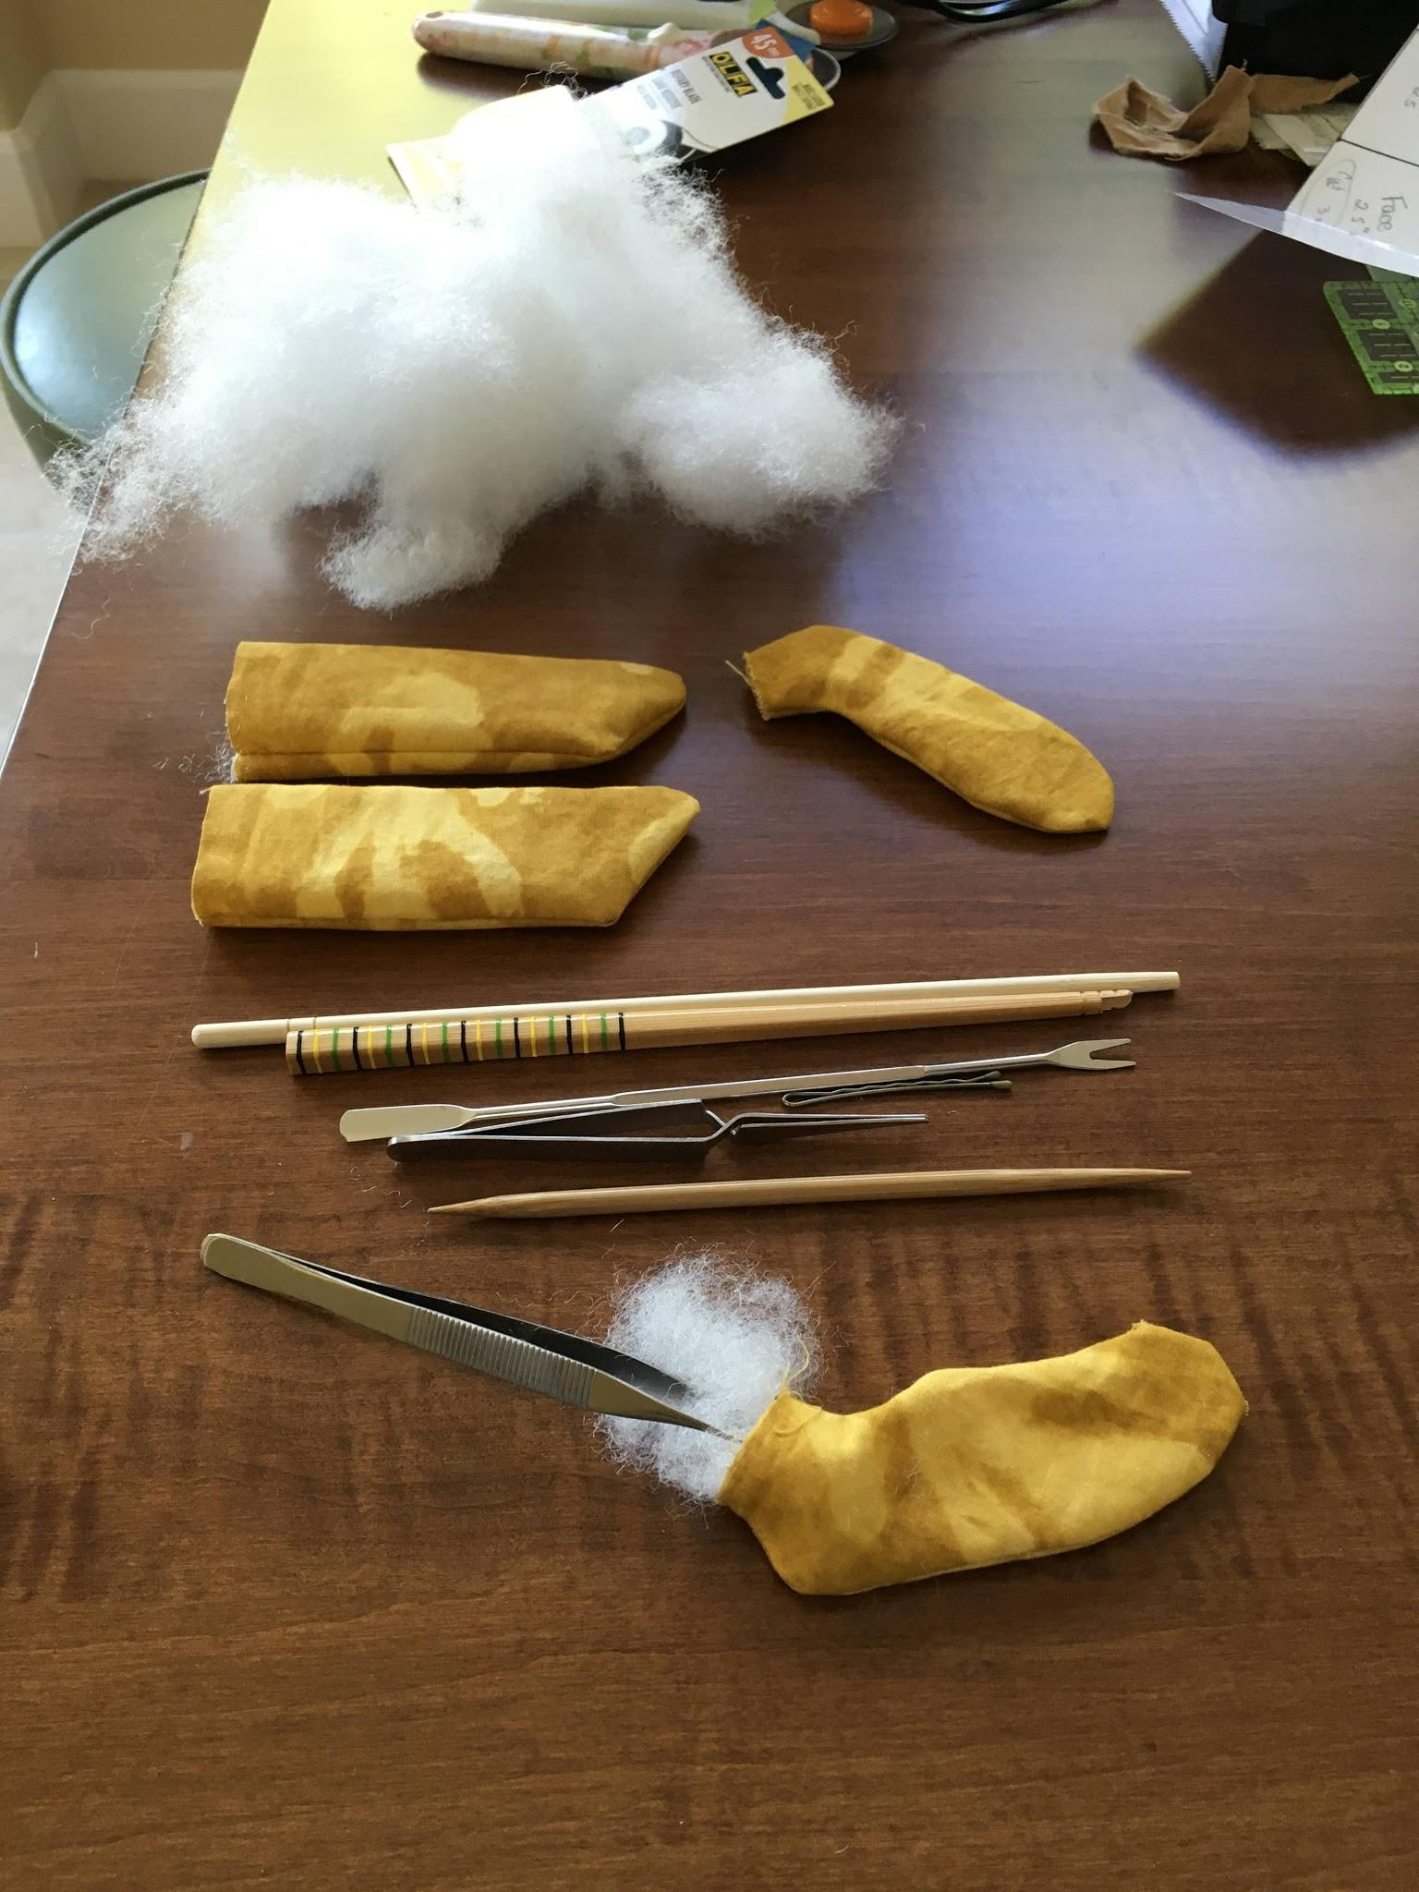
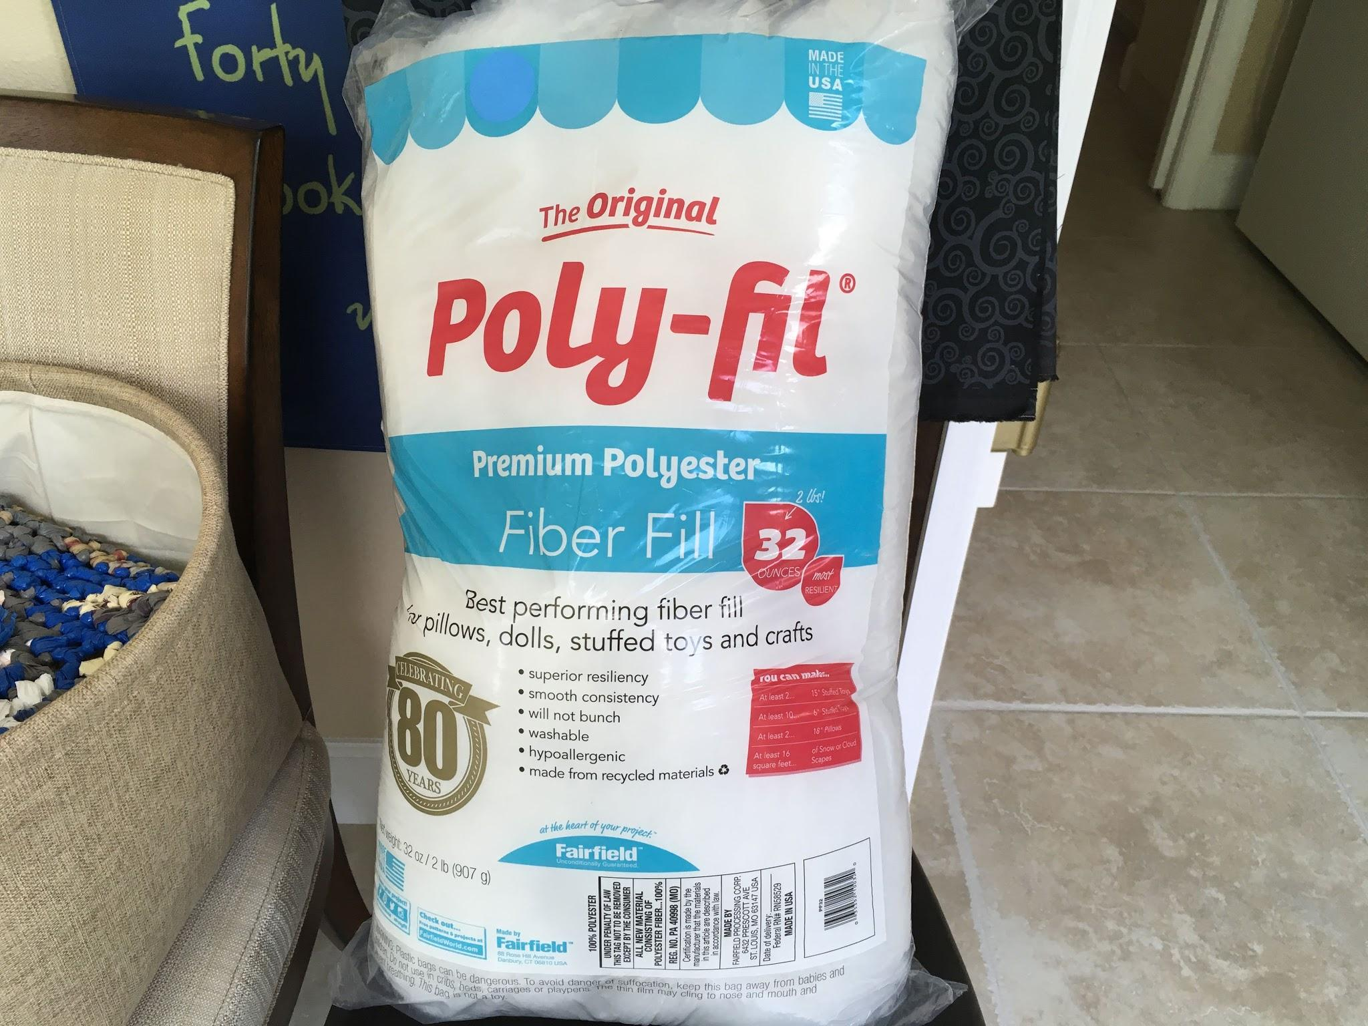
Stuff the limbs. Leave enough space at the top of the arms & legs ¼-½”. Then stitch them closed. No need to backstitch here. Sewing the limbs closed before attaching to the body helps to control the stuffing from migrating out as you stitch at the machine. It also keeps the limbs from shifting around as you sew.
Stuffing is an art! It requires lots of experience to get it smooth, not lumpy and sufficiently dense so no wrinkles at the neck or empty spaces at the tips of limbs.
Results may vary with your mood, like with knitting.

Slide 32
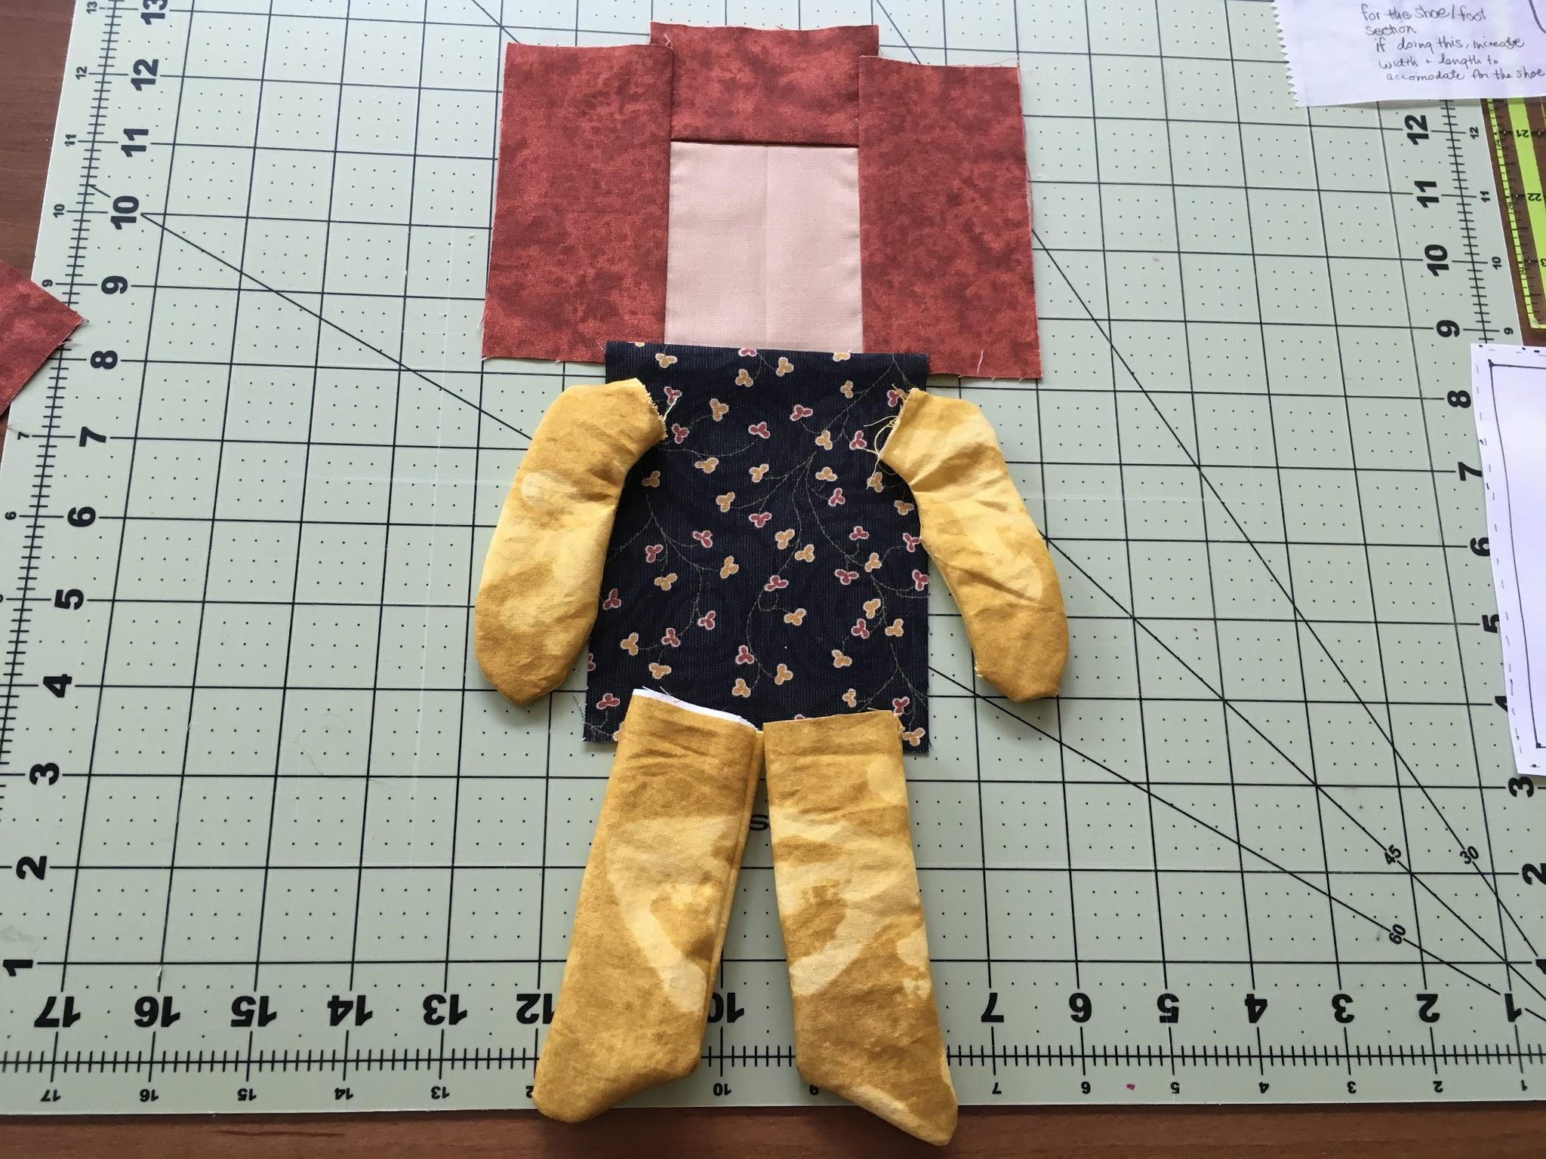
Think about the position and directionality of the appendages before sewing to the body. Do you want the toes turning inward or outward? Do you want arms facing down, up or 1 up 1 down? Make those decisions in your mind.
Now it is time to attach the limbs…..

Slide 33
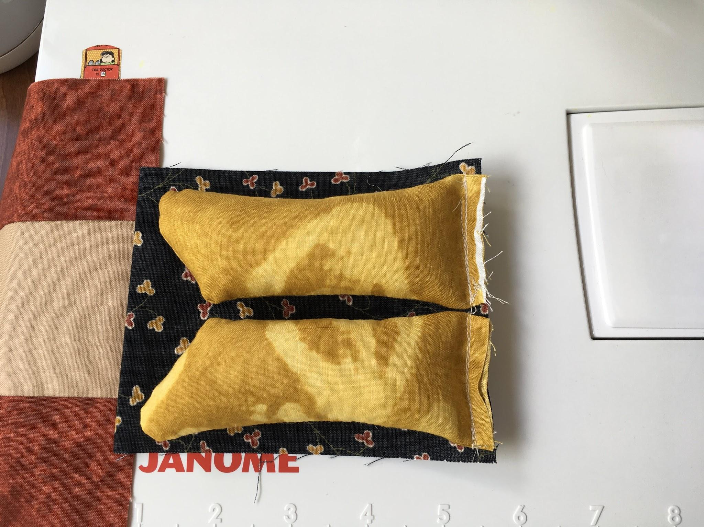
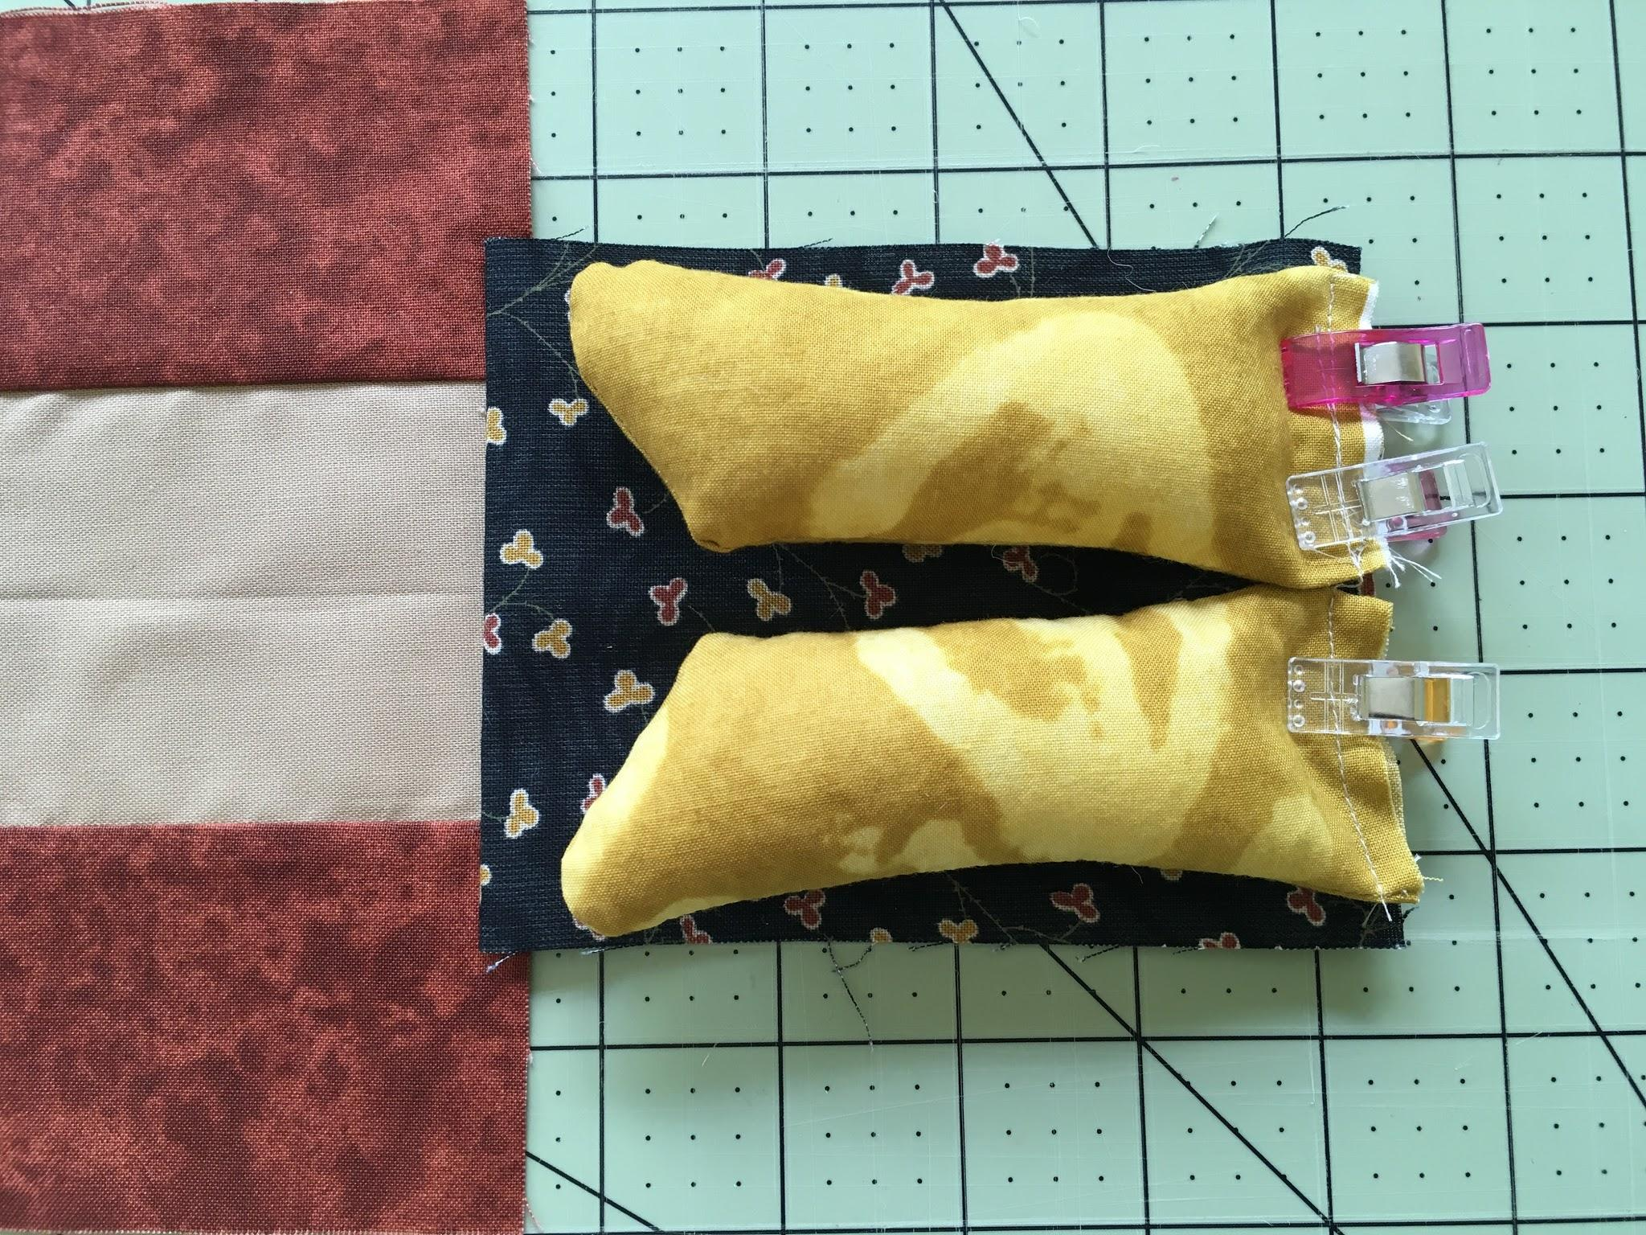
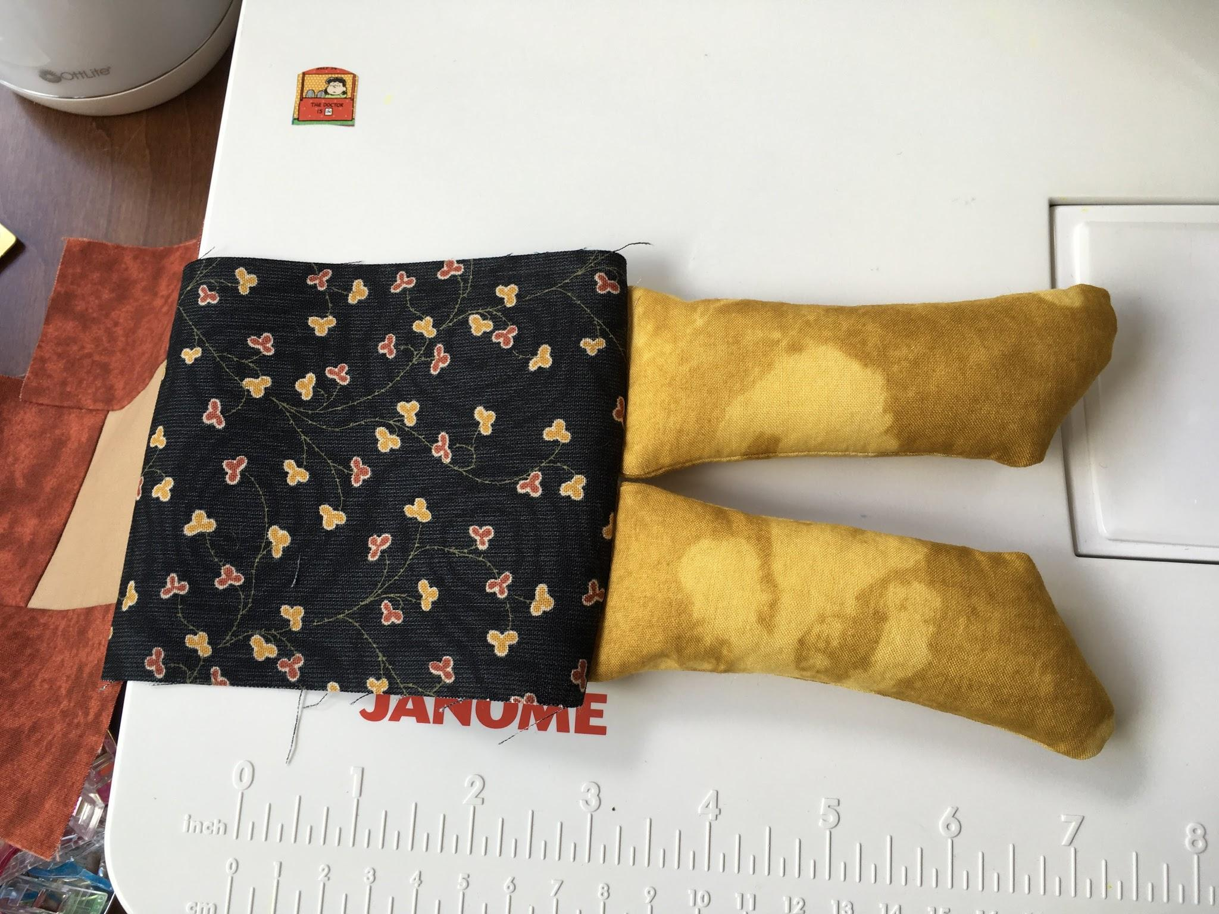
Position limbs laying on top of body. Keep limbs ¼-½” away from sides.
Stuff the limbs. Leave enough space at the top to stitch the limbs closed before attaching to the body. This will make it easier to keep the limbs in the position you want.

Slide 34
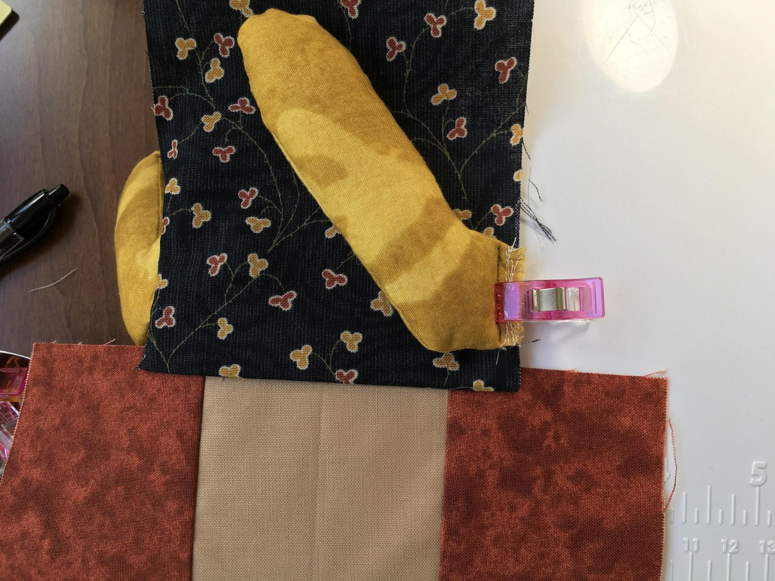
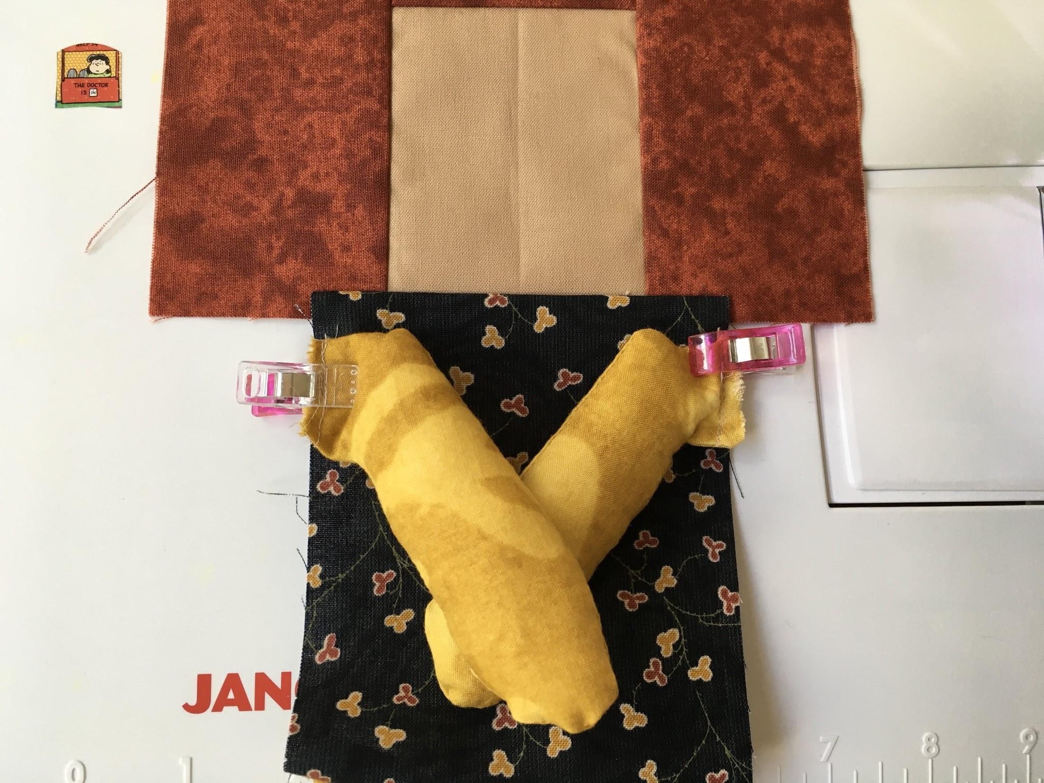
Arms are pre-stitched and positioned on top of body for attaching to body. Back stitch. Make sure arms are ½” away from top of body fabric.

Slide 35
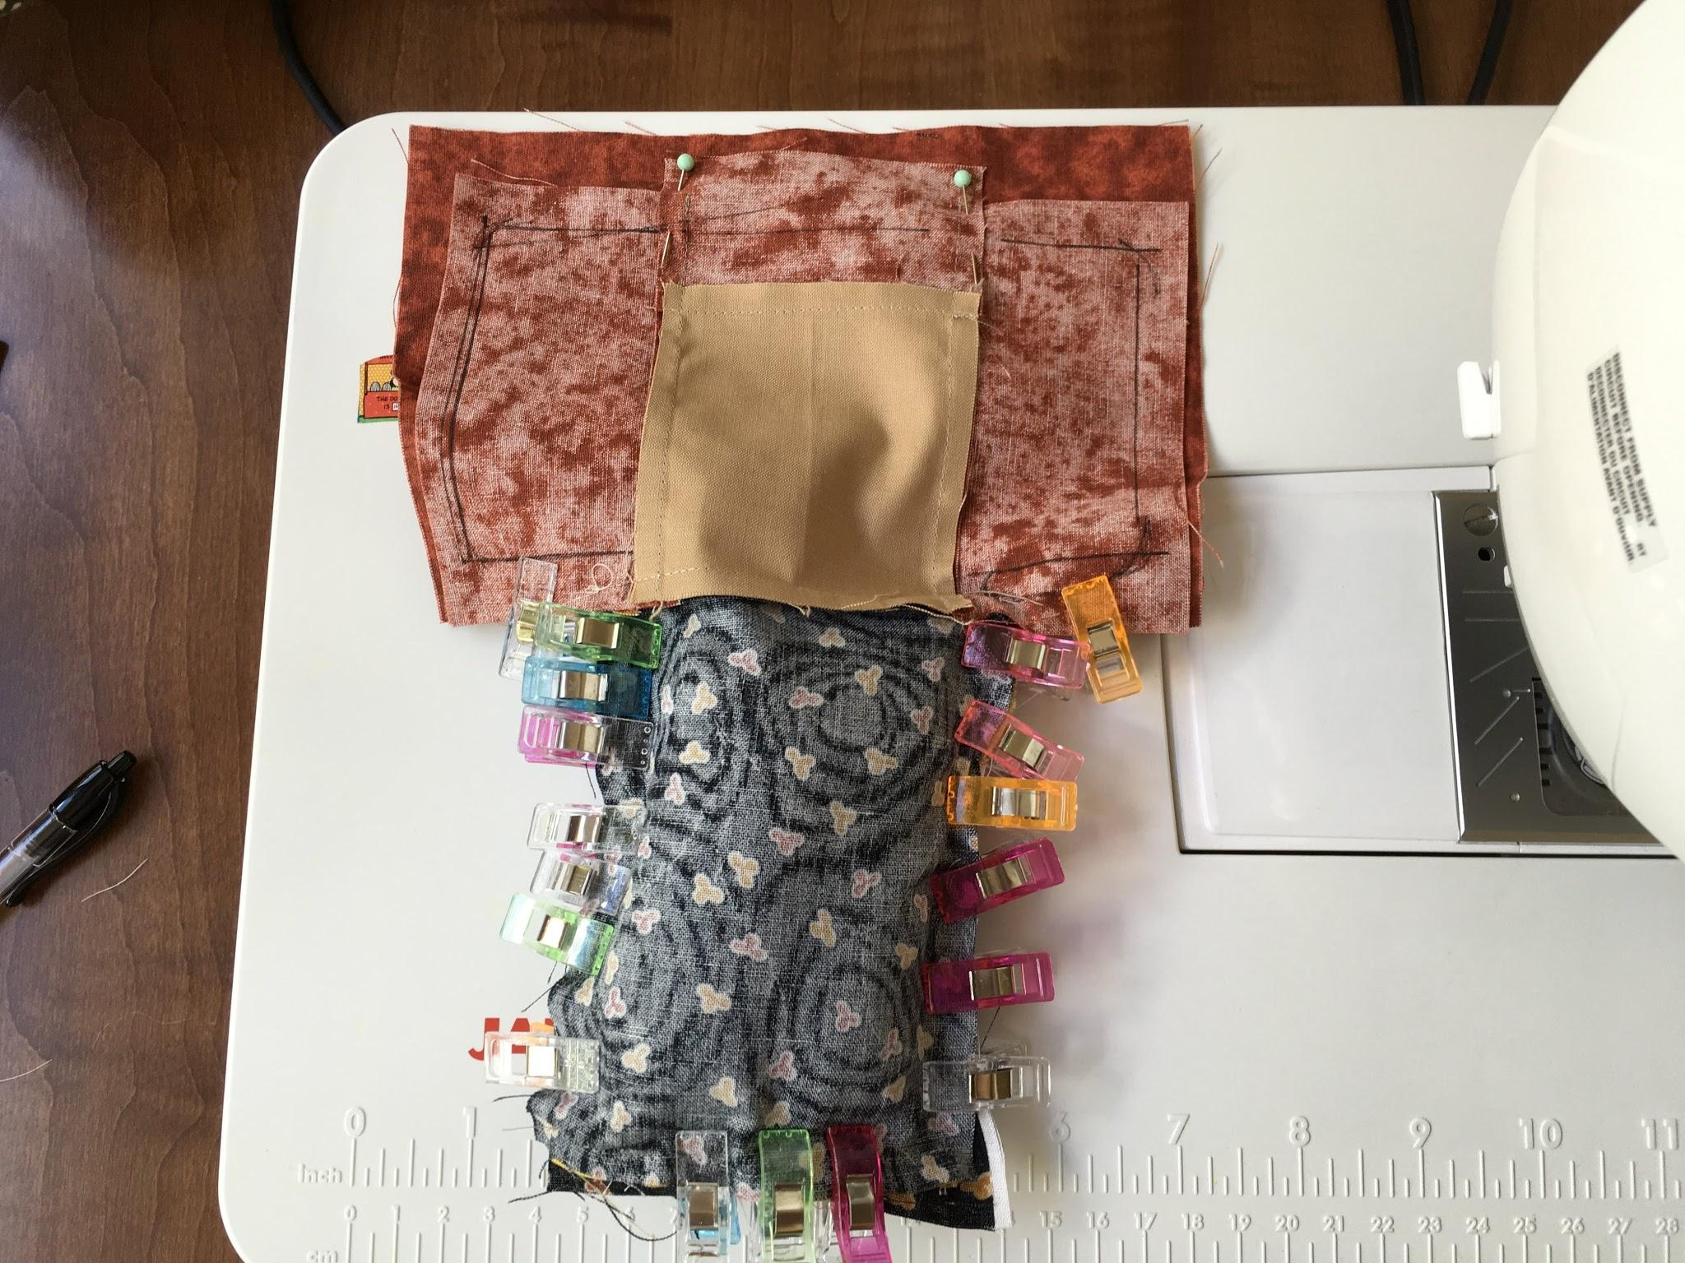
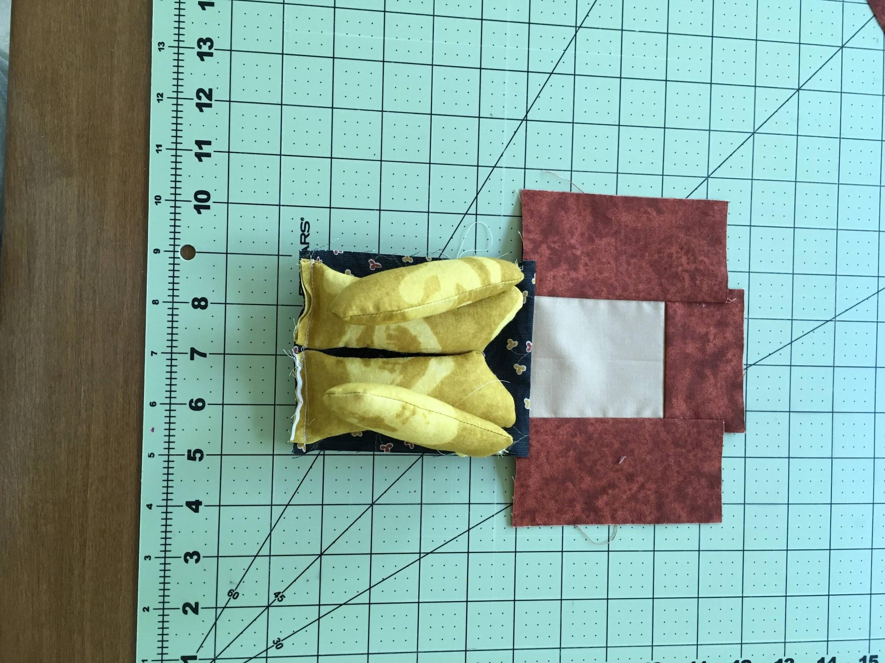
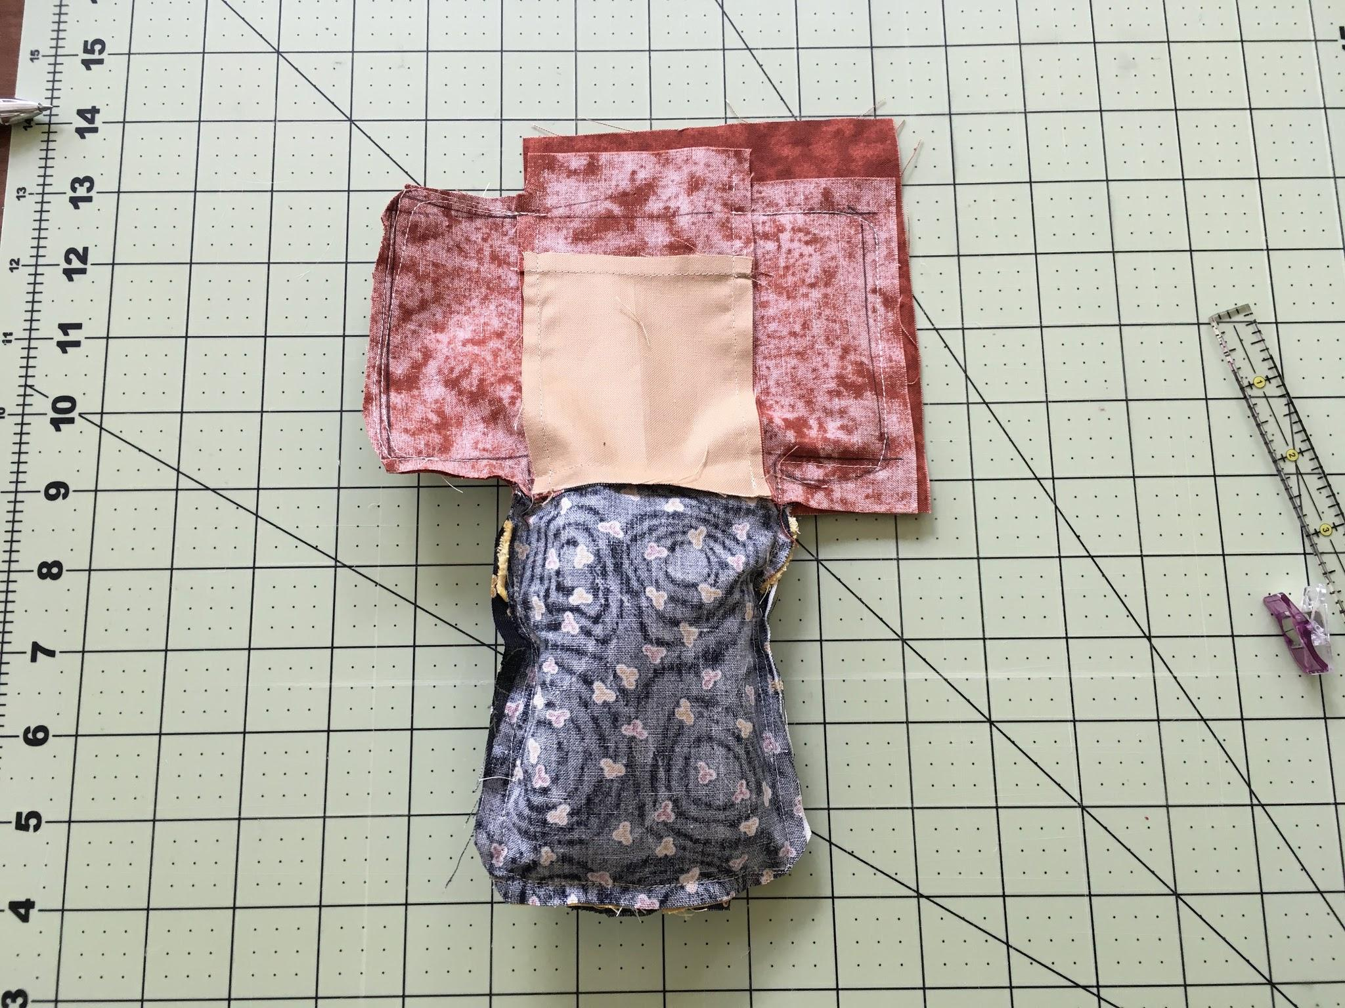
Making the Cocoon
Tuck limbs on top of body. Put back body piece face down on top. Line up along all edges. Use LOTS of clips, Push down on the puffy limbs to compress as necessary. Adjust often it will eventually come together. You need to have a ¼-⅜” seam allowance. Be aware no limb gets stitched by mistake. As you stitch around the limbs, make sure you keep the line of stitches on each arm and leg within the seam allowance.

Slide 36
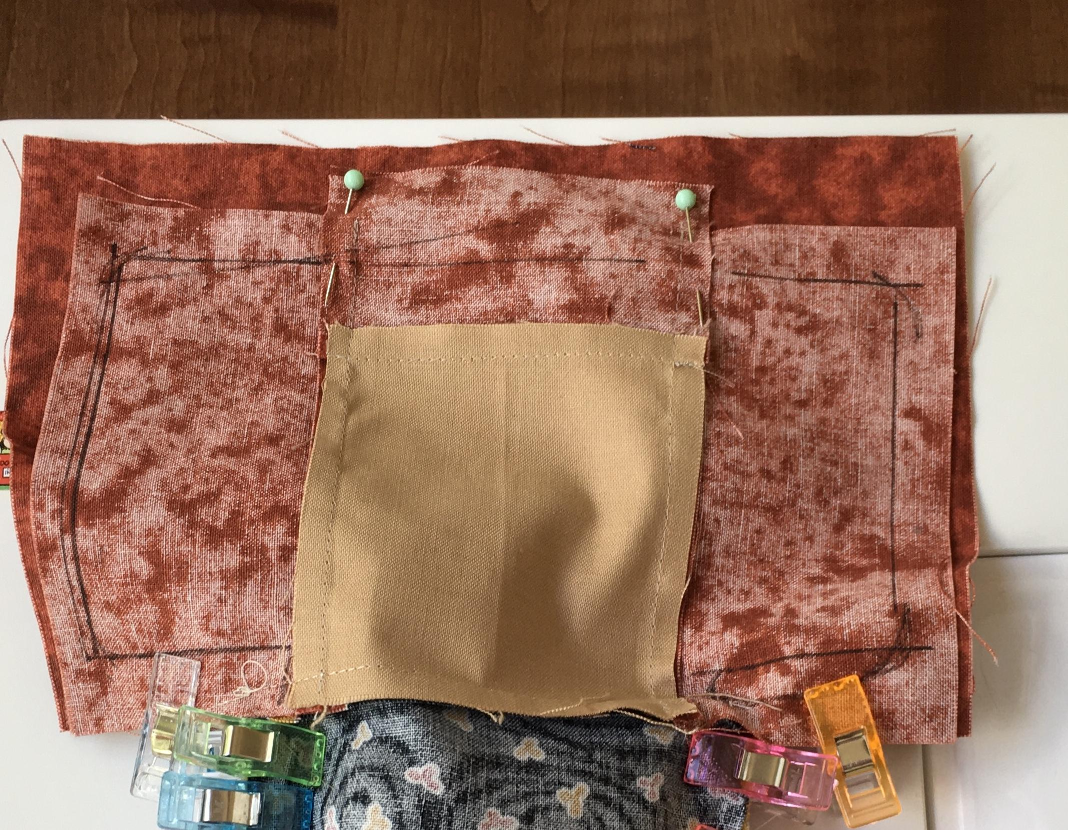
Mark the linear hair shape with a pen or pencil. I used a ruler to roughly measure for a balanced amount on each side. Alternatively you may use the template provided for a more rounded curve to the top of the head.
Leave an opening the width of the face to stuff. Mark with pins.Start sewing from the pin on the right all the way around to the other pin.
Be sure to back stitch at the beginning and end.

Slide 37
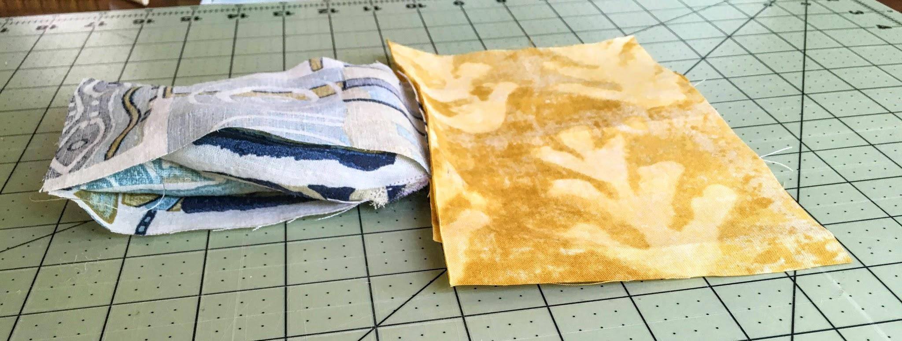
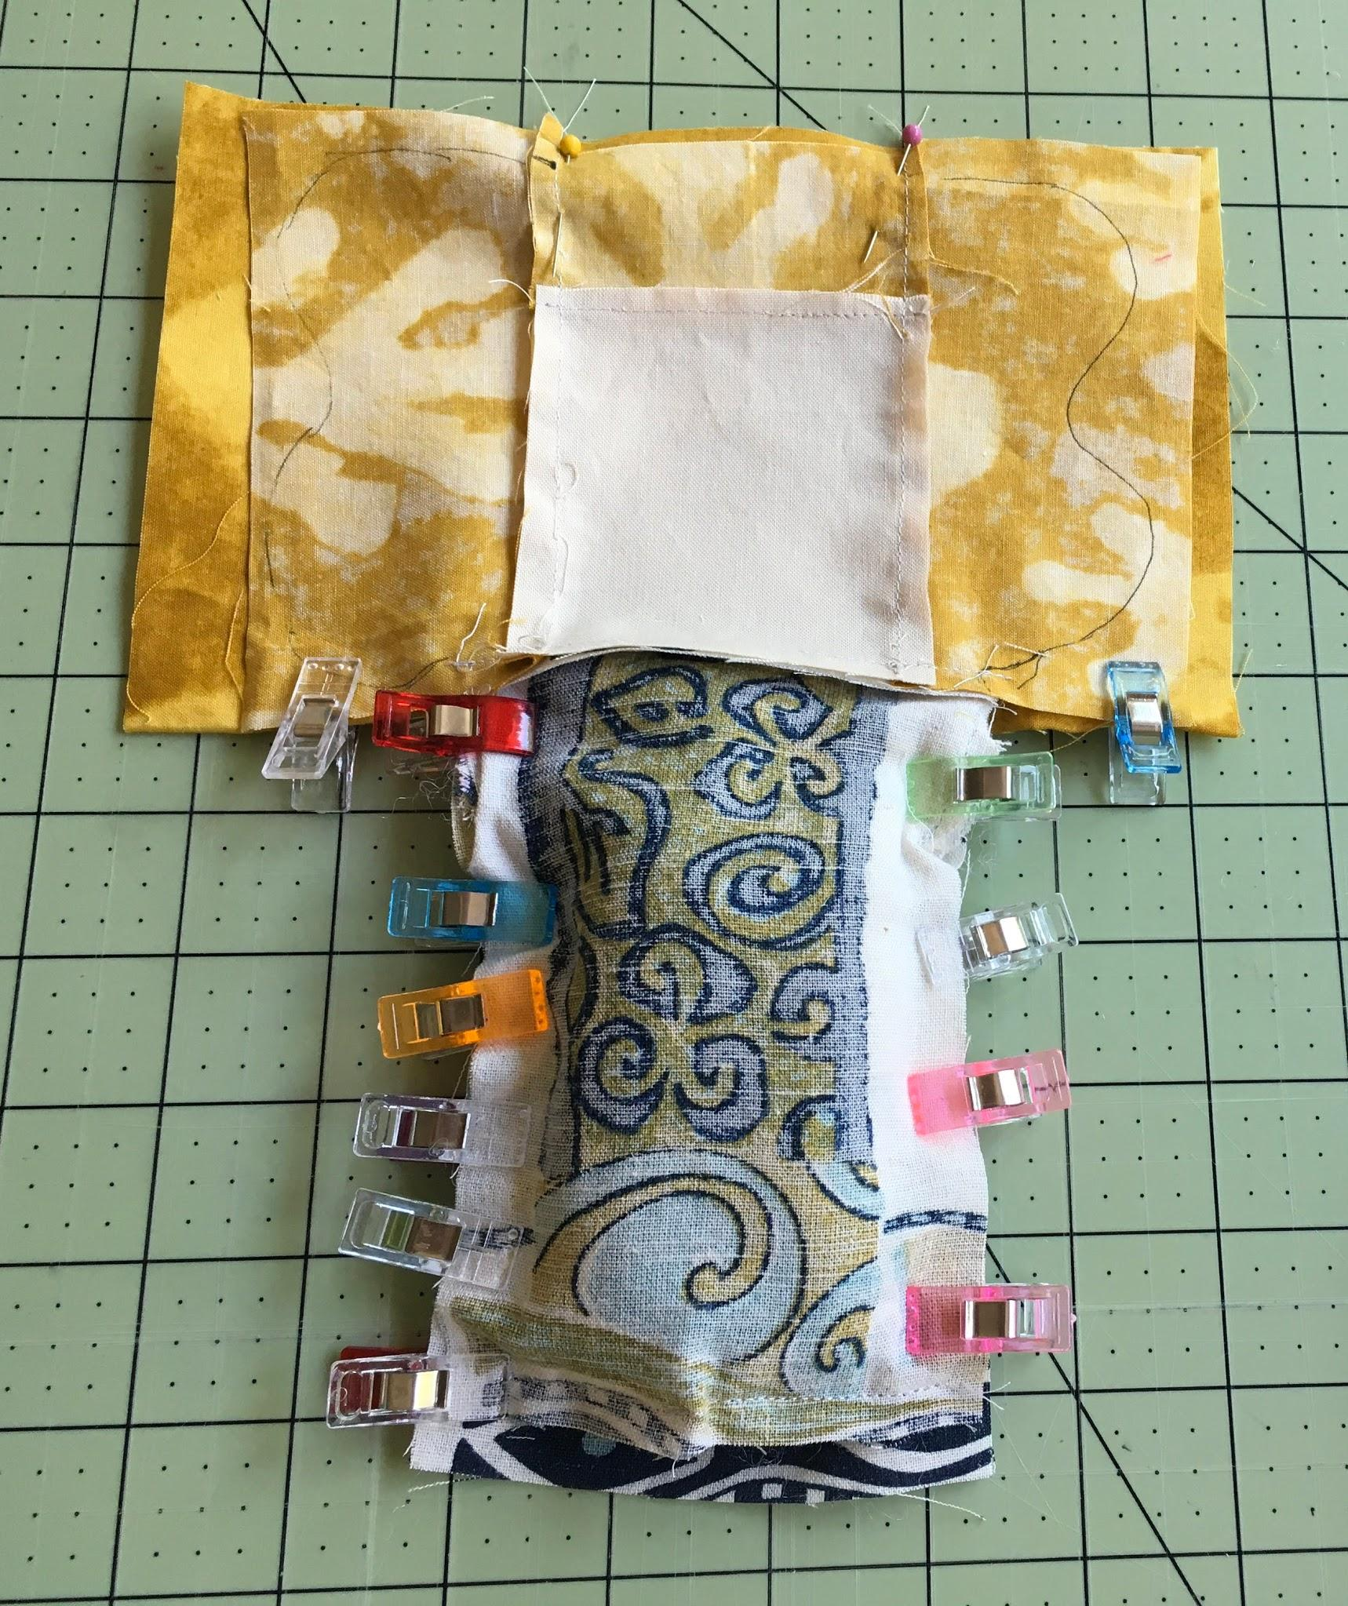
Doll sandwich.
Place front and back body pieces right sides together.
Limbs already sewn to the front of the body piece.
Clover Wonder Clips are great at keeping the stuffed limbs away from the edge!
Pin an opening the width of the face for turning inside out.

Slide 38
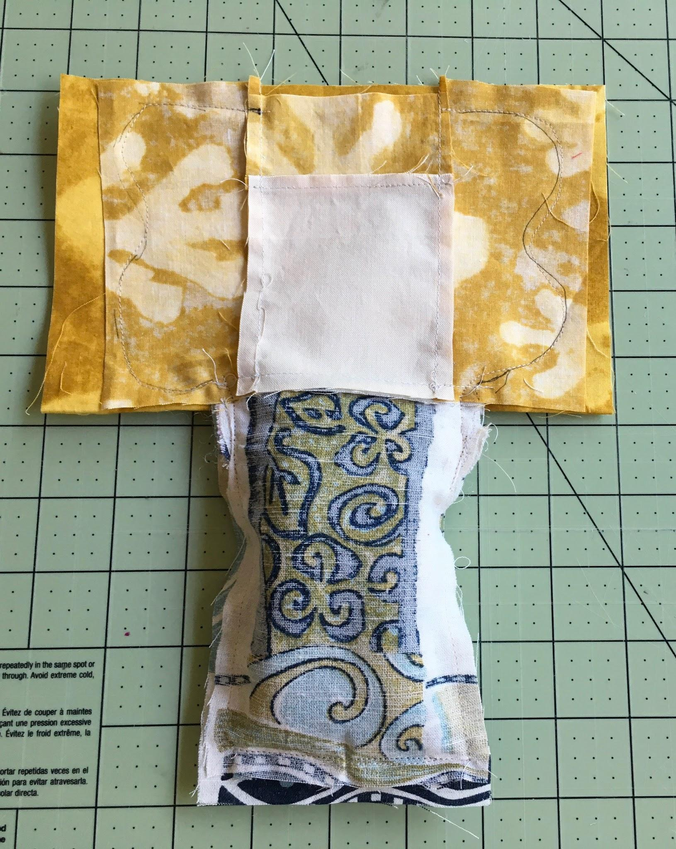
The hair is drawn wavy, freeform for this doll. It makes sewing much easier to use a bigger piece of fabric for the back hair. The extra material is cut off later.
Clip carefully around the intersection of the body and hair (the neck area).
Be careful not to stitch over the face material.
As you stitch around the limbs, make sure you keep the line of stitches on each arm and leg within the seam allowance.

Slide 39
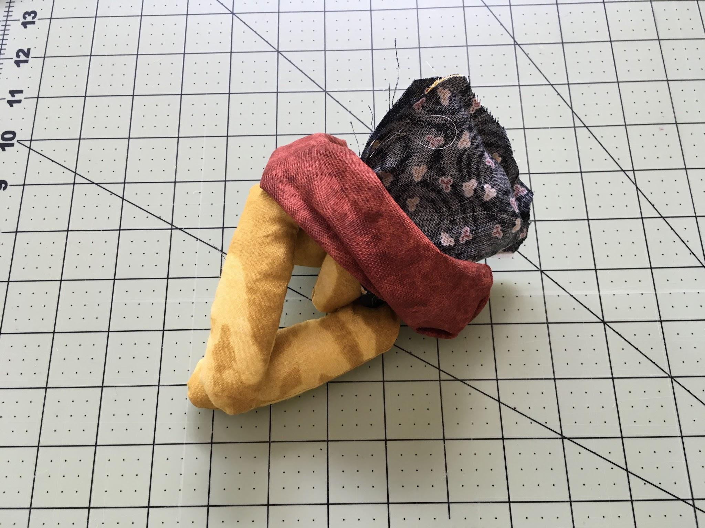
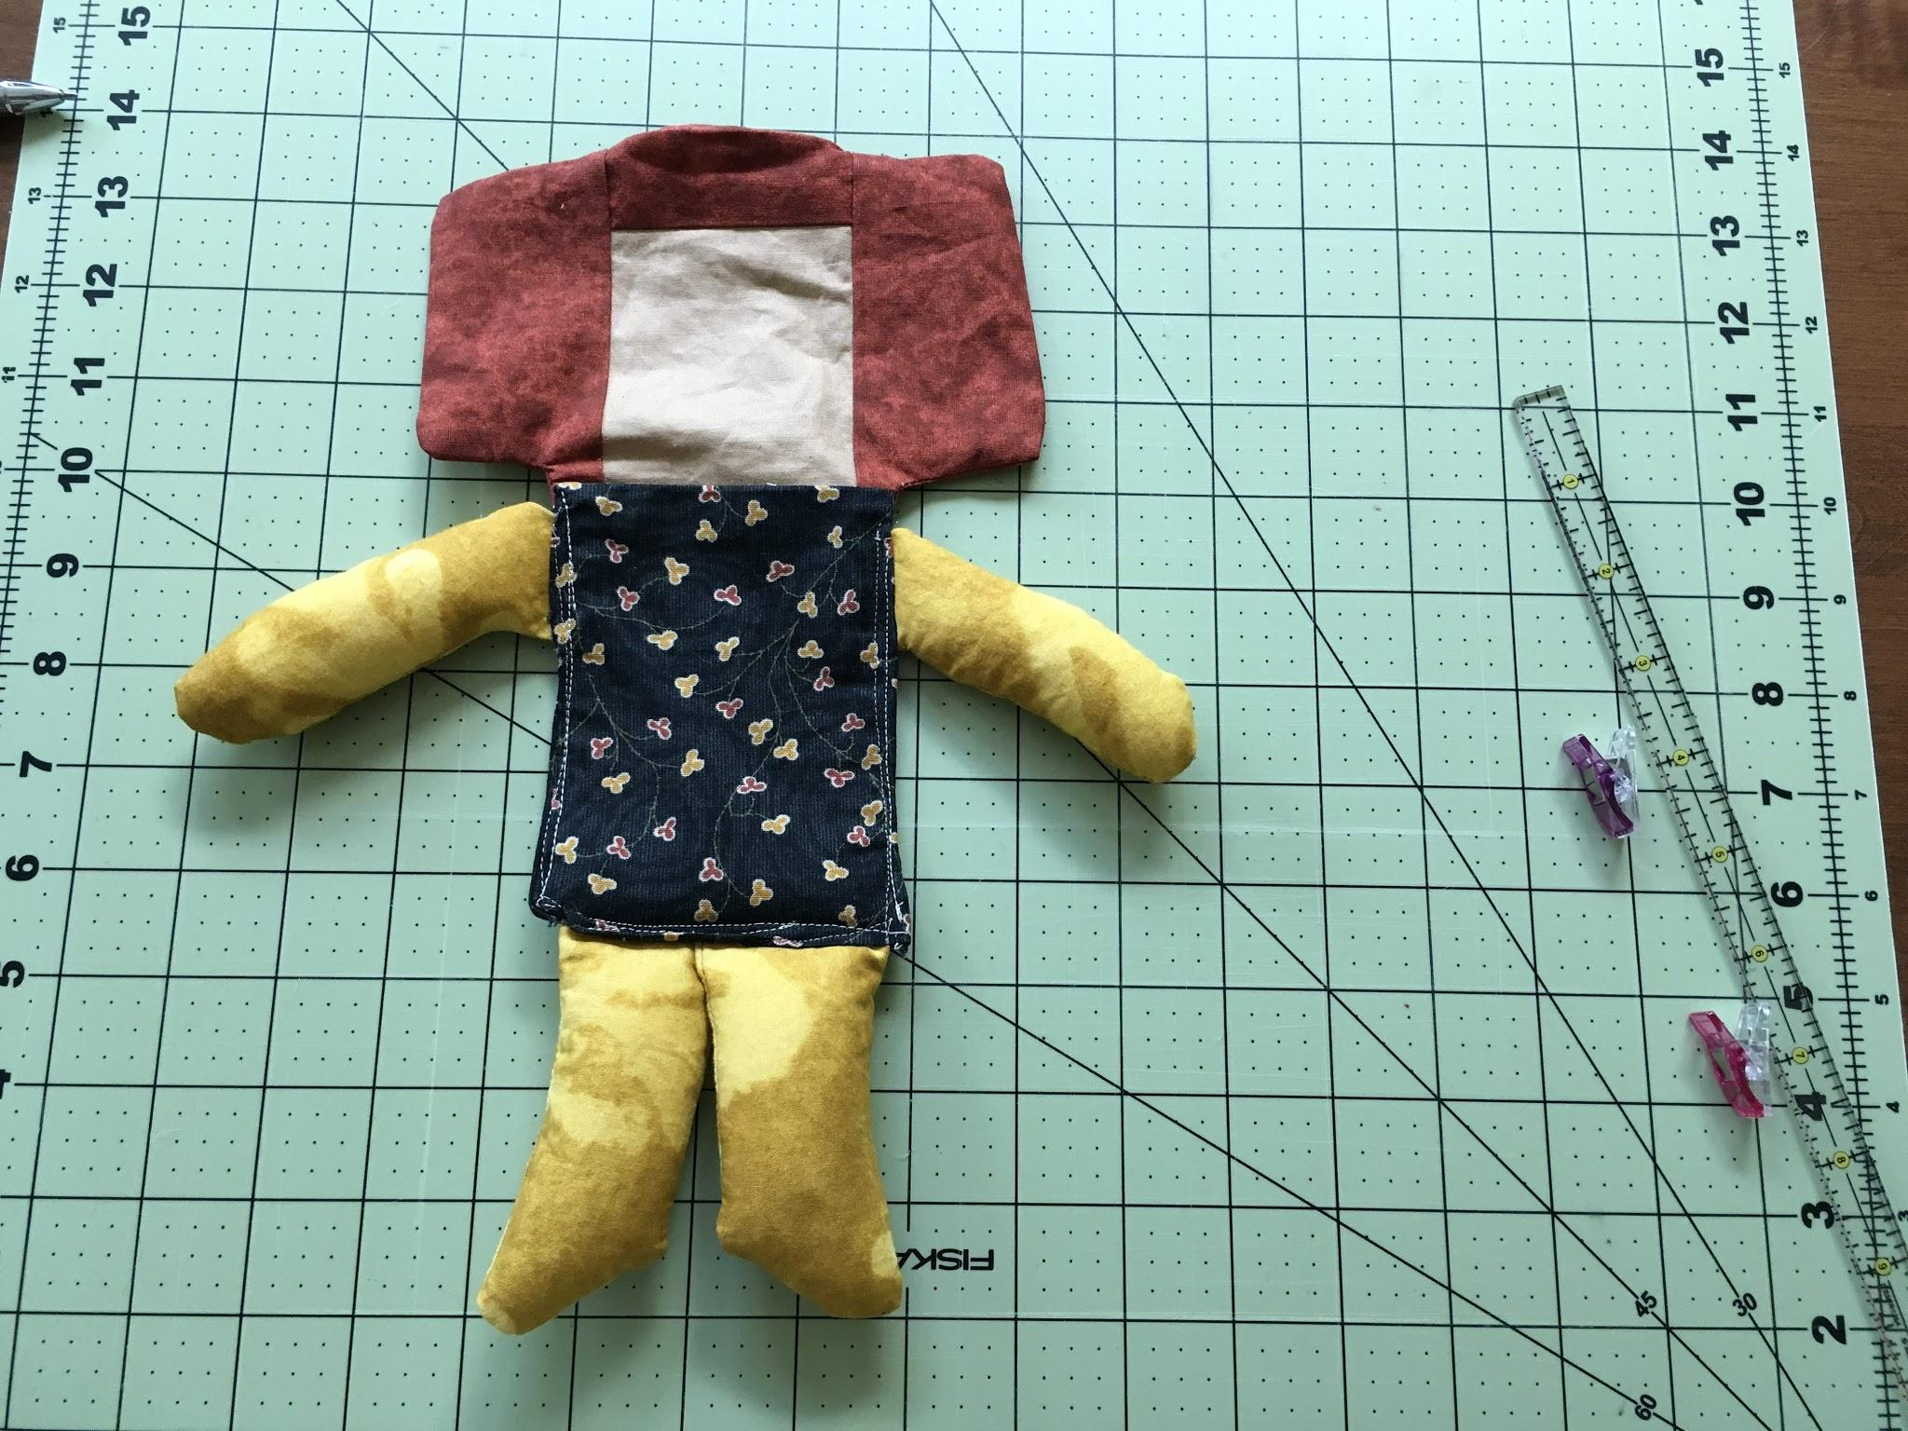
The Big Reveal
Turn inside out. Time to press the face area with iron.
(Note: This doll had construction issues. I had to unstitch, remove the limbs and insert them deeper inside so I stitched on the outside.)

Slide 40
Ready to close up the head with hand stitching. Continually add more stuffing, small whisps as the opening gets smaller. Decide as you go how you want the top of head to look.
This support pillow I made is perfect to support the doll for hand sewing the opening or making the face features. It frees up how I use my hands.

Slide 41
OPTIONS for DRAWING the FACE
Make the face on the fabric before any sewing construction.
Advantages:
can easily make another one, and another one and another one.
can work on a flat surface.
can trace the fabric onto paper for a template.
Make the face once the doll has been turned right side out, before stuffing by taping the doll to a window and inserting a paper template into the head opening.
Advantages:
can easily try out different expressions using premade templates that can be traced with light from a window or lightbox.
can get a sense of what kind of face features you want for each specific doll.
Make the face once the doll is completely stuffed and sewn!
Advantages
can get the most accurate picture of the head and face shape after stuffing which may guide your placement of the features as well as the type of features you want.
makes you commit to what the hand does and encourages self acceptance.

Slide 42
When to Make the Face?!?!?
Now
NO
You have 3 options. Option 1- After the doll is stuffed. This is the best time to determine what kind of face you want for this particular dolly. Since the head shaping is complete, there won’t be any subtle distortion of the face features from sewing construction or stuffing. Doing the face now makes me commit to what my hand does. It’s a great exercise in trust and self acceptance!

Slide 43
Option 2
Make the face when the doll is flat, before stuffing.
At this point, the doll has a personality, the essence speaks out..
Place the flat doll on the table, reference a model.

Slide 44
Option 2 continued: Tape doll to window or use a lightpad. Slip the premade face inside to trace the features.

Slide 45
My recommendation is to have designated face-making practice sessions. Also, a quick warm-up before you make each doll face is so beneficial.
Option 3
Make the face before the doll! Practice on paper with pencils. Practice on the actual fabric. Keep a ¼” margin around all edges. This space is taken up by the seam. Even though this is the safest way to go, I don’t premake the fabric doll faces. That is a bit too “clinical” for me.However, I do practice this way.

Slide 46
Resources and Tools for the Face
I love the white gelly roll pen to whiten the mouth inside the lips, add highlights, “dot of life” in eyes. Apply in layers.
Fons & Porter Chalk Pencils, air & water soluble ink for marking the landmarks.
My go-to archival fine tip & brush tip markers
Disappearing ink marker
For the cheeks-blush pencils and applicator wands or Q-Tips
Apply blush gently in circular motion. Re-apply for a deeper tone. Work in layers.

Slide 47
Book: Making Faces in Fabric workshop with Melissa Averinos
Draw, Collage, Stitch & Show
Go to Pinterest-search rag doll faces
Helped me understand the facial feature relationships. Sparked my joy and creativity.

Slide 48
Who has a scary face?!

Slide 49
Embellishment possibilities
It depends on the age of the recipient and what you have in your stash.
Doll embellishment is a great stash buster.
Yo yo’s, crochet flowers, yarn spirals, buttons, metal do dads, etc.

Slide 50
Curls for the Girls
Crochet corkscrew spirals for hair

Slide 51
I-Cord necklaces (knit with double pointed needles).
Allow your doll to travel hands-free!
A one-of-a-kind fiber art necklace.

Slide 52
Artsy Rag Dolls participate in Book Shares & Sewing Groups

Slide 53
Artsy Rag Dolls can hit the road on a bike & hang out texting.

Slide 54
Rag Dolls Artsy Style are:
A travel companion
An emotional support
A unique wearable piece of art
A conversation starter
A soft, sensory fidget
A hand free accessory
Good for all ages

