Slide 1
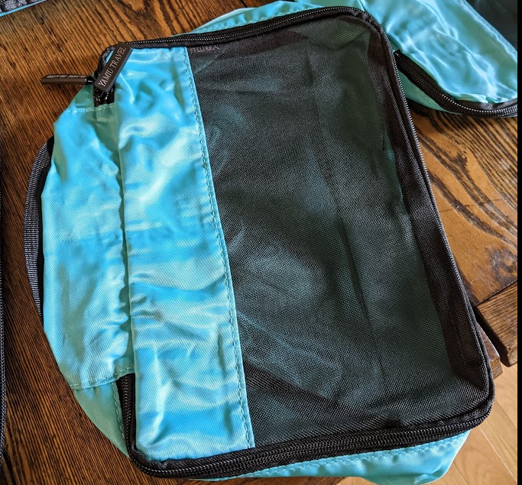
Sarasota Gulf Coast Chapter of the American Sewing Guild
Pins and Needles Neighborhood Group
Packing Cubes

Slide 2
Why Packing Cubes?
Lightweight
Easy to organize your clothing in your suitcase
Put your underwear in one– no more searching around
Pack outfits together
Compress clothing so more fits in the suitcase
Make sure you check the weight of the suitcase to make sure it is within the limit
Less luggage to carry around
Separates clothing when more than one person shares the suitcase
Adds privacy
May be used for organization at home, in your drawers or closet

Slide 3
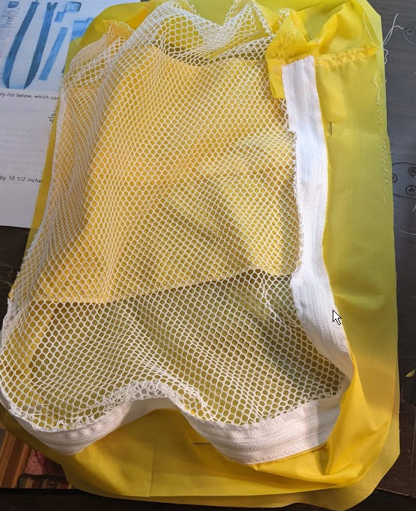
Packing Cubes: List of Requirements
½ Yard of Ripstop Nylon
1/3 Yard of Mesh
Iron on Vinyl
36” Zipper

Slide 4
Ripstop Fabric Properties
There two main types of ripstop: polyester and nylon. Both are used in clothing industry but there are few important differences that you should keep in you mind when choosing the right one for you project
Ripstop Polyester has higher water resistance than nylon
Ripstop Nylon is breathable, polyester is not
Ripstop Nylon is more durable, softer in touch and more stretchy – from our experience Ripstop nylon 70D is as durable as 140D polyester
Polyester is UV resistant and it is takes much longer for it to lose a color than nylon

Slide 5
Mesh Fabric

Slide 6
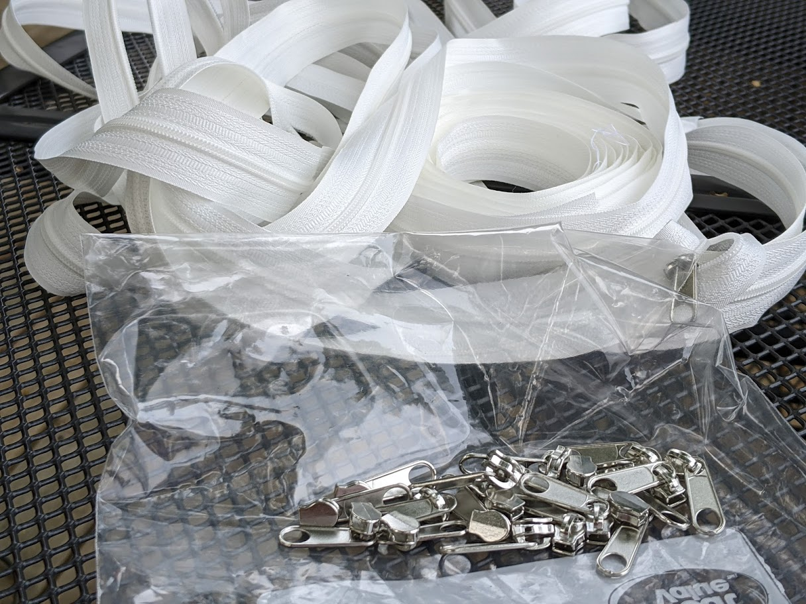
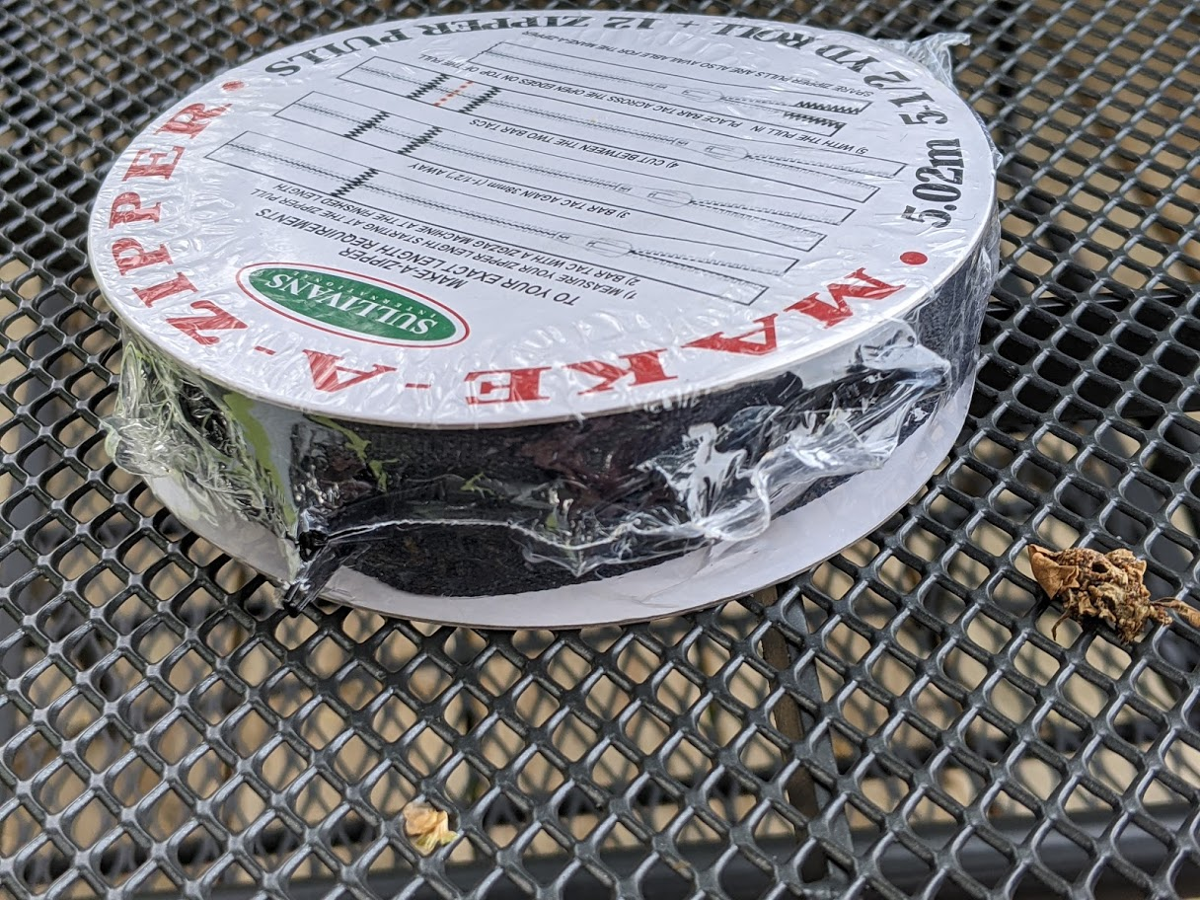
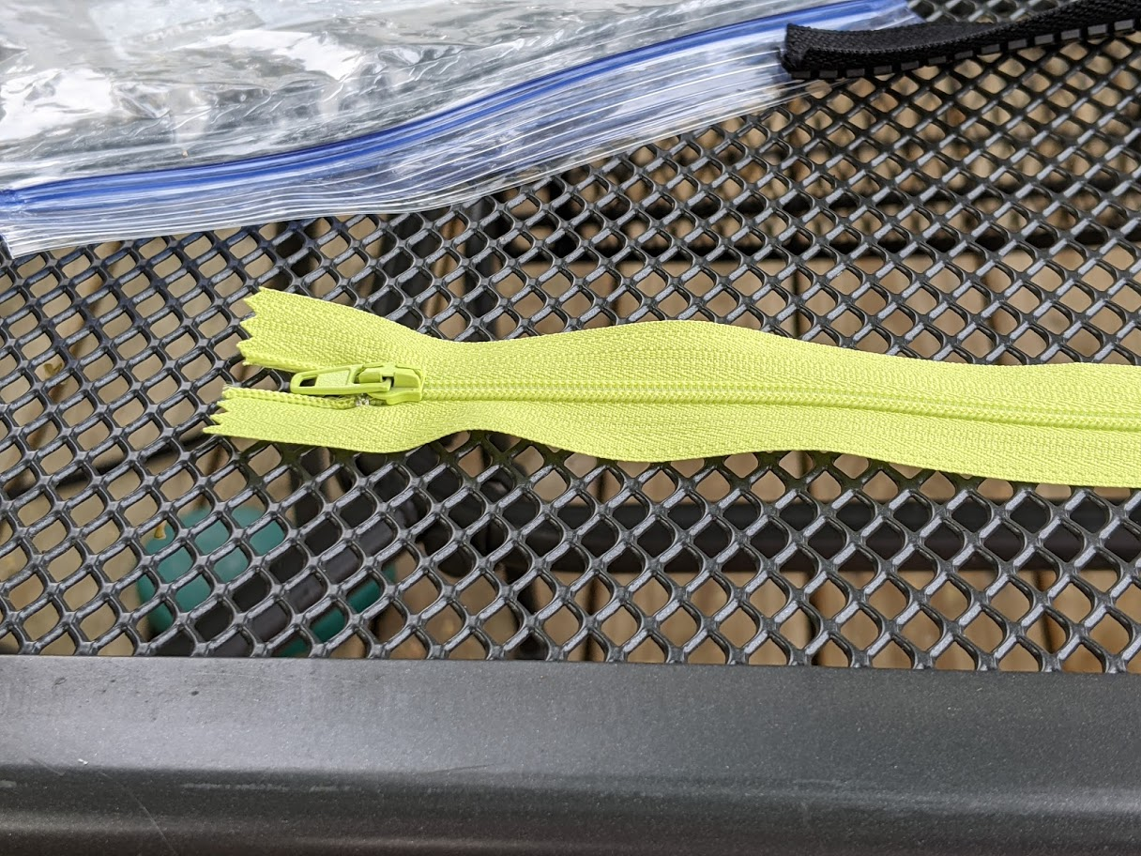
Zipper types/ You add Pull, Pull on, by Size
By the Yard You add the pull
By the yard Pull is already added for you
By size

Slide 7
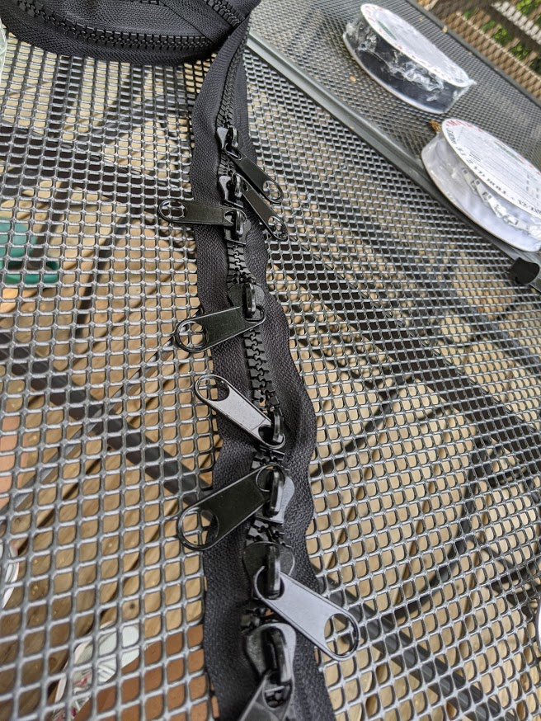
Fix broken zipper with fork ! - Bing video

Slide 8
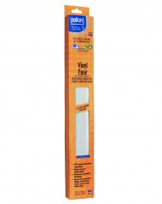
Iron on Vinyl
Pellon® 100 Vinyl Fuse™ is an easy to use product that adds a clear protective gloss finish to fabrics. It features a removable paper-backing for easy measuring and a pressure sensitive side for easy application. Great for projects such as cosmetic bags, mats, bibs, and more!

Slide 9
Pre heat dry iron, lay down silicone to protect your ironing board

Slide 10
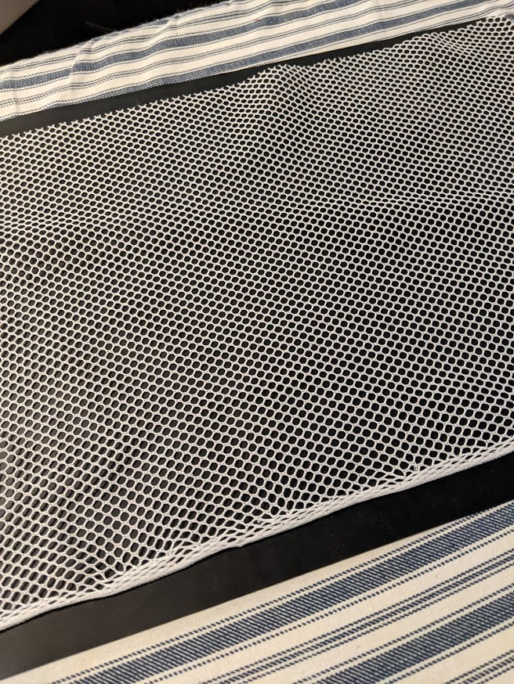
Peel Vinyl Fused Matte from release paper and place sticky side down, smooth

Slide 11
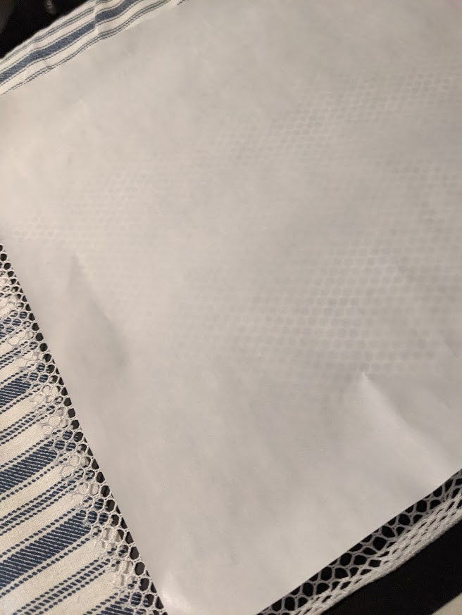
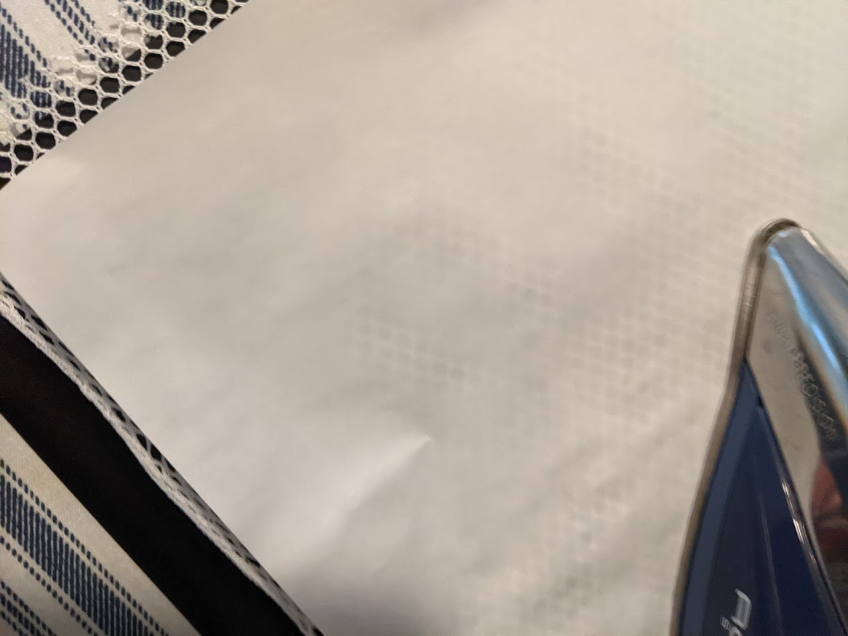
Place shiny side of release paper on top and press for 8 seconds DO NOT PRESS WITHOUT RELEASE PAPER

Slide 12
Flip over and iron the back side of the fabric

Slide 13
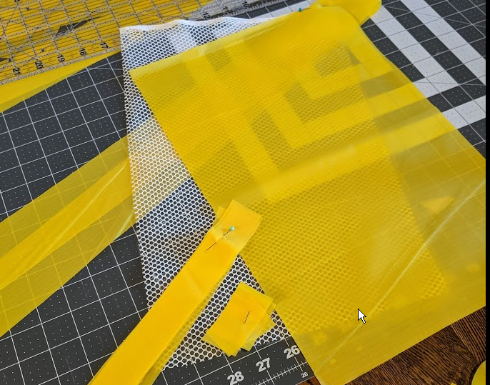
Fabric Sizes
16 inches by 10 ½ inches
Top (Mesh and Iron on Vinyl) and Bottom Ripstop Nylon
Side 46 ½ inches by 2 ½ i-nches
Side Tab A – cut one – 9 ½ inches by 1 ¼ inches
Side Tab B– cut one – 2 inches by 1 ¼ inches
36 inch Zipper
Optional 10 inch by 2 ½ inches for handle (not shown)

Slide 14
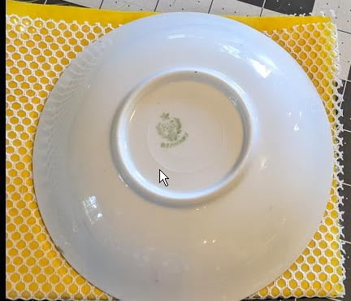
Construction Techniques
Fuse the iron on vinyl to the Mesh, set aside
Round off the corners of the top and bottom

Slide 15
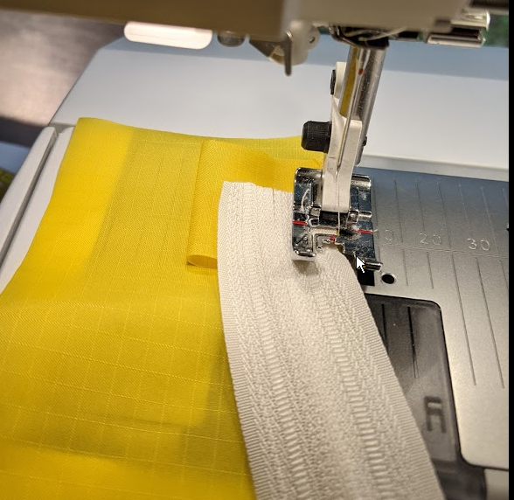
Begin Sewing
Place the side fabric right side up, then place Tab B folded and then the zipper right side down and sew.
I zig zagged close to the edge first and then sewed my seam

Slide 16
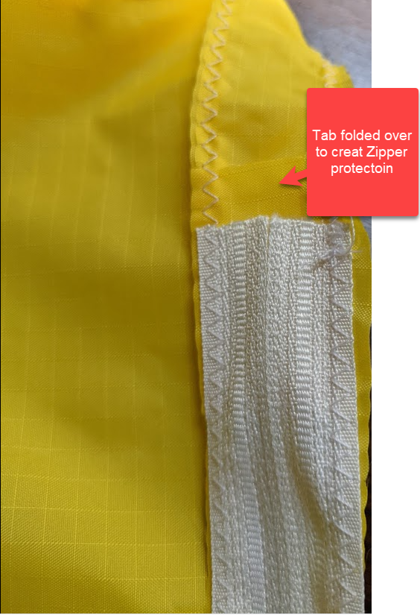
Sewing continued
Continue sewing until you get to about 2 inches of the end of the zipper and then add Tab A, folding the end to create a protection for the zipper end.
Sew the side seam
You can sew the side seam either before or after you sew the top to the side seam making sure you leave the seam allowance at the beginning and end of the side seam.

Slide 17
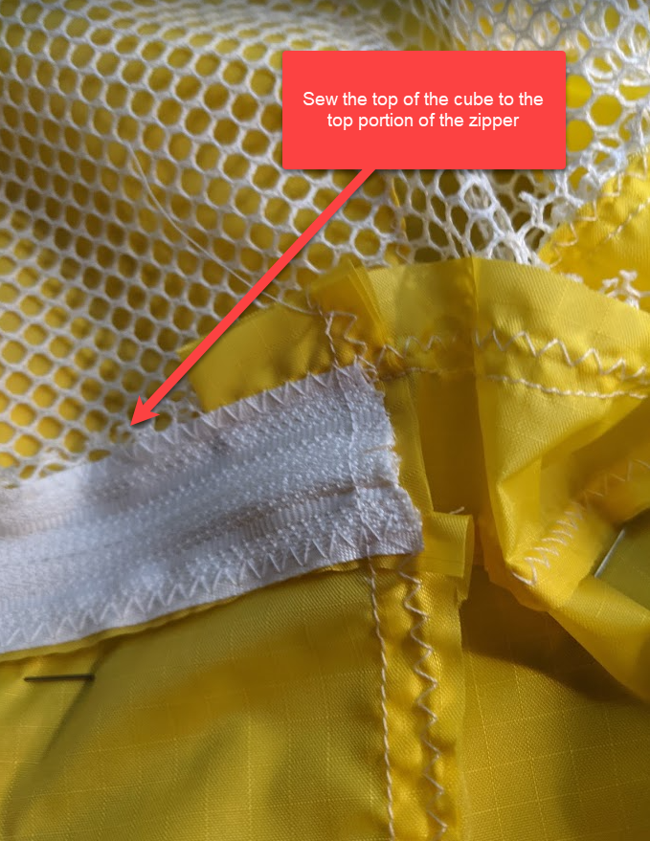
Sew the Top
Sew the zipper which has one side sewn to the side to the top of the cube
Begin sewing at the top of one side to the end of the other side, leaving one end with no zipper.

Slide 18
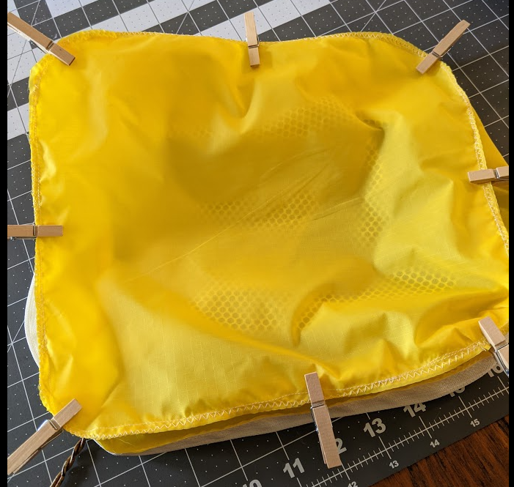
Sew the Bottom to the Cube
Align the top and sides of the bottom to the top and sides of the sewn cube.
Sew the top to the bottom, leaving the zipper partially open so you can turn the cube to the right side.

Slide 19
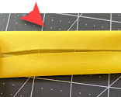
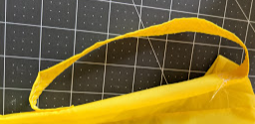
Turn to the Right Side
Turn the cube to the right side
Add a handle if desired. Fold the 10 “ by 2 ½” in half and then fold the side pieces to the center then sew the handle.
Sew the handle to the non zipper end of the packing cube

Slide 20
Your Cube is Finished!

Slide 21
Notes
I used an 12/80 needed and 2.5 as a stitch setting
You can you a micro tech needles if you need a sharper needle for your machine.
I zig zagged the edge first and then sewed a seam.
Nylon and the mesh both stretch so you need to be careful. I sometimes had to add more to the side piece to make it fit.
I also added some nylon to the top for interest and stability
Sometimes I did not use the vinyl on the top.
You can adapt this pattern to really any size

Slide 22
Example of Commercial Packing Cubes

